Slide 1
Oklahoma
MRO Contracts
How to prepare the response
Notes:
DG is both an organizational process and a structure. It establishes responsibility for data, organizing program area staff to collaboratively and continuously improve data quality through the systematic creation and enforcement of policies, roles, responsibilities, and procedures.
Improve Government Services Outcomes
Compliance and Security Risk Mitigation
Better Informed Decision Making
Leveraging Citizen, Financial, and Administrative Information
Streamlining Business Processes.
Data governance is used to define the decision making processes around data.
Data governance is a strategic, long term process.
It usually appears in an organization when it reaches a certain maturity level.
Data governance is a quality control discipline for adding new rigor and discipline to the process of managing, using, improving and protecting organizational information. Effective data governance can enhance the quality, availability and integrity of a company’s data by fostering cross-organizational collaboration and structured policy-making.

Slide 2
Required Bid Forms
Pricing – Attachment A (Sample Items)
Pricing - Attachment A1 (General Category Discount)
Business and Technical Response – Attachment B
Past Performance Information -Attachment C
Value Added Services – Attachment D
Responding Bidder Information
Non-Collusion Certification
Notes:
DG is both an organizational process and a structure. It establishes responsibility for data, organizing program area staff to collaboratively and continuously improve data quality through the systematic creation and enforcement of policies, roles, responsibilities, and procedures.
Improve Government Services Outcomes
Compliance and Security Risk Mitigation
Better Informed Decision Making
Leveraging Citizen, Financial, and Administrative Information
Streamlining Business Processes.
Data governance is used to define the decision making processes around data.
Data governance is a strategic, long term process.
It usually appears in an organization when it reaches a certain maturity level.
Data governance is a quality control discipline for adding new rigor and discipline to the process of managing, using, improving and protecting organizational information. Effective data governance can enhance the quality, availability and integrity of a company’s data by fostering cross-organizational collaboration and structured policy-making.

Slide 3
Pricing
Attachment A is a small sample of general items purchased. We ask that you complete as much of this as possible.
This list does not cover all of the items on contract. Most purchases will be under the Attachment A-1 discount percentage. This allows users to purchase a wide range of items that you offer a category discount for.
This list of prices should remain fixed for the first six (6) months of the contract.
Additional price increases will be limited to once a year
The State may refresh this list on an annual basis.

Slide 4
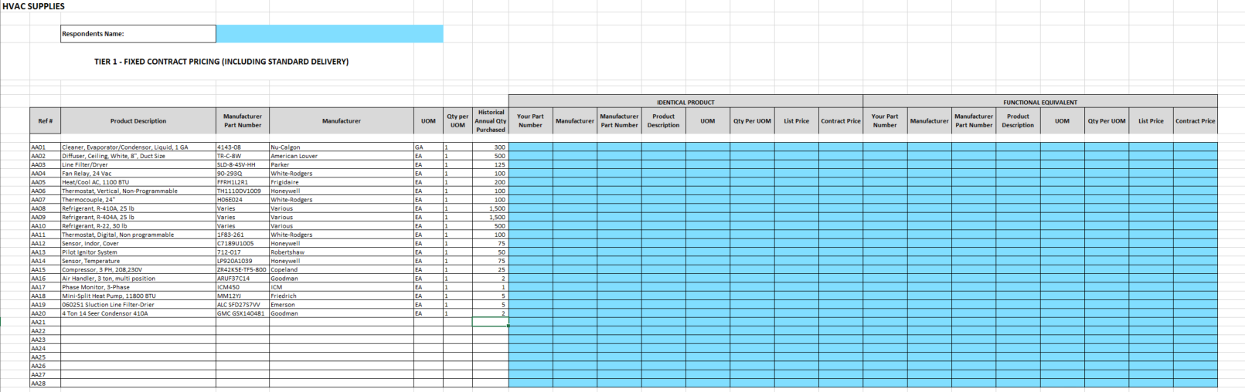
Attachment A

Slide 5
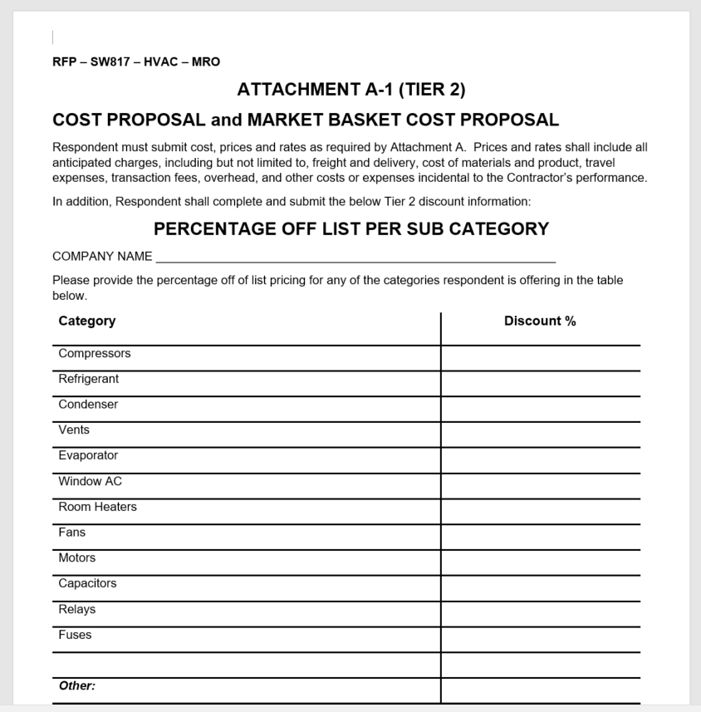
Attachment A-1
General Catalog and Category Percentage Discounts are listed here at your discretion.
You may add categories or even manufacturers to highlight your companies line of product offerings.
By offering category discounts, your entire inventory can now be purchased under contract.
These discounts allow your inventory to go through price changes as long as your discount percentage remains the same.
HVAC categories are used for this example.

Slide 6
Attachment B
Attachment B asks for information regarding your company and general policies.
These questions are also a large amount of the evaluation criteria score and must be completed.
Many times this attachment has been skipped or not completed correctly and has resulted in evaluation criteria not being addressed and resulting in no awards.

Slide 7
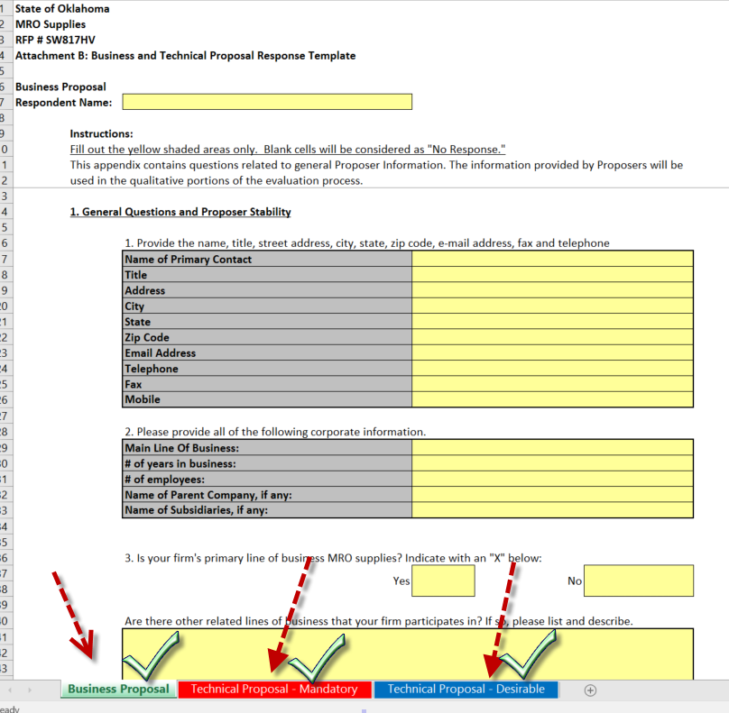
Attachment B
There are 3 tabs to complete here

Slide 8
Attachment B – Business Proposal
The first tab contains general business information such as:
Years in Business
Number of Employees
Main Line of Business
What areas in the State can you service?
Features which set you away from your competitors.
What type of Supplies do you specialize in?

Slide 9
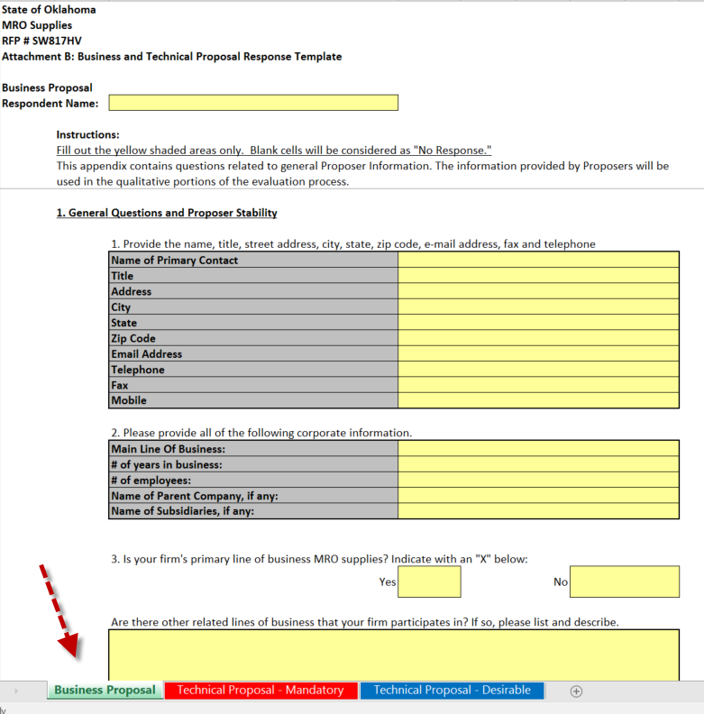
Attachment B - Business
There are 14 questions to answer for the Business Proposal Tab.
These consist of a general outlook of your company information.
There

Slide 10
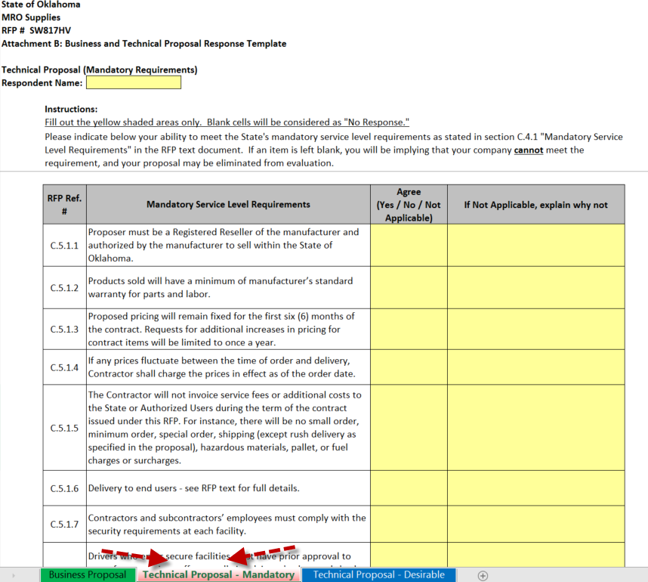
Attachment B – Technical Proposal / Mandatory

Slide 11
Attachment B – Technical / Mandatory
This tab identifies areas the State feels are mandatory requirements for a Statewide Contract.
Each question has a reference to the section of the solicitation.
There is a checkbox for Agree – Yes or No
If not applicable, you can enter comments.
All of these questions MUST be answered to be considered for award.
There are 9 questions to answer.

Slide 12
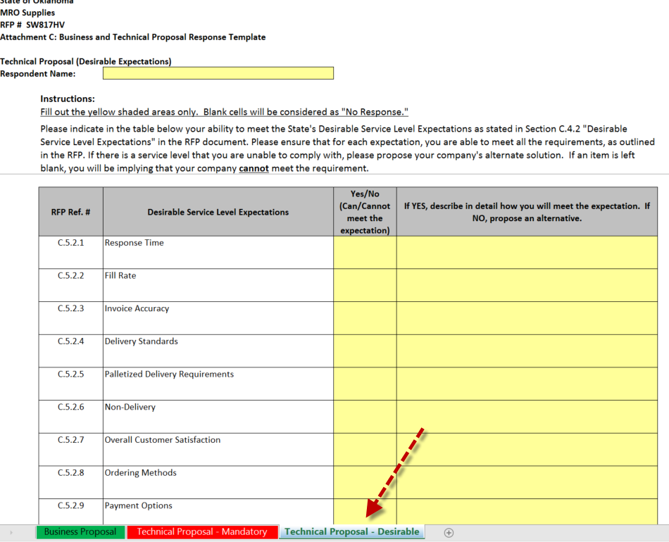
Attachment B – Technical Desirable

Slide 13
Attachment B – Technical Proposal / Desirable
The technical tab has questions about your general business model.
Information on delivery, ordering, freight, response time, customer service and general day to day operations.
These questions are scored and must be completed to receive points.
An evaluation team will review your responses to these questions and assign points as compared to other responses.

