Slide 1


Oklahoma
UPS Laboratory Shipping Services Review
April 26, 2018

Slide 2
Introductions
UPS Team
Erik Rowley – Director, State Government
John Alexander – Account Manager Illinois
Ray Vasinko - Manager, Customer Solutions
Felicia Hall – Project Manager, State Government - US
Tammie Hinds – Managing Director , State Government - US

Slide 3
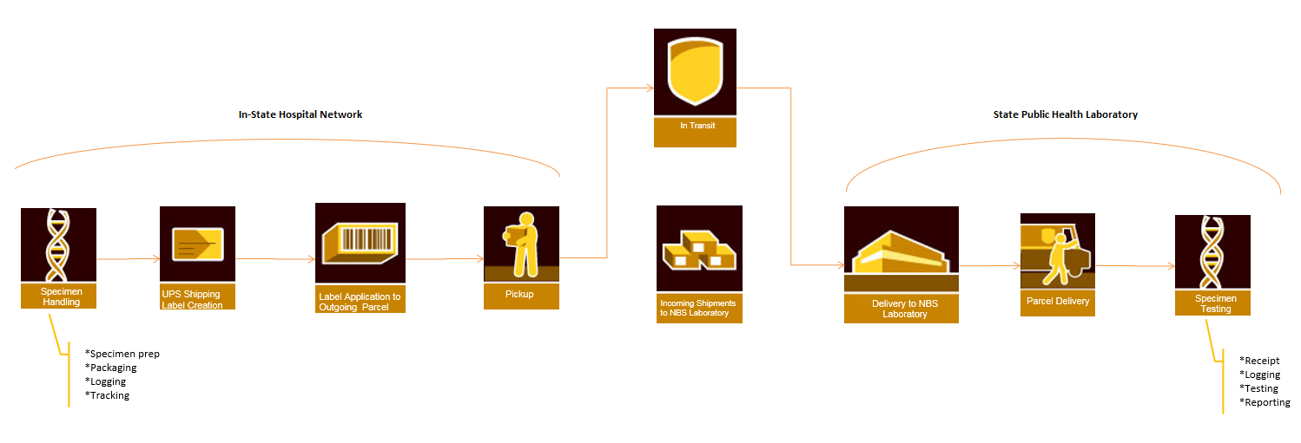
UPS Process
End-to-End Touch Points and Hand-offs
From Package Preparation to Delivery

Slide 4
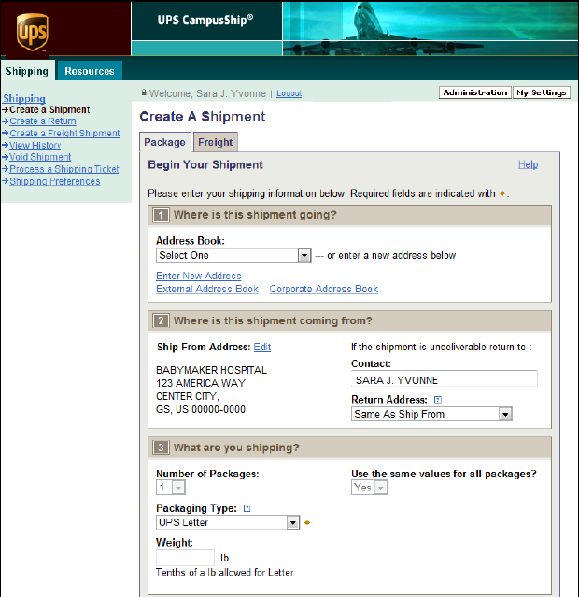
UPS Campus Ship
Shipping software dedicated to your state lab that grants access to each facility yet retains state lab control

Slide 5
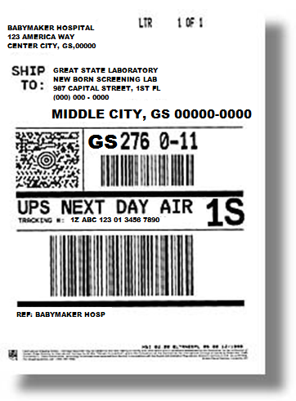
UPS Smart Shipping Label
The UPS Smart Shipping Label captures detail enabling inbound visibility and lab efficiencies
Package Level Detail remains valid for 18 months
Viewable in UPS platforms upon first scan
Flexible Configuration:
  Saturday Delivery
  (as a return, accessorial is only charged when used)
Optional Reference fields can be leveraged for optimization of work flow
  QVM - 5 custom fields, no additional charge
  Complete View - 10 custom fields, additional contract fee
  Customer Solutions can program 1st reference field to print alpha-numeric as a bar code which can be coupled with scanners to improve efficiencies

Slide 6
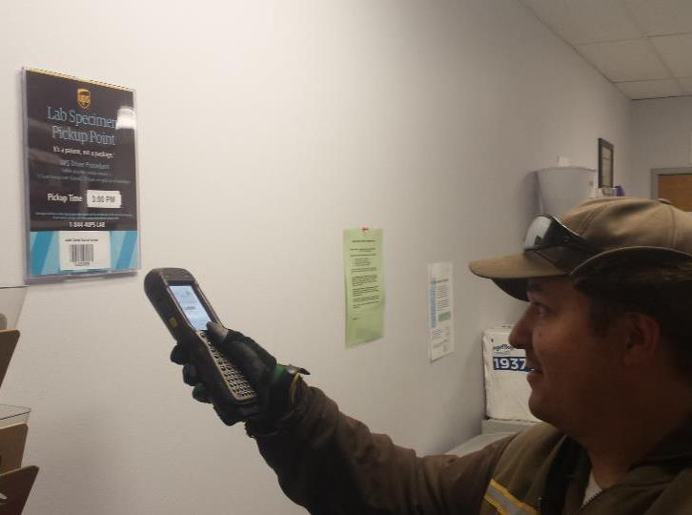
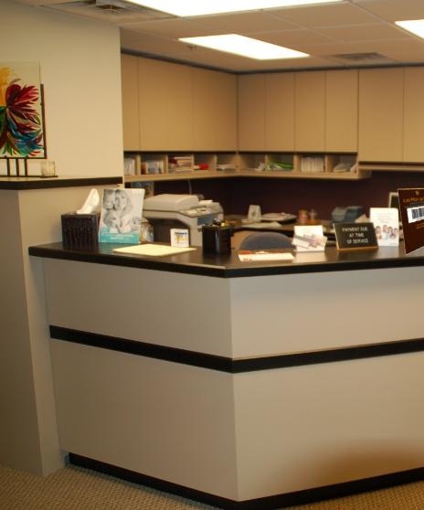
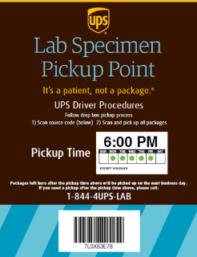
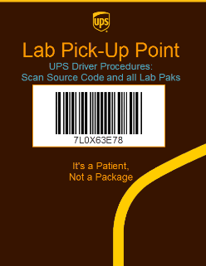

UPS Lab Specimen Pickup Point
Synchronizes lab, facility & UPS pick up days / times

Slide 7
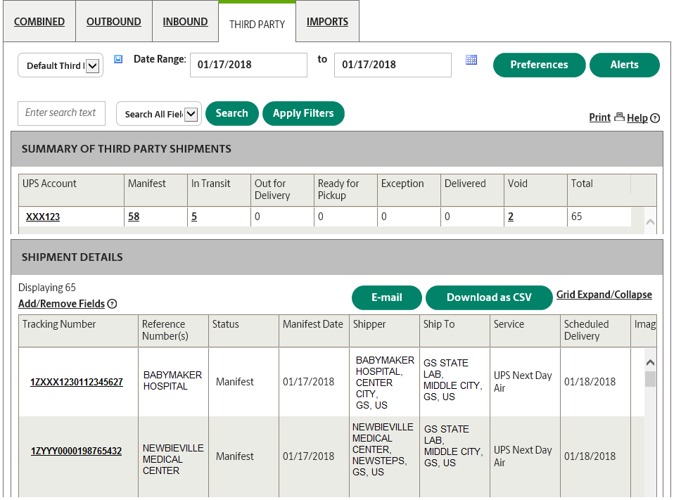
UPS Quantum View Manage
Specimen visibility and reporting portal that provides facility name, shipment status and notifications

Slide 8



UPS Specimen Packaging
Easily identifiable packaging for easy processing
UPS New Born Screening Custom Envelopes
  Currently available
  Additional fee assessed
UPS Laboratory Letter
  In production due Summer 2018
  No additional cost
3. UPS Express Envelope
  No Additional Fee
  Order Item # 010195101 at UPS.com

Slide 9
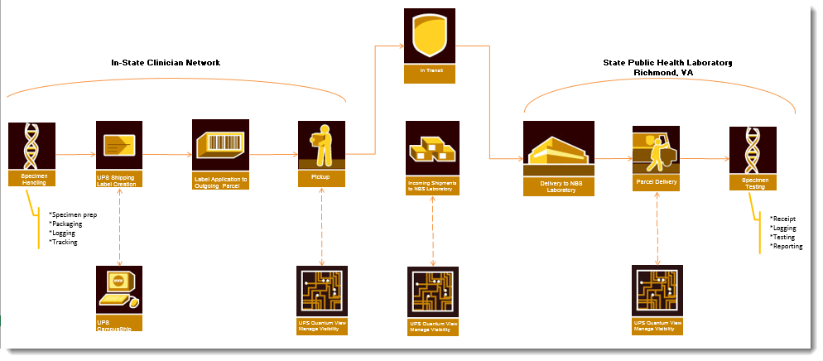
UPS Focus
Processes increases timeliness and visibility
From Package Preparation to Delivery

Slide 10
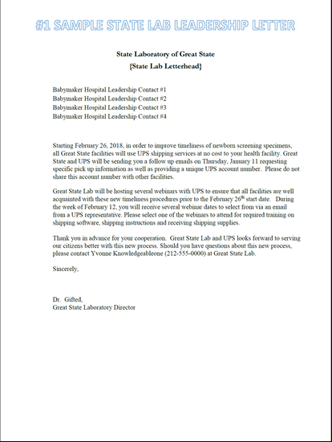
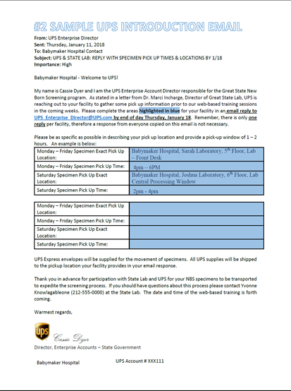
Helpful Hints
Communication between the lab, the facility and UPS is Key
Create introduction letter to hospitals from lab leadership
Follow up with communication from UPS
Keep training simple
Direct facilities to call UPS directly
Forward any pick-up questions, supplies requests etc. to UPS Government Support immediately

Slide 11
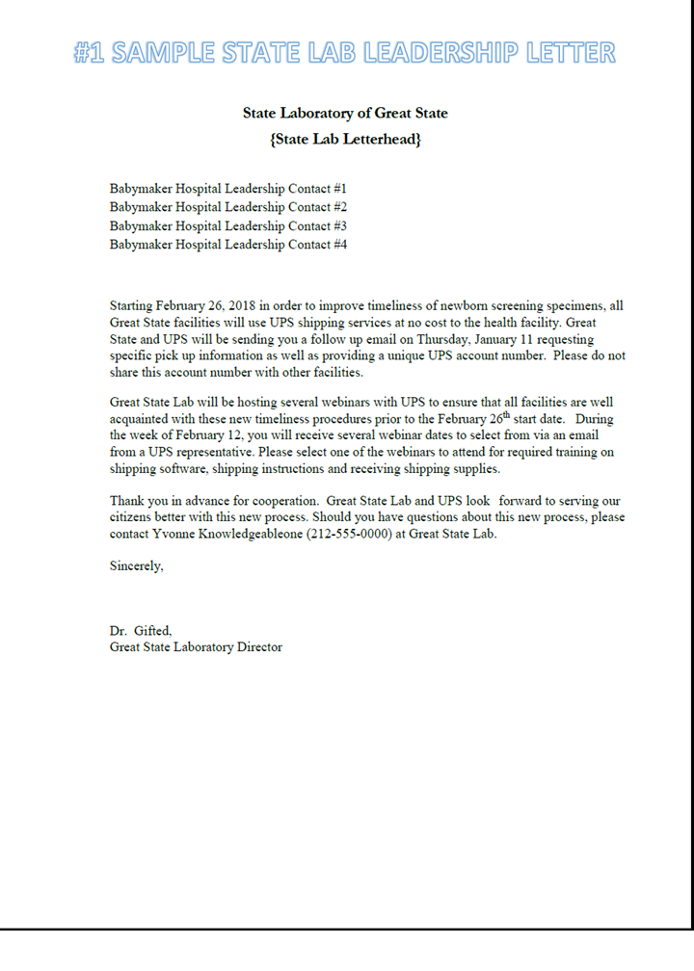
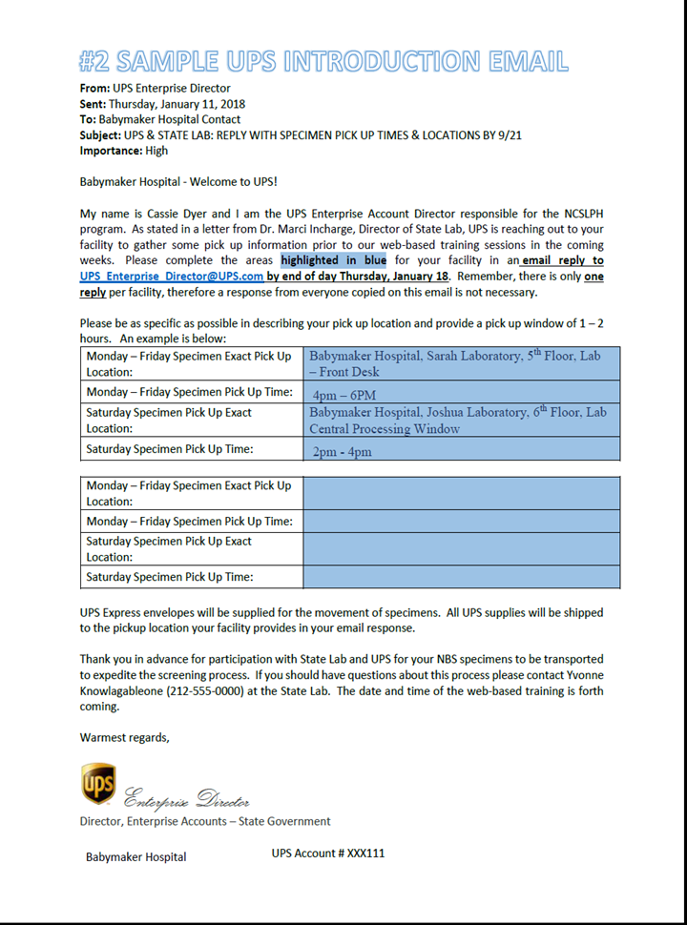
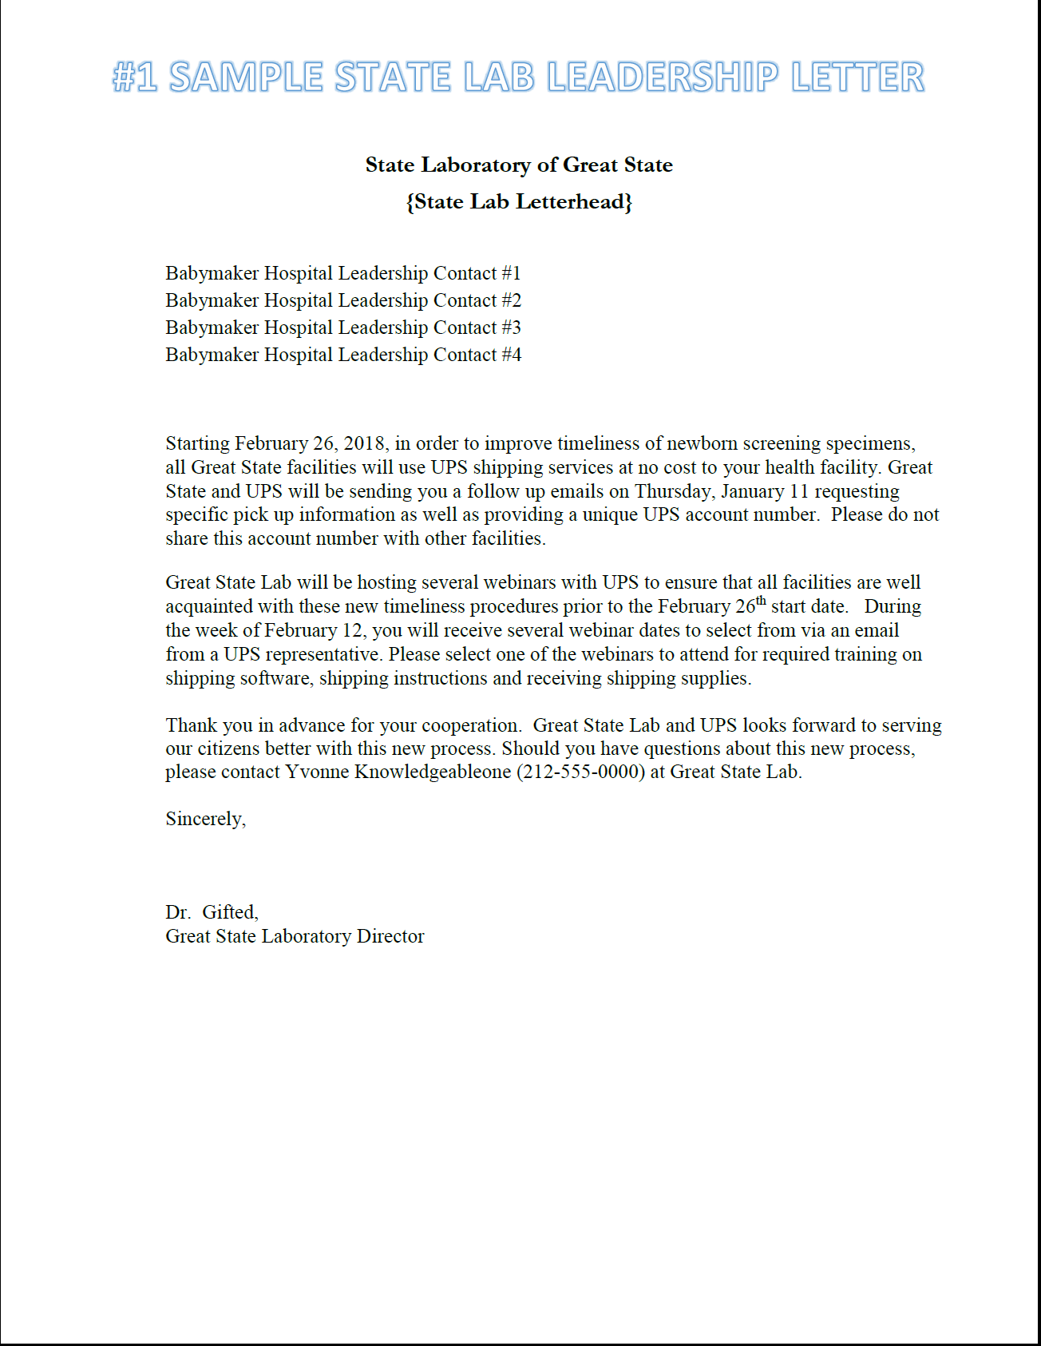

Helpful Hints
State leadership top down communication with UPS follow up

Slide 12
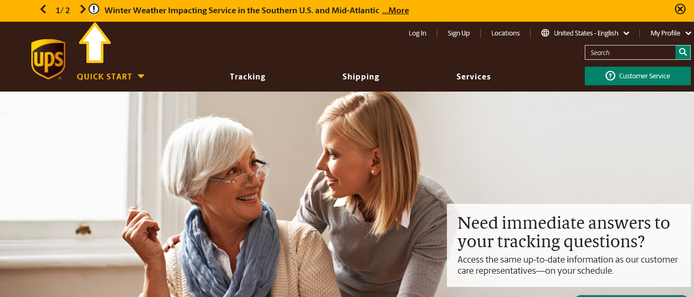
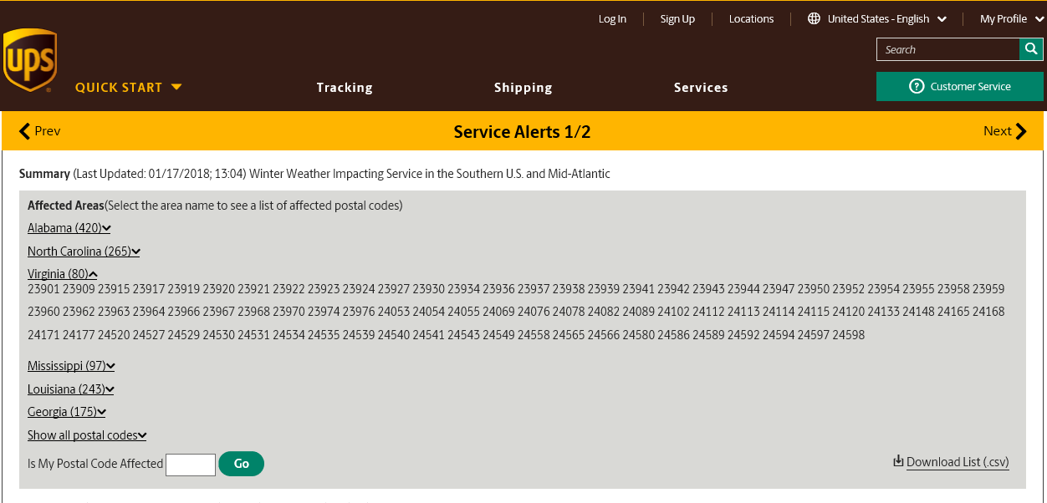
Helpful Hints
Accessing emergency or weather related information

Slide 13
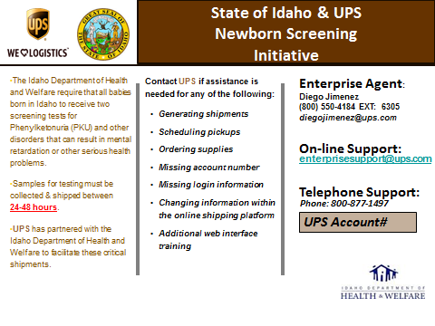
Helpful Hints -
Facilities can call or email UPS directly for questions about pick ups, supplies, emergencies etc. from 8AM EST to 9PM EST
EXAMPLE

Slide 14

UPS Government Account Support
(800) 877 – 1497
EnterpriseSupport@UPS.com
Please be prepared to offer your six digit
account number for customized assistance
It’s a patient, not a package.®

