Slide 1
Public Safety Video and Vehicle Mounted Equipment
OK-MA-145
Pre-Proposal Webinar
May 6, 2016

Slide 2
NASPO ValuePoint Background
Tim Hay, Lead Cooperative Development Coordinator for NASPO ValuePoint

Slide 3
Request for Proposal
Purpose:
The State of Oklahoma, (Office of Management & Enterprise Services (OMES), Central Purchasing (Lead State) is requesting proposals for Public Safety / Law Enforcement Video & Vehicle Mounted Equipment, in furtherance of the NASPO ValuePoint Cooperative Purchasing Program.
The purpose of this Request for Proposal is to establish multiple Master Agreements with qualified offerors that will provide a consistent and reliable source for the provisions of all categories of law enforcement camera systems – in car, body worn, etc. and vehicle mounted equipment which will help law enforcement meet all patrolling needs for all participating states.

Slide 4
Contract Highlights
Contract Term: Initial term will be 2 (two) years with renewal provisions for up to three (3) additional years.
Date of Award through Summer 2018
1st Option: through Summer 2019
2nd Option: through Summer 2020
3rd Option: through Summer 2021

Slide 5
Proposal Specifications
This RFP is designed to provide interested Offerors with sufficient information to submit proposals meeting minimum requirements, but is not intended to limit a proposal's content or exclude any relevant or essential data. Offerors are encouraged to expand upon the specifications to add service and value consistent with state requirements

Slide 6
Geographical Areas
While the primary purpose of this solicitation is to select Offerors who can offer the Products or Services for all members participating in the NASPO ValuePoint Cooperative Purchasing Program, Offerors are permitted to submit a Proposal on more limited geographical areas, but not less than one entire Member State.
Offerors must clearly describe the geographical limits (e.g. by State name) if proposing a geographical area less than that of all member States. However, if a Offeror elects to submit a Proposal for a single State then the Offeror must be willing to supply the entire State and will not be allowed to add additional States following award or at any time during the term of the contract or any renewals

Slide 7
Schedule of Events
Solicitation Release | April 20, 2016
Pre-Proposal Conference | May 6, 2016 8:00 AM PT (Pacific Time)
Question Deadline | May 19, 2016 4:00 PM CDT (Central Time)
Closing Date and Time | June 20, 2016 3:00 PM CDT (Central Time)
Anticipated Award | August 2016
Notes:
Stopped at 1.3

Slide 8
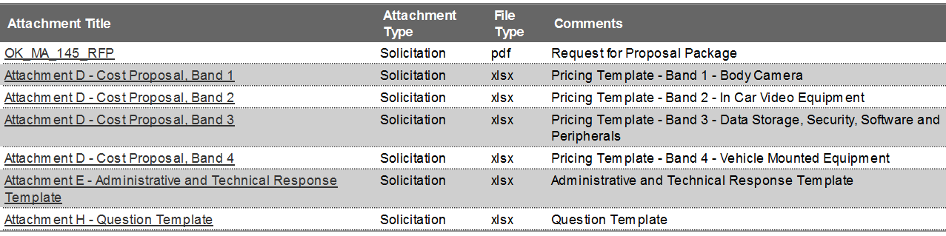
RFP Questions
All questions, including those about Terms and Conditions, must be submitted in writing, to Lisa.Bradley@omes.ok.gov by May 19, 2016, 4:00 PM CDT, in order to be considered.
Attachment H “Questions & Inquiries Submission Template”, has been provided to aid in the question process.

Slide 9
Amendments
Formal changes to this RFP including but not limited to contractual terms and procurement requirements shall only be changed via formal written amendments issued by the Lead State.
Proposals which have been submitted without formal acknowledgement of the amendment language may be deemed non-responsive.
No oral statement of any person shall modify or otherwise affect the terms, conditions, or specifications stated in the solicitation.

Slide 10
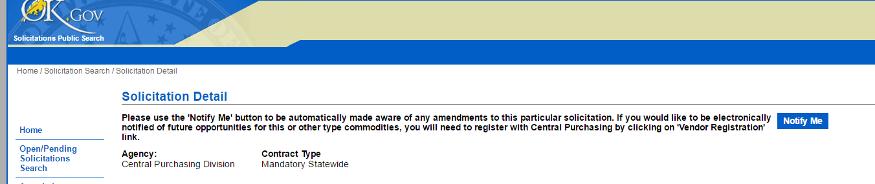
Amendments
The Lead State accepts no responsibility for a prospective Offeror not receiving solicitation documents and/or revisions to the solicitation. It is the responsibility of the prospective Offeror to monitor the State of Oklahoma’s website.

Slide 11
Proposal Submission
Proposals must be received by the posted due date and time.
June 20, 2016
One (1) Original marked “Master” hard copy.
One (1) redacted copy for public viewing in electronic format
Two (2) electronic copies on CD or USB flash drive.
Proposal pricing, Attachment D, must be submitted separately and must be in excel format. One hard copy and one electronic.

Slide 12
Required Format
Section 2.11 lists items which must be included
Section 2.13 identifies instructions for confidential or proprietary information submissions
Section 2.14 Offeror Exceptions to terms and conditions must be disclosed with original response.

Slide 13
Evaluation and Award
Section 3 contains information regarding the evaluation process.
Phase 1 – Verification that proposal conforms to RFP requirements and will be evaluated by pass/fail.
Phase 2 – Administrative and Technical Evaluation and possible clarification process.
Phase 3 – Cost Proposal Evaluation

Slide 14
Evaluation Criteria
Ability to Meet Scope of Work
Administrative Business Response
Technical Response
References
Acceptance of Terms and Conditions
Value Added Plan Response
Cost

Slide 15
Administrative/Technical Response Requirements
Section 4.1 describes requirements which must be met in order to be considered for evaluation phase.
Section 4.2 provides details on the scorable sections of the Business and Technical Requirements, Attachment E. Additional pages may be included to this attachment if needed.

Slide 16
Price and Cost Proposal
Section 5 addresses details regarding the pricing submission – Attachment D
Cost will be evaluated separately, and after business and technical responses.
Offerors may submit pricing for all bands, or for only one band.
Pricing must include all anticipated charges – freight, travel, transaction fees, etc.

Slide 17
Pricing Bands
Proposal has been separated into four (4) individual pricing sections to allow for detailed responses in each category.
Individual band proposal submissions will ensure transparency for all participating end users.
All bands will be awarded at a percentage discount to allow flexibility for new technology and products.
Submissions shall be marked with baseline identified and discount percentage.

Slide 18
Good, Better, and Best
With the wide variance of anticipated end users, this approach is to allow our customers the opportunity to decide which equipment is the best match for their current needs.
Each offeror is encouraged to provide products for the small rural areas, mid size cities, and large metropolitan public service entities.

Slide 19
Band Identifiers
Band 1 – Body Worn Video – Not permanently mounted – various mounting options
Band 2 – Vehicle Mounted Video – may also include public transit systems, school bus video and recording options.
Band 3 – Video Storage, Data Security, Software and Peripherals – optional equipment and back office solutions – both cloud and secured local storage.
Band 4 – Vehicle Mounted Equipment – Non-video related equipment which is incorporated to compliment public safety vehicles.

Slide 20
Contract Exclusions
Previous NASPO ValuePoint contract awards have been made for the following and will not be considered under this master agreement:
Body Armor
LED Light Bars, Sirens
Public Safety Radios
Radar and Lidar Equipment
General Computer Equipment
General Cloud Services (Non-Secured)

Slide 21
Attachment Index
Attachment A – NASPO Valuepoint Master Agreement Terms and Conditions
Attachment B – Scope of Work
Attachment C – Oklahoma Terms and Conditions for Award
Attachment D – Pricing Templates
Attachment E – Administrative and Technical Response Template
Attachment F – CJIS Security Policy V5.4
Attachment G – Reference Template
Attachment H - Question Template
Attachment I – Reporting Template Example
Attachment J – Value Add Plan Template
Attachment K – Additional State Terms and Conditions (Montana)
Attachment L – Additional State Terms and Conditions (Virginia)

Slide 22
Contact:
Lisa Bradley, CPO
405-522-4480
Lisa.Bradley@omes.ok.gov
Question Deadline:
May 19, 2016 4:00 PM CDT

