Slide 1

Purchase Card and
Travel Programs
Module 15

Slide 2
Overview
Overview of our P-card (purchase card) program along with who can and should be utilizing it.
Compare and contrast the costs of P-card versus purchase order procurement.
Information of the basics of card security and the requirements for program administration.
Overview of the state travel contract along with who should be utilizing it.

Slide 3
Learner Outcomes
Students will:
Recall the purchase limits of the P-card and recite examples as to what it can be used for.
List purchases that are prohibited when using the P-card.
Recall that a vendor does not have to be registered with OMES if the purchase is made from a P-card.

Slide 4
What is the Purchase Card (P-card)?
The P-card is a credit card issued to state employees to purchase goods and services needed for conducting official state business at fair and reasonable prices.
  Funds for P-card purchases are encumbered up front through an Authority Order to meet the prior encumbrance requirements (62 O.S.§ 34.62).
It is a charge card – merchant receives point-of-sale payment.
It’s not a debit card – funds don’t leave account at point of sale.
It’s not the same as a personal credit card – the State of Oklahoma carries no balances and pays no fees or interest.
It is a corporate liability card, meaning the liability rests with the state, not the employee.

Slide 5
Single Transaction Limits
$5000 maximum single transaction limit.
  With the exception of utilities, statewide contract purchases issued by OMES, interagency payments and professional services as defined in Title 18.
Single transaction limits are determined at the agency level and set by the entity P-card administrator. Limit can be less than the statutory $5000 allowed.

Slide 6
Statutory References
All purchases shall be made in accordance with state statutes, rules and these procedures, which include but may not be limited to:
  Central Purchasing Act, 74 O.S. § 85.1 et seq.
  State Travel Reimbursement Act, 74 O.S. § 500 et seq.
  OMES, Central Purchasing Codified Rules, OAC 260:115.
  State of Oklahoma Policy & Procedures for Purchase Card and Online Booking Tool.
  State Agency Internal Purchasing and P-card Procedures.
  Statewide Accounting Manual.
Notes:
Tip: Add your own speaker notes here.

Slide 7
Bank of America – Merrill Lynch
The State of Oklahoma P-card is a Visa purchase card issued by Bank of America.
The BOA P-card contract is administered by OMES (SW200).
There are no fees associated with the program.
Zero liability for unauthorized charges or for lost/stolen cards (bank must be notified within 24 hours).
The terms of the statewide contract allow higher education entities and political subdivisions to participate in the program.
It is the only credit card authorized by the State of Oklahoma for use by state agencies.
Notes:
Tip: Add your own speaker notes here.

Slide 8
Did You Know?
Transactions less than $5,000 typically represent about 5-10 percent of total spending for a company, BUT represent about 75-80 percent of spend volume.

Slide 9
Why P-cards?
Reduced number of purchase orders for small dollar purchases.
Broaden vendor and category options.
Agency convenience.
Merchant cash flow.
Eliminates lost, stolen or returned checks.
Rebate earned through combine spend.
Simplify vendor maintenance (vendor does not have to be registered with OMES if the purchase is made with a P-card).
Immediate payment to vendor.
Visibility and transparency.
Potential for discounts for faster payment.

Slide 10
Cost and Time Savings
Reduce transaction processing costs and time
  Average savings per transaction: $74* including sourcing, purchasing and payment activities.
  Reduction in procurement cycle time by approximately eight days
    19,682 POs for $5,000 or less in 2015 ($27,975,680).
    Potential savings of $1.4 million.
    *RPMG Research, P-card Benchmark Survey Results

Slide 11
P-card vs. PO Comparisons
P-card
100% transparent to public via web.
Limits on types of purchases made.
Rebate potential.
Small town/remote business acceptance.
100% external continuous monitoring.
One voucher per billing cycle to bank.
Tracked fraud and misuse data.
$17 average cost per transaction.
Purchase Order
Transparency only through Open Records Requests.
No limits on types of purchases made.
No rebate potential.
Limited acceptance.
Limited external monitoring.
One (or more) voucher(s) per PO.
No tracking of fraud and misuse.
$91 or more average cost per invoice paid.

Slide 12
Prohibited Purchases
Entertainment.
Per diem food and beverages.
Cash advances.
Purchase of goods for personal use.
Motor vehicle fuel for state-owned or personal vehicles.
Automotive maintenance.
Automatic drafts.
Gift certificates.
Split purchasing.

Slide 13
Revenue Sharing
Provided to all participants based on
  Total dollar spend.
  Average transaction size.
  Speed of pay.
Most recent rebate received: $3.3 million (including higher education) divided among participants, based on agency spending for FY 16.

Slide 14
Program Organization
Executive Advisory Group
State Comptroller
State
Travel Manager
State P-card Administrator
Agency
P-card Administrator
Agency
Approving Officials
Agency
Approving Officials
P-card holders
P-card holders
P-card holders
P-card holders

Slide 15
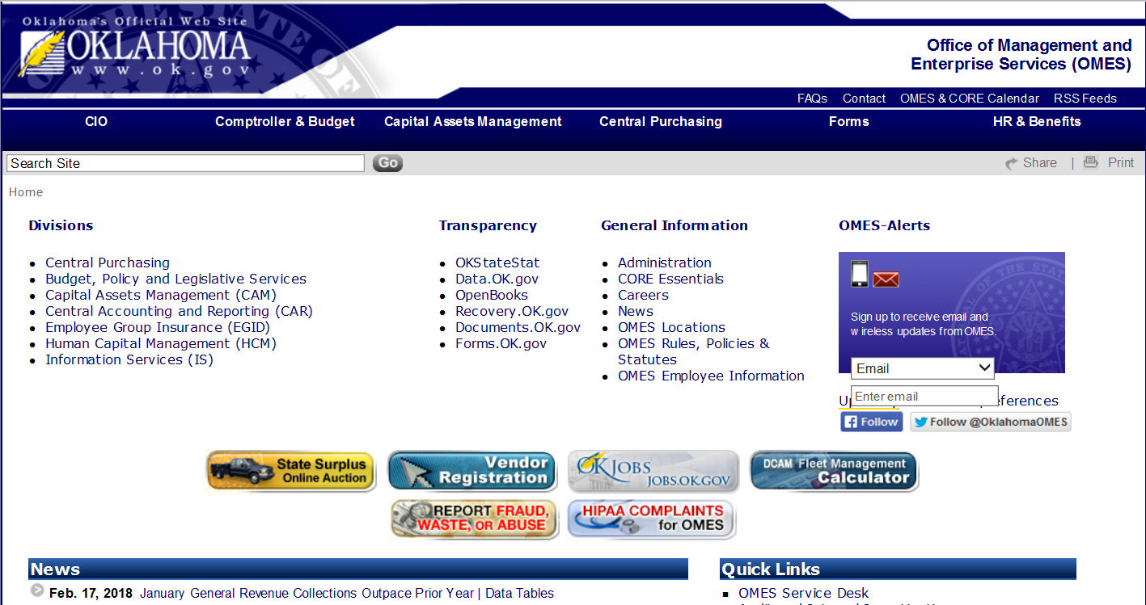
Access P-card Information

Slide 16
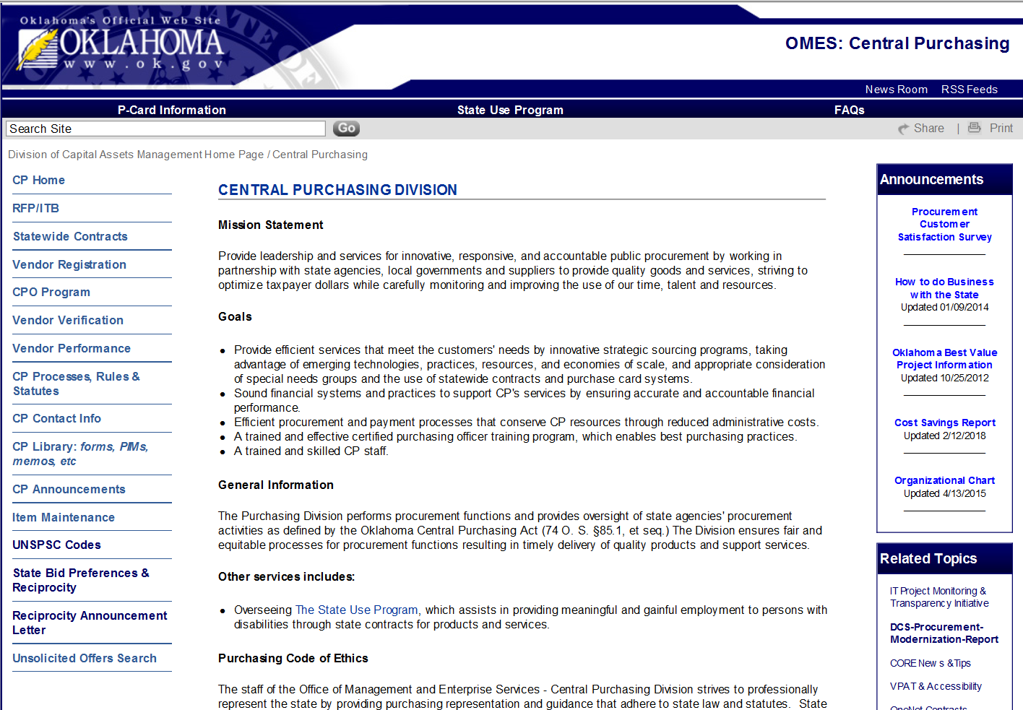
Access P-card Information

Slide 17
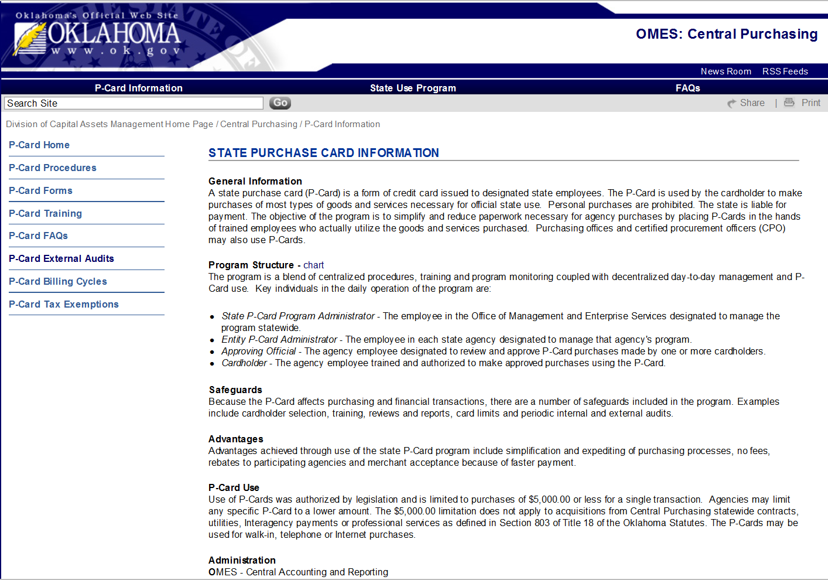
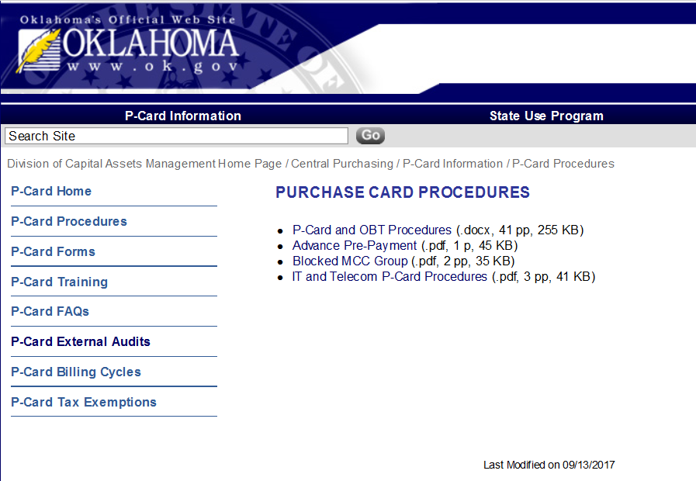
Access P-card Information

Slide 18
State P-card Team
Linda Powell
405-522-1654
linda.powell@omes.ok.gov
Cindi Reisman
405-522-4812
cindi.Reisman@omes.ok.gov
Central mailbox
pcard@omes.ok.gov

Slide 19
Travel
SW210 – Provides an online booking tool called Concur or optional phone assistance through FCM Travel Solutions with a dedicated Oklahoma team agent.
Contract use is mandatory for all state agencies.
Mobile alerts (app downloaded to phone).
Able to capture accurate state travel spend for all payment processes.

Slide 20
Travel
American Airlines city pairs pricing is available for certain domestic and international destinations.
Risk management tracking for travel booked through FCM/Concur.
Agencies can issue P-cards to frequent travelers or opt to have all travel booked by agency travel arrangers.
Agencies should use internal travel approval process prior to booking.

Slide 21
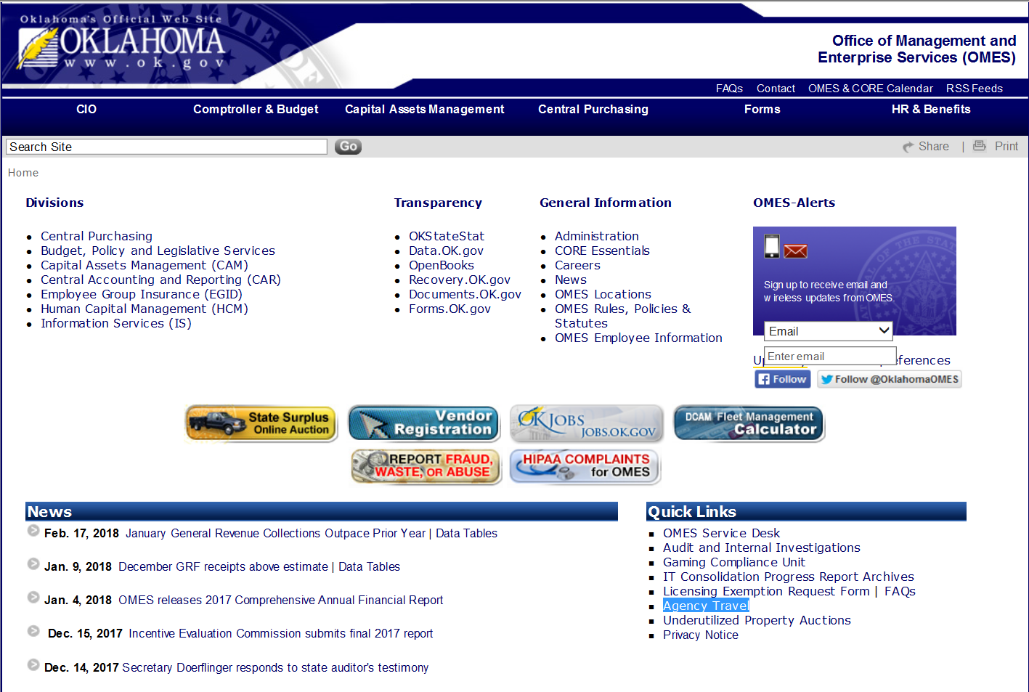
Access Travel Information
21

Slide 22
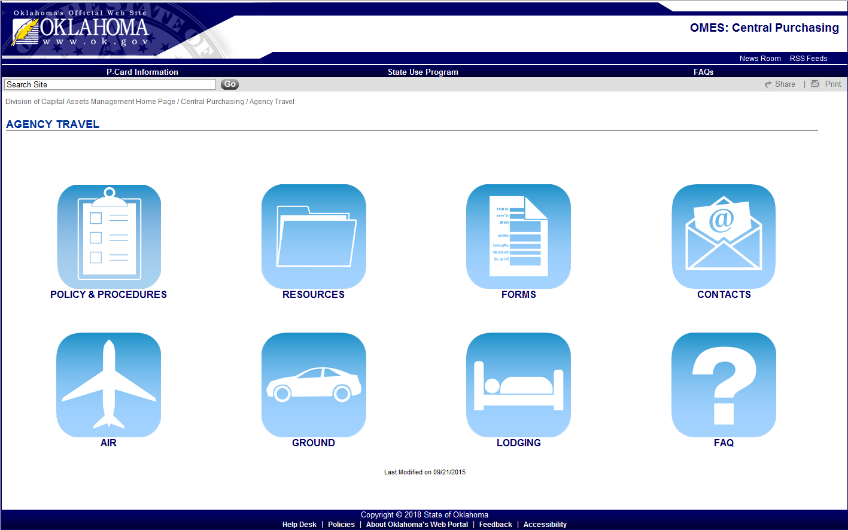
Oklahoma State Travel Website
http://www.ok.gov/DCS/Central_Purchasing/Agency_Travel

Slide 23
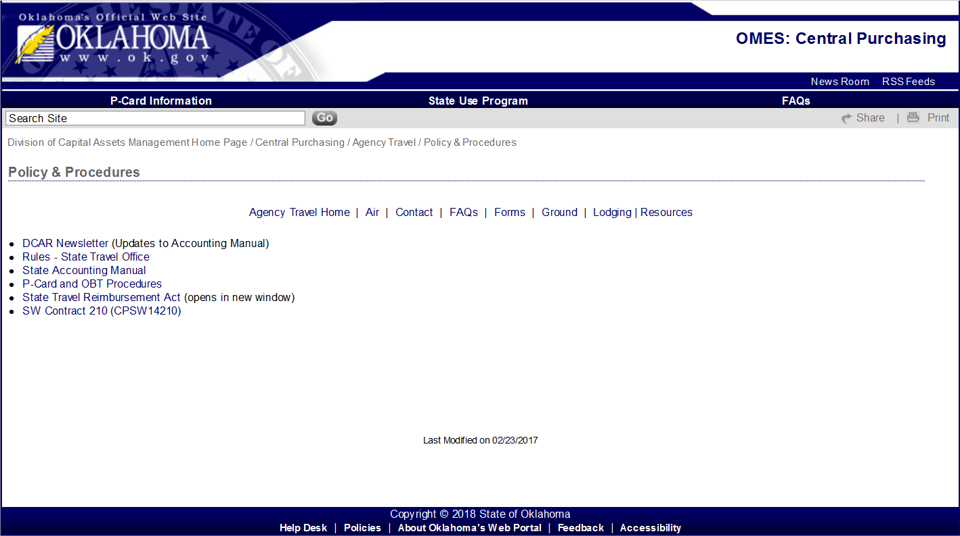
Oklahoma State Travel Website

Slide 24
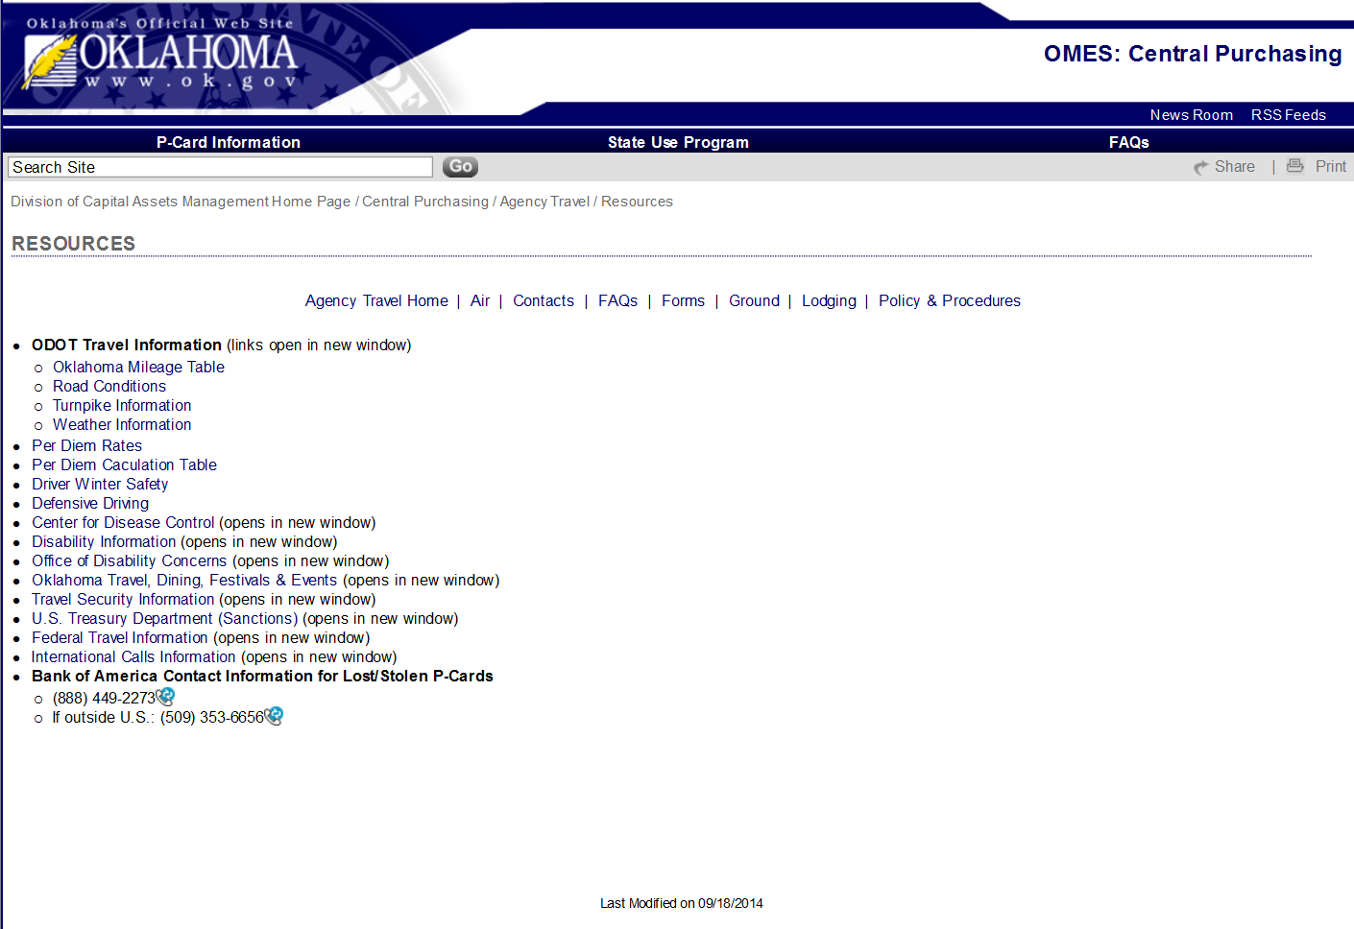
Oklahoma State Travel Website

Slide 25
OMES Travel Contact
Cindi Reisman, State Travel Manager
405-522-4812
cindi.reisman@omes.ok.gov

Slide 26
CONTINUE TO MODULE 16
26

