Slide 1

OMES Information
Technology Acquisitions
Module 13

Slide 2
Overview
Information Technology
  Review the House Bill that delegates authority of information technology and telecom procurement to the state chief information officer.
  Making an IT/telecom acquisition and what resources are available to the agency.

Slide 3
Learner Outcomes
Students will:
Recall the main goals of OpenRange.
Recognize examples of items the CIO has to authorize for purchases.
Identify the documents needed in IT Procurement Flow, such as PeopleSoft requisition – ePro, solicitation description and scope, evaluation method and criteria, evaluation scoring tool, and instructions to suppliers.

Slide 4
Learner Outcomes
Students will:
Recall Source Code Escrow Title 62 O.S and the vendor’s continuing obligation relating to customized computer software developed or modified exclusively for a state agency.
Identify when agencies are encouraged to request an IT solicitation preplanning meeting with OMES.
Recall when source code is required.
Recall what happens if when evaluating multiple vendor products, a vendor fails to submit a VPAT when required.

Slide 5
OMES Information Services Mission Statement
Lead, Support and Serve
To support State of Oklahoma agency information technology initiatives by providing quality, efficient service with integrity and understanding.

Slide 6
Business Segments and
Business Segment Directors

Slide 7
Business Segments
The business segments represent a concerted effort to encompass all State of Oklahoma agencies and their respective IT needs for the purpose of implementing a consolidated IT organization at the state level. Through consolidation of IT support and services across the State of Oklahoma, agencies and taxpayers can realize efficiencies and savings as related to IT needs and functions.
Affiliates.
Construction.
Education.
Eligibility and Insurance.
Financial and Administration.
Health.
Natural Resources.
Public Safety and Defense.
Regulatory.
Revenue.

Slide 8
Business Segment Director
The purpose of the BSD is to provide daily management and leadership for the agencies within the assigned business segment. The BSD reports directly to the state CIO and the chief operations and accountability officer and works closely with all members of the Office of Management and Enterprise Services and all IT employees to manage the IT services for each assigned agency.

Slide 9
Business Segment Director
Role of the business segment director (BSD):
Set direction.
Establish IT procurement strategies.
Oversee IT procurement .
IT cost efficiency.
IT operation efficiency.
IT security.
http://www.ok.gov/cio/Business_Segments/index.html.

Slide 10
State of Oklahoma Program
OpenRange

Slide 11
State of Oklahoma Program OpenRange
OpenRange Mission:
Provide State of Oklahoma agencies and affiliates access to shared IT services and establish road maps for collaboration to reach IT goals in an ever-changing technology landscape.
OpenRange Goals:
Remove obstacles.
Promote leading practices.
Encourage collaboration.

Slide 12
State of Oklahoma Program OpenRange
Who is an affiliate?
Any governmental entity specified as a political subdivision of the state pursuant to the Governmental Tort Claims Act, including any associated institution, instrumentality, board, commission, committee department or other entity designated to act on behalf of the political subdivision; a state county or local governmental entity in its state of origin; and entities authorized to utilize contracts awarded by the state via a multistate or multi-governmental contract.

Slide 13
State of Oklahoma Program OpenRange
Learn more about OpenRange
Email
Send your email to info@openrange.ok.gov and we will keep you informed of products and services.
Events
Visit our website for upcoming events.
Go to OpenRange.ok.gov and select Events and News.
Facebook
Like us on Facebook at facebook.com/OpenRangeOK.
Twitter
Follow us on Twitter @OpenRangeOK.

Slide 14
Procurement and Purchasing

Slide 15
Procurement vs. Purchasing
Procurement:
To define “procurement” broadly, it is the overarching function that describes the activities and processes to acquire goods and services. Importantly, and distinct from “purchasing,” procurement involves activities to establish fundamental requirements such as market research, vendor evaluation and negotiation of contracts. It can also include the purchasing activities required to order and receive goods.

Slide 16
Procurement vs. Purchasing
Purchasing:
The term “purchasing” refers to the process of ordering and receiving goods and services. It is a subset of the wider procurement process. Generally, purchasing refers to the process involved in ordering goods such as request, approval, creation of a purchase order record (a purchase order or PO) and the receipting of goods.
~ Purchasing Insight and NIGP Dictionary
of Purchasing Terms, 5th Edition

Slide 17
IT Procurement and Purchasing
IT procurement and purchasing activities within the framework of project management are essential to any organization that utilizes information systems and equipment to drive projects, processes and procedures.

Slide 18
IT Procurement Processes
Deployment and Management
An IT procurement process, whether formal or informal, exists in every organization that acquires information technology.
Deployment Processes
  Requirements determination.
  Acquisition.
  Contract fulfillment.
Management Processes
  Supplier management.
  Asset management.
  Quality management.

Slide 19
Electronic Information Technology
and House Bill 1304

Slide 20
IT Consolidation and Coordination Act
HB 1304
Question:
What is defined as information technology according to House Bill 1304?

Slide 21
IT Consolidation and Coordination Act
HB 1304
Answer:
Information technology is defined as any equipment or interconnected system or subsystem of equipment that is used in the acquisition, storage, manipulation, management, movement, control, display, switching, interchange, transmission, telecommunications or reception of data or information. The term shall include computer, ancillary equipment, software, firmware and similar procedures and services, including support services and consulting services, software development and related resources.

Slide 22
IT Consolidation and Coordination Act
HB 1304
Question:
Is the approval requirement for IT under the IT Consolidation and Coordination Act (HB 1304) a $0 threshold or, since it says assets, the inventory threshold?

Slide 23
IT Consolidation and Coordination Act
HB 1304
Answer:
Under the act, no state agency shall expend or encumber any funds for the purchase, lease, lease-purchase or lease with option to purchase, rental or other procurement of any IT assets without the prior written approval of the chief information officer. In addition, no state agency shall initiate or implement an IT-planned project without the prior written approval of the CIO. Copiers are included.

Slide 24
IT Consolidation and Coordination Act
HB 1304
Question:
Does the act include maintenance of computer equipment, license or any other IT encumbrance?
Answer:
Yes, the act includes maintenance, licenses and any other IT encumbrance.

Slide 25
IT Consolidation and Coordination Act
HB 1304
Question:
If I need to buy a keyboard for a PC, a desktop workstation, and/or scientific/analytical testing equipment that is computer driven and/or a copier, am I required to have those purchases authorized by the CIO?
Answer:
Yes.

Slide 26
OMES IT Procurement
Methods and Flow

Slide 27
OMES IT Procurement
IT procurement methods after approval by the business segment director:
Competitive Bidding Process
  Informal – an unsealed bid.
  Formal – a sealed bid.
An agency may make IT acquisitions with approved internal procedures on file at OMES.
Acquisitions above the agency’s dollar threshold are procured by OMES.

Slide 28
OMES IT Procurement
Non-Competitive Bidding
Sole source.
Professional services (Title 18).
Consolidated contracts.
Emergency acquisitions.
Competitively Bid, Negotiated and Established Agreements
Statewide contracts.
OneNet contracts.
GSA contracts.
WSCA contracts.
Texas DIR contracts.

Slide 29
IT Procurement Flow
Documents needed to submit a request for an IT acquisition:
PeopleSoft requisition – ePro.
Solicitation description and scope.
Detailed specifications.
Agency special provisions.
Instructions to suppliers.
Evaluation method and criteria.*
Evaluation scoring tool.*
Agency suggested vendor list.
File submission. (Note: All files should be submitted electronically and in a modifiable format.)
*Additional details can be found at ww.ok.gov/cio/Procurement/.

Slide 30
Electronic Information Technology Accessibility
and
Voluntary Product Accessibility Template

Slide 31
Oklahoma’s 508 Legislation
A Model for State Accessible Electronic and Information Technology
In April 2004, the State of Oklahoma enacted a law requiring its state departments and agencies to become 508 compliant by purchasing and using only electronic and information technology that is accessible to people with disabilities.

Slide 32
Oklahoma’s 508 Legislation
A Model for State Accessible Electronic and Information Technology
Oklahoma’s law is patterned after the federal 508 legislation which mandates that the equipment used when federal departments and agencies “develop, procure and maintain” information be accessible to people with disabilities.
Note: Here, as with the ADA, the “undue burden” provision is in effect.

Slide 33
Oklahoma’s 508 Legislation
A Model for State Accessible Electronic and Information Technology
The scope of 508 is very broad, covering almost everything in the modern office.
Software applications and operating systems.
Web‑based information and applications.
Telecommunication products.
Video and multimedia products.
Self-contained, closed products (e.g., information kiosks, calculators and fax machines).
Desktop and portable computers.
Independent Living Research Utilization (ILRU) – http://www.ilru.org/.

Slide 34
508 Compliance Electronic Information
Technology Accessibility
Why it’s important?
It’s the law.
Section 508 of the Rehabilitation Act (29 U.S.C. 794d), as amended by the Workforce Investment Act of 1998 (P.L. 105-220), August 7, 1998.

Slide 35
508 Compliance Electronic Information Technology Accessibility
Why comply? It’s the right thing to do.
6.4 million people in the United States have a visual disability.
10.5 million people in the United States population have a hearing disability.
20.9 million people in the United States population have an ambulatory disability.
14.8 million people in the United States population have a cognitive disability.
That means, on average, that 13.2 million people in the United States have at least one disability that Section 508 is meant to help with.
~ HHS.gov and U.S. Department of Health & Human Services

Slide 36
Electronic Information
Technology Accessibility
Accessibility determination is conducted as part of the objective evaluation. The degree of adaptation to the IT Accessibility Standards is accomplished through a review of vendor-provided information submitted in the form of a VPAT or similar document. It is recommended that the evaluation team include a subject matter expert(s) as part of the evaluation process.
Upon award, an agency may also use the EITA checklist together with a completed VPAT to document information related to selection of an electronic information technology product or service.

Slide 37
Electronic Information
Technology Accessibility
The majority of IT acquisitions must meet EITA standards.
IT Solicitation Template.
Section E contains the following language:
For Statewide Contract Acquisitions
“VPAT Website – Vendor/Contractor is to provide a URL link to a website providing VPAT for product deliverables through resulting contract.”

Slide 38
Electronic Information
Technology Accessibility
For Non-Statewide Contract Acquisitions
“Bidder must provide a Voluntary Product Accessibility Template (VPAT) that indicates compliance of all products offered with the provisions of Section 508 of the Rehabilitation Act Amendments included in the Workforce Investment Act of 1998.”
The following language should be included in non-statewide acquisitions:
  “Please complete the attached VPAT & Accessibility OMES form. Also attached is the VPAT Instructions Template.”

Slide 39
Electronic Information Technology
Accessibility Procurement
Agency Acquisitions
Agencies should require and maintain a VPAT for all EIT acquisitions along with the EITA checklist. The checklist is designed to support the acquisition.

Slide 40
Electronic Information Technology
Accessibility Procurement
OMES-IS Procurement Acquisitions
When submitting specifications for review, agencies should include or reference the corresponding VPAT required for the acquisition. It should be determined if the VPAT will be referenced as an attachment to the RFP or a statement as to where bidders may locate the required form(s). Occasionally a procurement may include more than one standard category. For example, an acquisition may include one or more of the categories below:
  Software applications and operating systems.
  Web-based internet and intranet information and application.
  Telecommunication products.
  Information, documentation and support documentation requirements.

Slide 41
Electronic Information
Technology Accessibility
EITA Standards
Copy of the existing EITA standards is on the OMES website at www.ok.gov/cio/documents/IS_itas.doc.
EITA Clause
The EITA clause used in all IT solicitations is on the OMES website at http://www.ok.gov/cio/Procurement/index.htm.

Slide 42
Voluntary Product Accessibility Template
VPAT assists in making preliminary assessments regarding the availability of commercial, electronic information products by highlighting features that support the Section 508 accessibility criteria as established by the state.
VPAT forms should be completed by acquisition type.
Agency should maintain a copy of all VPATs and VPAT checklists.

Slide 43
VPAT Evaluations
VPAT Evaluations
When evaluating multiple vendor products, if the vendor is required to submit a VPAT and the vendor fails to meet the requirement, then this is considered Non-Responsive.
“When procuring a product, the accessibility determination will be conducted as part of the objective evaluation and will be subservient to the general, technical and functional requirements of the procurement specifications.”
“At a minimum, it will be done through review of vendor-provided information submitted in the form of the VPAT or comparable document with judgments made regarding degree of conformance to the access standards.”

Slide 44
VPAT Evaluations
VPAT Evaluations
“The relative accessibility weighing may be adjusted for due cause based on the specific procurement.”
“When procuring a product, the accessibility determination should be made in accordance with OAC 260: 15-1-4 Accessible IT acquisitions.”
The VPAT documents are written to cover an entire category of IT acquisitions. Therefore, any one product may not meet every item on the checklist for a category. There should be a subject matter expert in the evaluation to determine if areas not in compliance effect the acquisitions being evaluated.

Slide 45
Voluntary Product Accessibility Template
VPAT Forms by Acquisition Type
053-4.2: Software Applications and Operating Systems
053-4.3: Web-Based Internet and Applications
053-4.4: Telecommunication Products
053-4.5: Video and Multimedia Products
053-4.6: Desktop and Portable Computers
053-4.7: Information, Documentation and Support
055: Accessible Technology Procurement Checklist and Documentation
056: EITA Undue Burden
VPAT Procedures and Checklists
Forms and additional information can be found at
http://www.ok.gov/cio/Procurement.

Slide 46
Source Code is required on (IT) acquisitions when acquiring or modifying software for the state.

Slide 47
What is Source Code?
Source code is the only format that is readable by humans. When programs are purchased, they are usually received in their machine-language format. They can be executed directly by the customer. They cannot be read or modified by the customer. Some software manufacturers provide source code, but this is useful only if there is an experienced programmer.
~ WEBOPEDIA and IT Business Edge

Slide 48
Source Code Escrow, Title 62 O.S.
If required under applicable Oklahoma law relating to customized computer software developed or modified exclusively for a state agency, the vendor shall have a continuing obligation to comply with such law and place the source code for such software and any modifications thereto into escrow with an independent third-party escrow agent unless the source code has been supplied to the agency.
Vendor shall pay all fees charged by the escrow agent and enter into an escrow agreement, the terms of which are subject to the prior written approval of the state, with the escrow agent including terms that provide the state receives ownership of all escrowed source code upon the occurrence of any of the following:

Slide 49
Source Code Escrow, Title 62 O.S.
A bona fide material of the obligations of the Vendor under the agreement with the agency;
An assignment by the Vendor for the benefit of its creditors;
A failure by the Vendor to pay, or an admission by the Vendor of its inability to pay, its debts as they mature;
The filing of a petition in bankruptcy by or against the Vendor when such petition is not dismissed within sixty (60) days of the filing date;

Slide 50
Source Code Escrow, Title 62 O.S.
The appointment of a receiver, liquidator or trustee appointed for any substantial part of the Vendor’s property;
The inability or unwillingness of the Vendor to provide the maintenance and support services in accordance with the agreement with the agency;
The ceasing of a Vendor of maintenance and support of the software; or
Such other condition as may be statutorily imposed by the future amendment or enactment of applicable Oklahoma law.

Slide 51
Source Code Escrow, Title 62 O.S.
Why?
Should the software provider cease to support the software, it becomes the property of the purchaser. It is the responsibility of the purchaser to arrange for continued maintenance of the product.
Neutral third parties, the source code escrow agents, serve both the end user and the software supplier by providing physical and legal protection for the escrow deposits and all related services.

Slide 52
Source Code Escrow, Title 62 O.S.
Why? (cont.)
The necessity of escrow assures the continued operation and maintenance of custom software applications in the event the software provider should fail to maintain the application, cease business operations or encounter some other pre-negotiated released event.
~ Dictionary.com and Purchasing Insight

Slide 53
OMES IT Information Gems

Slide 54
OMES IT Information Gems
IT procurement pre-planning between the agency and OMES:
  Should begin as soon as the need is identified.
  Will help with RFP development.
  And help formulate requirements.
ePro.
Contracts, purchase orders and PeopleSoft.
ITSW contracts.
Reports.
Helpful web links.

Slide 55
IT Solicitation Preplanning
RFP Development
What is IT Solicitation Preplanning?
Providing good quality service with greater efficiency.
Early involvement of OMES is recommended for high dollar and complex acquisitions.

Slide 56
IT Solicitation Preplanning
RFP Development
OMES will:
Assist with developing the solicitation, evaluation tools and any required research, etc.
Review and discuss agency timeline to establish a timely completion.
Provide any other additional procurement assistance required.

Slide 57
IT Solicitation Preplanning
RFP Development
Agencies are encouraged to request an IT solicitation preplanning meeting with OMES when:
The need has been established.
The expenditure has been verified.
The expenditure is in the agency IT budget and on file at OMES.

Slide 58
IT Solicitation Preplanning
RFP Development
Who should the agency involve?
Agency purchasing/contracting officer.
Subject matter expert.
Administration.
End user.
Anyone who will have a vested interest in the final outcome.

Slide 59
Benefits of Preplanning
Requirements are a major contributing factor to project failures. They are complicit to the number of software projects an organization delivers that are past deadline or over budget, or the organization just fails to deliver.
Top five issues at the root of the requirements problem:
Focus on the wrong things.
Not enough time spent on requirements.
Wrong people responsible for requirements.
Business analysts without the right skills.
Contracting requests too large to be suc­cessful.
Blueprint-whitepaper

Slide 60
IT Solicitation Preplanning
What is your solution type?
Hardware/Software Solutions
Turnkey: Complete and ready to use upon delivery or installation.
Commercial Off The Shelf: Hardware or software products that are standard manufactured products rather than customized for specific uses.
  In most cases, COTS products cannot be customized (i.e., Adobe Acrobat, Microsoft Excel)
Custom/Developed: This is a hardware or software designed specifically for the agency.

Slide 61
IT Solicitation Preplanning
What is your solution type?
Hosted Solutions
Vendor Hosted
  Hosted by the vendor on their server(s) or virtual servers/cloud.
  Controls all function or files.
Agency Hosted
  Hosted from or on the agency’s network/servers.
  Controls all functions or files.
  May involve implementation and may require customization.
Note: Whether it is vendor or agency hosted, in some cases these solutions may require some type of customization, configuration or modification.

Slide 62
IT Solicitation Preplanning
RFP Determining Language Requirements
Specific language the RFP may require is important.
Data transfer agreement.
Data conversion – timeline/business continuity.
Federal.
Disaster recovery.
Incident management and problem escalation.
Delivery, testing and what constitutes acceptance.
Notice to cure.

Slide 63
IT Solicitation Preplanning
RFP Determining Language Requirements
Implementation/Workplan (milestone schedule).
Training Plan.
Staffing Plan.
Maintenance Plan.
Project Kickoff.
Project Management.
Agency Policies.
Current Environment.

Slide 64
Solicitation (RFP) = Contract
    The contract resulting from this solicitation shall consist of the following documents in order of preference: State of Oklahoma Statutes, contract award documents, including but not limited to the purchase order, contract modifications, required certification statement, and change orders; the solicitation including any amendments; and the successful offer to the extent that the offer does not conflict with the requirements of the contract award documents or solicitation or applicable law.
    In the event there is a conflict between any of the preceding documents, the contract award documents prevail over the solicitation, and both the contract award documents and the solicitation shall prevail over the successful offer.

Slide 65
Exhibit A or Attachment A
Contract Award Documents
Exhibit A/Attachment A to RFP #
  State of Oklahoma Office of Management and Enterprise Services/IT Procurement – Contract Award – On behalf of
The award document herein referred to as Exhibit A is the contract incorporating the Request for Proposal, Terms and Conditions, Contract Provisions, Scope of Work/Services and/or Technical Specifications, and the Contractor’s Proposal as clarified/negotiated.

Slide 66
ePro
Agencies are required to:
Acquire ePro training.
Who should receive training?
All CPOs.
Requestors and approvers.
Accounting.
Agency asset managers.
Procedures can be found at IT and Telecom ePro Requisition Procedures at
http://www.ok.gov/cio/Procurement/index.html.

Slide 67
Schedule of Reports
Following is a list of reports all state agencies are required to submit annually to OMES.
Sept. 1 – Disaster Recovery/Business Continuity Plan(s), Title 62 O.S. § 34.12.
Dec. 1 – Statewide Security Risk Assessment,
Title 62 O.S. § 34.32.

Slide 68
IT Statewide Contracts
IT-related statewide contracts are on the OMES website at
www.ok.gov/dcs/solicit/app/contractSearch.php
and
www.ok.gov/cio/Procurement/Statewide.

Slide 69
Contracts, Purchase Orders and PeopleSoft
Continuous Improvement
Utilizing PeopleSoft modules for the intent and purposes for which they were designed.
  Purchase order
    Issued for one year.
    Will use the PeopleSoft purchase order function.
  Multi-year agreement
    Generated using the PeopleSoft procurement Contracts function.
    Refer to training supplement document for PeopleSoft examples. https://www.ok.gov/cio/Customer_Portal/Business_Application_Services_Essentials/Financials/.

Slide 70
Building Your Own ePro Requisition
and Creating a PO From an
Agency-Specific Contract

Slide 71
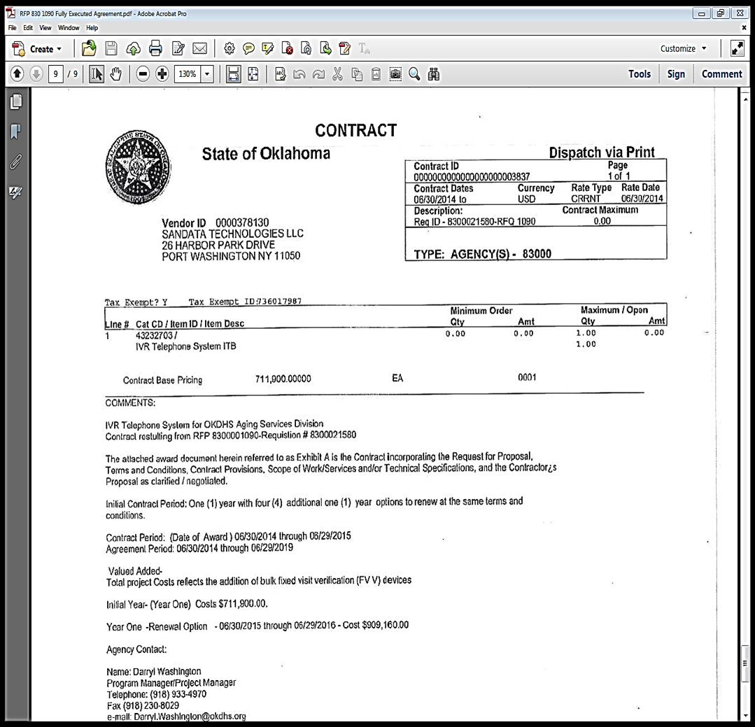
Agency Multi-Year Contract

Slide 72
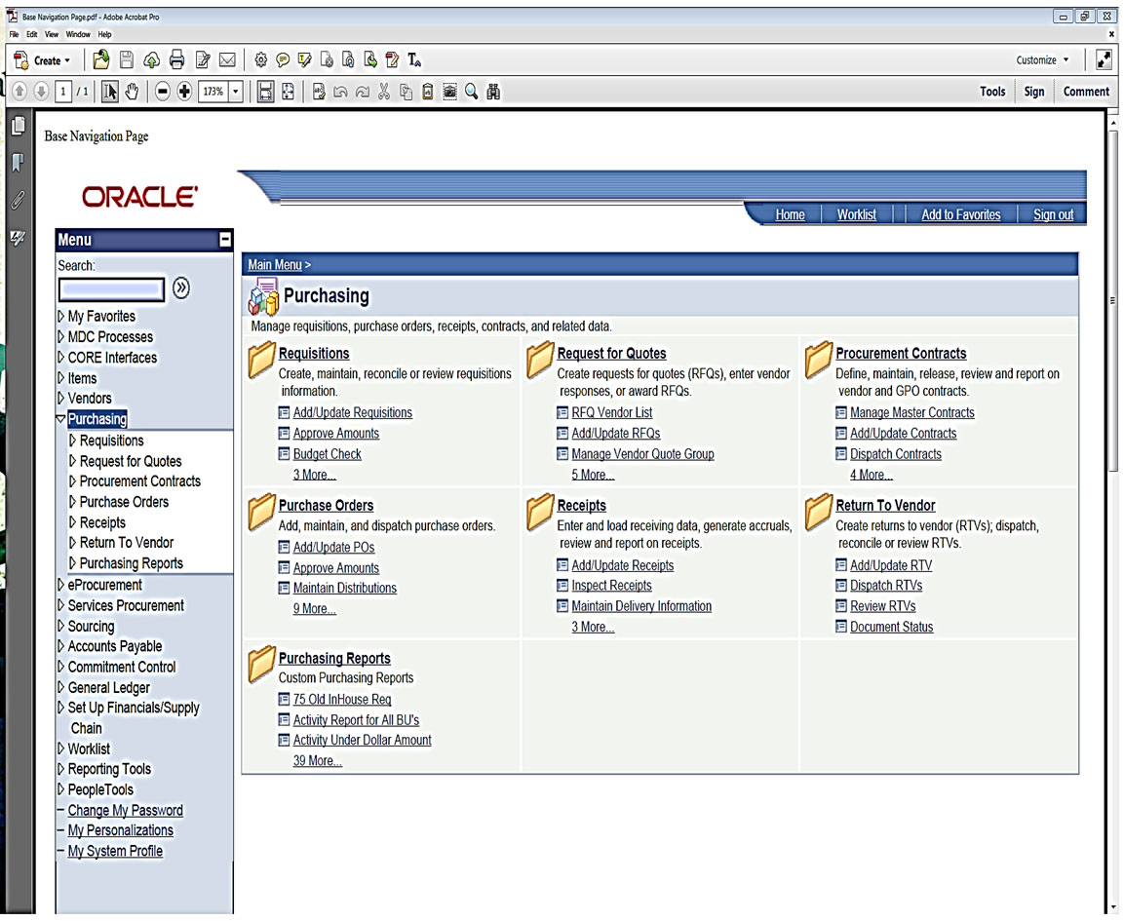
Step 1: How to Access an
Agency-Specific Contract

Slide 73
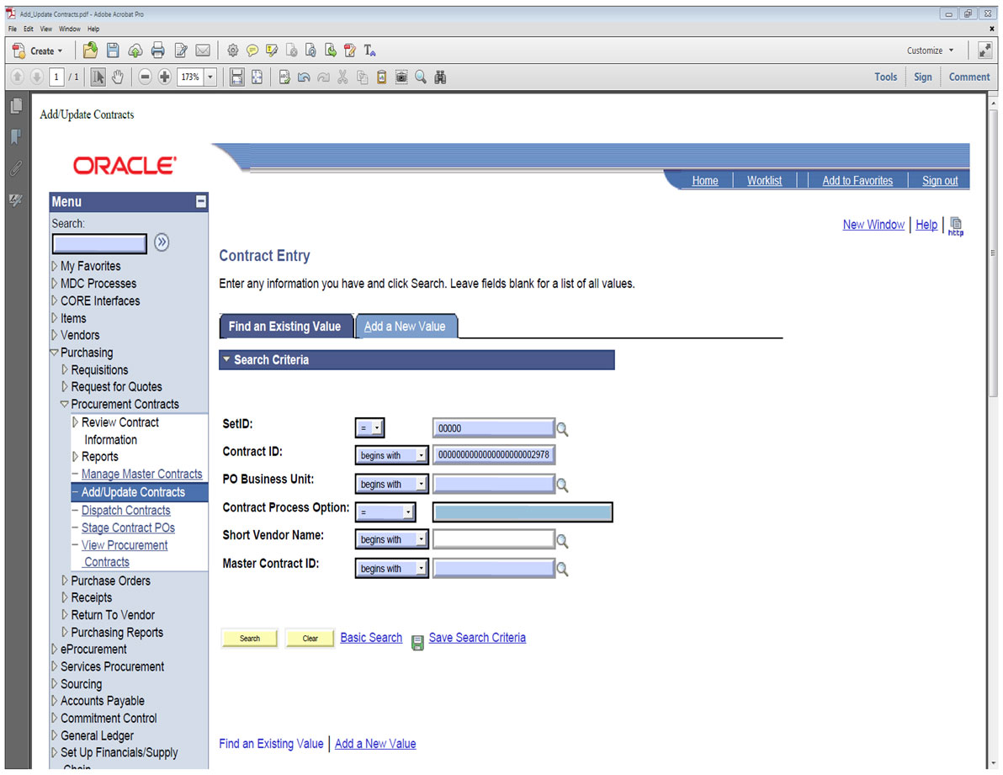
Step 2: How to Access an
Agency-Specific Contract
PeopleSoft Contract ID
Your Agency Number

Slide 74
Agency-Specific Contracts
Agency-Specific Contracts are multi-year agreements resulting from an agency RFP and are commonly awarded to a single vendor, however this can vary dependent upon what is in the best interest of the state. The contract will have a PeopleSoft contract ID number.

Slide 75
Agency-Specific Contract Requirements
The agency/buyer will be required to submit an ePro requisition for change orders, renewals, etc. The buyer will build the requisition directly from the contract. Agency-specific contracts generally are not associated or tied to an Item ID, therefore the buyer would build the requisition using the item description, category code and vendor ID as shown on the agency-specific contract. The requisition must mirror the contract.

Slide 76
Agency-Specific Contract Requirements
After the requisition is completed, the buyer should submit it through ePro along with any required documents for the proper approval. After the requisition process is complete and notification of approval is received, the buyer will be able to generate the purchase order by copying from the approved requisition or the agency-specific contract. In order to achieve better results it is recommended to copy from the requisition.
Enter the Vendor ID in the requisition default.

Slide 77
OMES IS IT Procurement
Helpful web links:
http://omes.ok.gov
http://cio.ok.gov
https://www.ok.gov/DCS/Central_Purchasing/index.html
http://www.ok.gov/cio/Procurement/
http://www.ok.gov/cio/documents/Bid_Process.pdf
https://wiki.ok.gov/display/itprocurement/Home
http://www.ok.gov/cio/Procurement/Solicitations/
https://confluence.atlassian.com/display/CONF35/Watching+a+Page+or+Blog+Post

Slide 78
Questions?
For questions regarding IT acquisitions, please contact OMES CP Procurement at purchasing@omes.ok.gov.
For more information, visit the OMES website at www.ok.gov/cio/procurement.

Slide 79
CONTINUE TO MODULE 14

