Slide 1

Bid Evaluations
Module 10

Slide 2
Learner Outcomes
Students will:
Recall if a bidder will be disqualified if any of the specifications used in the bid was provided by the bidder.
Recall the list of reasons to be classified as a Non-Responsible Bidder.
Identify definition of reciprocity as related to bid evaluations.

Slide 3
Introduction
It is critical to understand the evaluation process because:
  It allows us to be fair and competitive in our bidding practices.
  It brings value to the State of Oklahoma by ensuring we get both best price and best value.
  It avoids costly re-evaluations and re-bids which add cost to the State of Oklahoma.
  Effective evaluations minimize the threat of a sustainable protest.

Slide 4
Team
From the moment the need is identified, the CPO should begin forming the evaluation team.
Subject matter experts.
End users.
Outside agency subject matter experts.
Agency CPO (and/or OMES Contracting Officer).

Slide 5
Begin With the End in Mind
Evaluations will tie directly to the solicitation documents. The CPO begins working with the requestor to establish the absolute minimum solicitation requirements (Section C of the Solicitation Package).
The requestor would look to subject matter experts, end users and possibly outside agency subject matter experts, along with independent research, to determine the minimum requirements of the acquisition.
Enlisting those people as evaluation team members will get them involved in the process from the beginning.

Slide 6
Begin With the End in Mind (Cont.)
This will assure they are fully informed of the desired outcome of the acquisition and reduce any confusion with regards to specific requirements listed in the solicitation.
The agency CPO and/or the OMES Contracting Officer will also serve on the evaluation team as the manager of the solicitation process. The term “CPO” will be used to represent the agency CPO and/or the OMES Contracting Officer where ever you see the term “CPO” in this lesson.

Slide 7
Methods of Acquisition
Lowest and Best (may include)
    Lowest total purchase price.
    Quality and reliability of the products.
    Consistency of the proposed acquisition with the state’s planning documents and announced strategic program direction.
    Ability to deliver in required timeline.
  (For very small purchases, or when price analysis is the most appropriate method of evaluation.)

Slide 8
Methods of Acquisition
When making an acquisition pursuant to the terms of Title 74, the State Purchasing Act, it is required to use either “Lowest and Best” or “Best Value” in determining the success of a bidder.
The statutes give these areas to consider when evaluating a bid on the lowest and best method.
Lowest and best means an acquisition based on criteria which include, but are not limited to, the these factors.

Slide 9
Method of Acquisition
    An instance where lowest and best might be used would be the acquisition of products where the only factor of importance other than cost is the vendor’s ability to deliver the product by the date needed.
    With the lowest and best bid method, you are still required to do a formal evaluation of the submittals and document your reasons for award determination. You cannot use ONLY price/cost as determination of your award. You must document quality, reliability and delivery times for best.

Slide 10
Methods of Acquisition
Best Value (may include)
    Acquisition’s operational cost to a state agency.
    Quality of the acquisition, or its technical competency.
    Reliability of the bidder’s delivery and implementation schedules.
    Acquisition’s facilitation of data transfer and systems integration.
    Acquisition’s warranties, guarantees and the bidder’s return policy.

Slide 11
Methods of Acquisition
    Best Value (cont.)
    Bidder’s financial stability.
    Acquisition’s adherence to the state agency’s planning documents and announced strategic program direction.
    Bidder’s industry and program experience and record of successful past performance with acquisitions of similar scope and complexity.

Slide 12
Methods of Acquisition
    Best Value (cont.)
    Anticipated acceptance by user groups.
    Acquisition’s use of proven development methodology and innovative use of current technologies that lead to quality results.

Slide 13
Methods of Acquisition
  Per statute “Best Value” may include but are not limited to these factors. This can be found at 74 O.S. § 85.2.19.
  Best value is the method to use when you are not using lowest and best as your evaluation method.
  Using the information received regarding what is important and looking at the statutory definition of the chosen evaluation method is a great way to begin establishing the evaluation criteria.

Slide 14
Scoring Processes – Advantages
  Individual Scoring
  versus
  Consensus Scoring

Slide 15
Scoring Processes – Advantages
With Individual Scoring
    On less complex solicitations, it takes less time.
    Logistics or schedules of the team may make it difficult for them to meet.

Slide 16
Scoring Processes – Advantages
With Consensus Scoring the advantages are:
    Upon discussion, additional missed information may be found, from the first round of scoring.
    Someone in the group may have interpreted the vendor’s response wording with a different context.
    Better buy-in from the evaluation team, who may be end-users of the product or service.
    The recommendation of OMES is not to hold group discussions when doing individual scoring or evaluate as a group as a general rule.

Slide 17
Scoring Processes – Advantages
    One exception to this would be to have every evaluator score the responses individually and then reconvene and work together to fill out a separate scorecard based on the group’s discussion.
    Another option would be to score based on milestones where each evaluator evaluates on their area of expertise and each area scored comes together to form the final evaluation.
    It is important to note that these are the best practices offered by OMES Central Purchasing.
    Particular circumstances may warrant a variation of the previously described scoring processes.
    In the event that an agency chooses to vary, the decision and process must be fully documented and saved in the acquisition file.

Slide 18
QUESTION 1
  What is the Method of Acquisition that considers anticipated acceptance by user groups as a criteria?
  Best Value

Slide 19
What is Important?
Minimum/Mandatory Requirements – Pros
Allows evaluation committee to only evaluate qualified bidders.
There may be size or weight restrictions for the installation.
Assures some services do not void warranties.
Required sometimes when using grant or federal funds to meet federal requirements.

Slide 20
What is Important? (Cont.)
Minimum or mandatory requirements in your evaluation criteria can be helpful in narrowing the field of available bidders when certain requirements must be met with your acquisition.
An example would be a service contract for hardware that is still under factory warranty. You would need a factory-certified company to maintain that equipment.
Another example would be federally-funded community development block grants that may specify all the funds being expended to be to businesses in a particular area.

Slide 21
What is Important? (Cont.)
Minimum/Mandatory Requirements – Cons
Unnecessary restriction of competition.
Restriction of competition results in higher prices.
Alienation of bidders.
Inability to locate qualified bidders.

Slide 22
What is Important? (Cont.)
The cons to minimum/mandatory requirements in your solicitation are that you are narrowing the playing field at a cost.
Pricing increases as competition goes down.
If the requirement is not absolutely required for the success of the acquisition, it can result in a protest or rebid situation.

Slide 23
What is Important? (Cont.)
It can taint the reputation of the agency if they are using unnecessary requirements. Bidders begin to assume the agency is targeting one bidder for award. If the agency IS targeting one bidder, it may have unintended consequences.
There may be no bidder who qualifies or the one bidder who qualifies may not be the bidder they believe they needed.
The takeaway should be that quality, qualified bidders will usually reveal themselves without unnecessary mandatory requirements.

Slide 24
What is Important? (Cont.)
If your mandatory requirement dictates how the supplier will perform the services after award, as the supplier is the expert, the bidder/supplier may have had a better, cost efficient way to perform the services.

Slide 25
What is Important? (Cont.)
Other considerations:
Source of funding.
Service costs.
Quality.
Delivery and completion schedules.
Supplier expertise.
Technical merit.
Financial stability.

Slide 26
What is Important? (Cont.)
Other considerations (cont.):
Territory coverage.
Product offerings and innovation.
Social considerations and environmental characteristics.
Negotiations.
Accessibility (mandatory for applicable IT acquisitions).

Slide 27
What is Important? (Cont.)
Earlier training taught you to satisfy the minimum need with acquisitions. Likewise, the evaluation criteria should not include items that are not necessary to achieve the purpose.
Consider what is important at the beginning of evaluation criteria establishment.
You must always know your source of funding. Agencies who do not normally receive federal funds may find themselves doing a solicitation such as the Recovery Act projects, where federal funds are involved.

Slide 28
What is Important? (Cont.)
Federally funded projects usually contain requirements with regard to the solicitation and the competitive process of award. You must have a copy of those requirements to assure your solicitation and award are in compliance.
You cannot use specifications received from a supplier to develop your bid specifications. Suppliers know the specifications of their competition and will notify the CPO when they see an agency doing so.

Slide 29
Bidding Preferences – Reciprocity
State agencies shall not discriminate against bidders from other states except as provided and outlined by Title 74:85.17A.
"Reciprocity" means a preference, which the State Purchasing Director or state agency shall apply against the price submitted for an acquisition by an out-of-state bidder whose home state applies a similar preference against Oklahoma bidders.

Slide 30
QUESTION 2
  What Scoring Process is best used for less complex solicitations, and when logistics or schedules of the team may make it difficult for them to meet?
  Individual Scoring

Slide 31
What is Important?
Using Strategic Sourcing Methods
How much do we currently purchase?
(Leverage)
What do we currently pay?
(Baseline)
Buying several varieties of the same thing?
(Standardization)
What is available?
(Market Analysis)

Slide 32
What is Important?
Using Strategic Sourcing Methods (Cont.)
When you apply strategic sourcing principals to a solicitation, you are taking into consideration your historical use of products and several other factors.
Looking at historical information, the current market and where efficiencies such as standardization can be leveraged, results in lower pricing and better quality for the agency.

Slide 33
What is Important?
Using Strategic Sourcing Methods (Cont.)
Who can provide?
(Increased Competition)
What are our users’ needs?
(End User Interviews)
What will be our strategy?
(Solicitation Approach)
Are we getting what we expected?
(Contract Management)

Slide 34
What is Important?
Using Strategic Sourcing Methods (Cont.)
With the Contract Management component, you are developing the historical data you need for the next acquisition of those products and services.

Slide 35
What is Important?
Using Strategic Sourcing Methods (Cont.)
Opportunity Assessment:
Spend Analysis.
End User Interviews.
Prioritize Categories.
Build Baseline.
Identify Savings Levers.
Note: With this information, you can identify what individual items should be weighted higher, what items should be prioritized in a negotiation and what items are critical to the success of the acquisition.

Slide 36
CPO Responsibilities – Incorporating the Evaluation into the Solicitation
List criteria in solicitation in order of importance.
Reflect the same criteria within scoring tool.
Must be developed prior to solicitation issue date and provided in a separate section of the solicitation (Section D in the Standard Solicitation Package).
Must state whether lowest and best or best value is chosen method of evaluation.
Must be consistent with solicitation.
Providing the evaluation criteria for award in a solicitation informs prospective bidders of the basis for award decisions and the sequence of events that will take place in the evaluation of the proposals received.

Slide 37
CPO Responsibilities – Incorporating the Evaluation into the Solicitation (Cont.)
Solicitations that include federal funds require that the evaluation criteria be listed in order of importance.
Develop the habit of listing it in order of precedence and you will never be out of compliance.

Slide 38
CPO Responsibilities – Incorporating the Evaluation into the Solicitation (Cont.)
Items not in the instructions on the submittals, cannot be scored on the responses.
Must state whether negotiations will be held.
Weights do not need to be disclosed.
Must state if interviews or site visits will be done.
Should have a baseline for scoring metrics:
  To facilitate consistency.
  To guide evaluation team.

Slide 39
CPO Responsibilities – Incorporating the Evaluation into the Solicitation (Cont.)
Regardless of how great the information is, you cannot include information that was received from one bidder that was not requested of all bidders in your scoring unless you are including a value added item in both your requested submittals and your evaluation criteria.
Additionally, you cannot use any knowledge you may have of the abilities of a bidder’s product/services that have not been documented in the response.

Slide 40
CPO Role-Bid Closing
Bids are opened at a public opening only when requested from the public.
    Public opening.
    Non-Public opening.
    CPO or designee stamps bids and notes the bidder responses on the Bid Tabulation sheet.

Slide 41
CPO Role-Bid Closing (Cont.)
If it is a public opening:
  The cost submittals are not opened, as the cost may change with negotiations.
  Only the bidders’ names and state of origin are disclosed.

Slide 42
CPO Role-Bid Closing (Cont.)
  If it is not a public opening:
  No information concerning the bid is disclosed, such as:
  How many bids were received.
  Who the bids came from.
  This is done in a non-public opening because disclosing information relating to the number of bids and names of bidders decreases the CPO’s negotiating leverage.
  Bidders know their competition. Knowing who they are competing against, or in some cases, that there is not another bidder, gives the bidder leverage in a negotiation.

Slide 43
QUESTION 3
In what order should criteria be listed in the solicitation Section D?
  In order of importance

Slide 44
PLEASE NOTE
Be sure to read all the notes below the remainder of the slides for very important information that is not on the following slides!

Slide 45
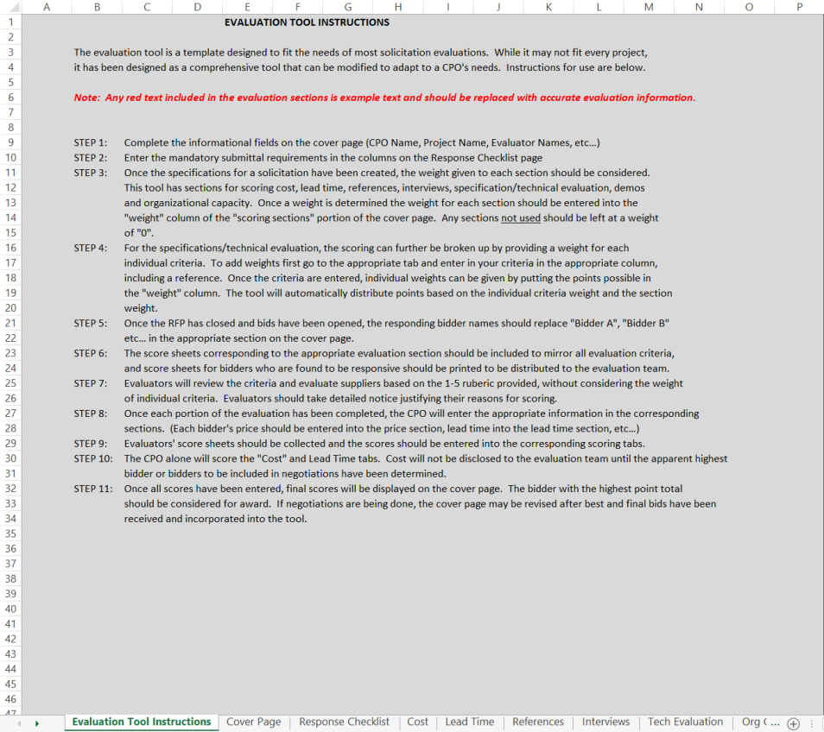
Tool – Evaluation Tool Instructions
Notes:
Designing a generic Evaluation Tool in the form of an interfacing Excel workbook can be a great time-saver and will assist the CPO/Contracting Officer in covering instructions to the Evaluation team and documenting the Evaluation process for the permanent procurement file.
Instructions regarding use of the Evaluation Tool should be created and remain at the beginning of the Evaluation Tool or workbook to use for reference on the current evaluation and kept as a part of the permanent procurement file.
The Evaluation Workbook used in this training is a generic workbook that can be used for most types of evaluation.
You simply do not use the tabs that are not needed, line items are at zero so that the interactive formulas function properly.

Slide 46
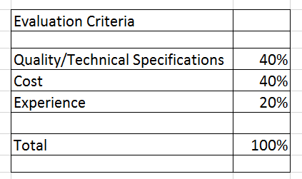
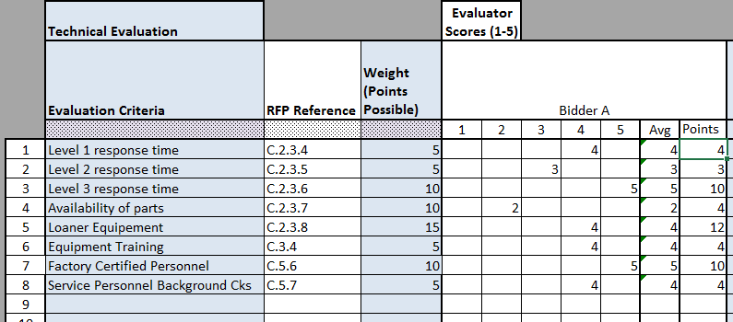
Tool – Weighting Non-Cost
Example of Weights by Category
Example of Weights by Technical Evaluation Line
Notes:
Weighting can be used in more than one way.
It can be applied to Sections of Evaluation such as the example on the left, where the category of the evaluation is weighted by its importance to the team.
Individual lines within the Scoring Tool may be weighted by their importance to the team as indicated in the example on the right above.
Cost can also be weighted two ways. These will be covered with the Cost slides below.

Slide 47
Tools
Cost.
Lead time.
Financial stability.
Accessibility.
References.
Interviews.
Technical evaluation.
Demos/Samples.
Organizational capacity.
Notes:
A tool can be created with sections for all areas to be evaluated such as cost, lead time, financial stability, accessibility, references, interviews, specification/technical evaluation, demos and organizational capacity.
Once the specifications for a solicitation have been created, tailor the tool to the requirements of the solicitation. Delete the sections you do not need. The weight given to each section should be considered.
For specifications/technical evaluation, the scoring can further be broken up by providing a weight for each individual criteria based on the importance of that line item.
The evaluation score line will tie directly to the solicitation section line.
Tying each requirement in section to the evaluation tool will give the evaluator the exact location of the requirement in the solicitation to allow understanding of context.
The combined score sheets for each category appear as the first tabs in the workbook. Individual tabs that will be printed, duplicated and distributed to the evaluation team for use in their individual scoring appear behind the combined score tabs.

Slide 48
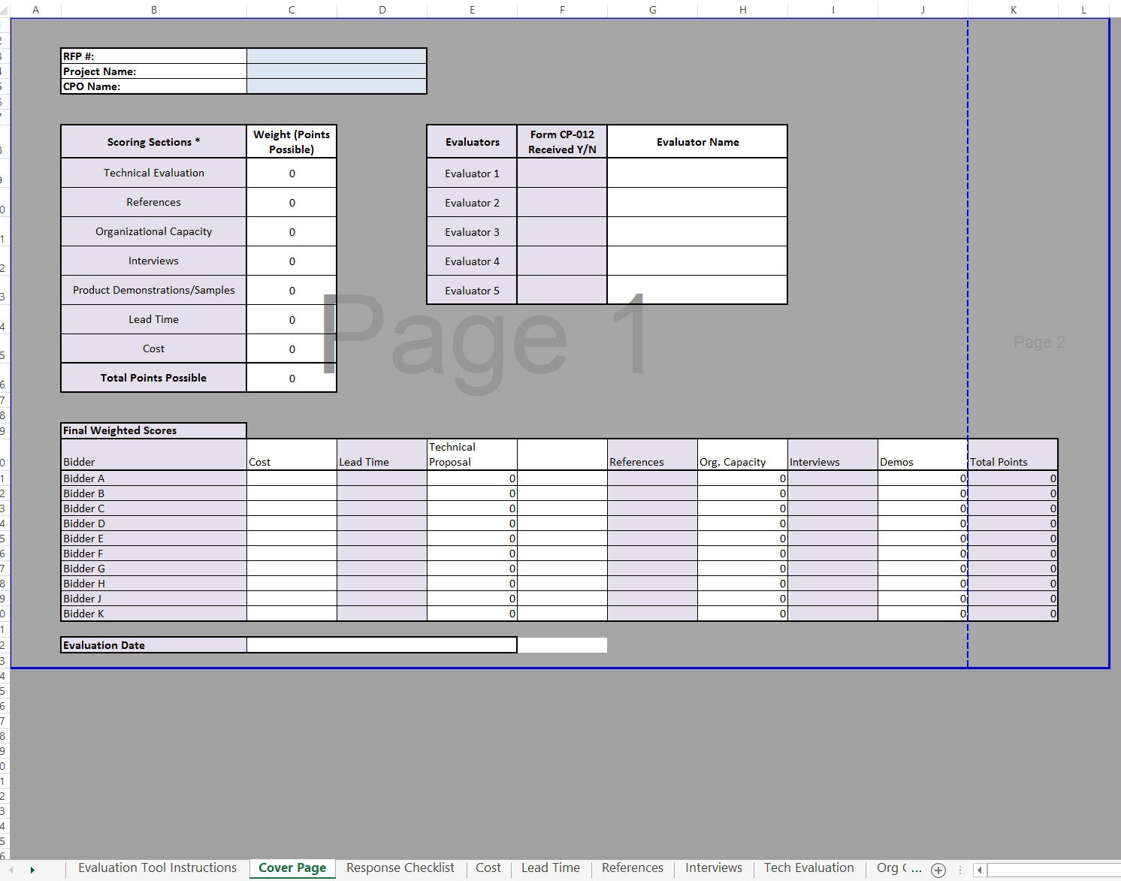
Tool – Cover Page
Notes:
When the bids are opened, enter the RFP#, Project Name, CPO/Contracting Officer name, Evaluator names and bidder names in the tool.
Then enter the responding bidder names on the Conflict of Interest and Non-disclosure Statement for Evaluation Team (OMES-CP-Form 012’s) and send them to the evaluation team members to be signed and returned.
No bid information should be distributed to an evaluation team member until the completed Form 012 has been received.
If the Form 012 indicates a relationship, the nature should be evaluated by the CPO/Contracting Officer to determine if a conflict exists and the member should be disqualified prior to any bidder information being distributed to them.
If the Excel pages are designed to be interactive, the CPO will only need to enter the bidder names and evaluators on the Cover page and they should transfer to the other pages of the tool.

Slide 49
Tool – Cover Page (Cont.)
Contracting officer may limit contact regarding a solicitation between suppliers and agency personnel during the solicitation process. Team should be made aware in advance of participation that any and all contact with any responding bidder will be required to be disclosed and if contact is inappropriate, bidder will be disqualified.
Team should be made aware in advance that specifications from one supplier can’t be used to establish the criteria. If a bidder supplied any of the specifications used in the bid, the bidder will be disqualified.

Slide 50
Tool – Cover Page (Cont.)
Evaluation Team – confidentiality before and after award.
    Names of team members.
    Names of bidders.
    Information in bids.
    Information in evaluations.
    No direct contact with bidders without CPO present.
Notes:
CPO/Contracting Officer must inform all team members that any and all information related to the bid before and after award can only be disclosed by the CPO/Contracting Officer conducting the solicitation process.
The names of the team members cannot be disclosed by anyone other than the CPO/Contracting Officer.
If a bidder attempts to contact an evaluation team member, the team member is to notify the CPO immediately.
Any questions or additional information needed by the evaluation team to clarify a bid response must be submitted to the CPO in writing.
The CPO will get any and all clarification information requested from the bidders. Any interaction between an evaluation team member and a bidder without the presence of the CPO may result in disqualification of the bidder.
Any contact with the bidder and the evaluation team must be done in the confines of the evaluation and with the guidance of the CPO.

Slide 51
Tool – Cover Page (Cont.)
Weighted/scored criteria.
Example of Weighting:
    Total possible points equal 100.
      Cost weight = 40 percent (weighted, not scored).
      Technical submittal = 40 percent (scored, then weighted).
      Experience = 20 percent (scored, then weighted as scored).
Notes:
On the Cover Page, the Weights created for each section of the Evaluation Tool will be entered on the right side of the page.
Once the specifications for a solicitation have been created, the weight given to each section should be considered.
Weighting allows more importance to be associated with criteria.
EVERY point scored in the solicitation response must tie directly to a point in the Solicitation and submittal requirements (Section E).
Although listed in order of importance in the solicitation, weights are not typically disclosed in the solicitation.

Slide 52
QUESTION 4
Why does the CPO/contracting officer disclose no information on non-public bid openings?
  Negotiation leverage.

Slide 53
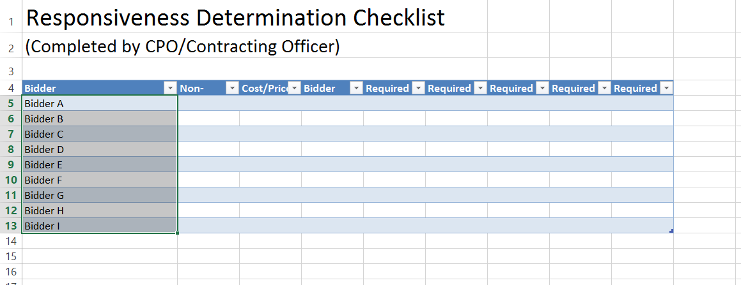
Tool – Response Checklist
Notes:
A quick checklist of required submittals and mandatory requirements can be added at the beginning of the Evaluation Tool for the CPO/Contracting Officer to use after the bid opening to document responsiveness and request/track materials identified as minor deficiencies.
Enter the solicitation specific requirements in the columns after the Bidder Information column headings.
Then use them to monitor the status of each bidder with regards to those requirements by updating them as items are requested or received.

Slide 54
Tool – Response Checklist
What:
  Financial stability.
  Required submittals.
Why:
  To keep playing field level.
  To determine responsiveness.
  To simplify qualification process.
Notes:
The CPO will begin creating the Evaluation Tool based on the needs identified as the minimum requirements for the acquisition.
When the bid closes, the CPO will determine initial “responsiveness” and remove the Cost section of the responses prior to distributing them to the Evaluation Team members.
Mandatory Criteria: All mandatory specifications should be evaluated first using a pass/fail method. If a bid does not meet mandatory specifications, it should not proceed to the technical evaluation phase.
Responsiveness to the RFP: Does the response address the RFP specifications or does it deal primarily with generalities?
Does the Supplier explain the reason for any variations in content from the information requested in the RFP?
There is no need to score a bidder who fails to deliver the required submittals and/or submit minor deficiencies identified and requested by the CPO/Contracting Officer.
Why Pass/Fail on Financials?
To keep the playing field level: Scoring financial responsibility would handicap a small firm who has the financial resources to do the job, but will never score as high as an international company.

Slide 55
Tool – Response Checklist
Pass/Fail
Non-Responsiveness
      Failure to return a Non-Collusion Affidavit.
      Failure to submit the required documents after minor deficiencies have been requested.
      Bidder states they cannot meet the delivery schedule.
      Failure to provide samples.
Notes:
A responsive bidder is one who returns the documents that are required in the solicitation in a timely manner.
Samples are not being evaluated for quality at this point. They are simply being checked to see if they submitted the samples required from the RFP.
Other documents may have been required in the solicitation. The state may waive a minor deficiency, such as receipt of one of the insurance certificates, if submitted upon request of the CPO. A minor deficiency should not be waived from one bidder if minor deficiencies are not waived for all bidders.

Slide 56
Tool – Response Checklist (Cont.)
  Pass/Fail
  Responsible Bidder.
  Non-Responsible Bidder:
      Bidder without the financial resources to complete the work.
      Bidder who has failed to complete prior projects on time or on budget.
      Bidder who has significant litigation.
Notes:
Central Purchasing Rules describe a Responsible bidder as “a supplier who demonstrates capabilities in all respects to fully perform the requirements of a contract that may include, but may not be limited to, finances, credit history, experience, integrity, perseverance, reliability, capacity, facilities and equipment, which will ensure good faith performance.”

Slide 57
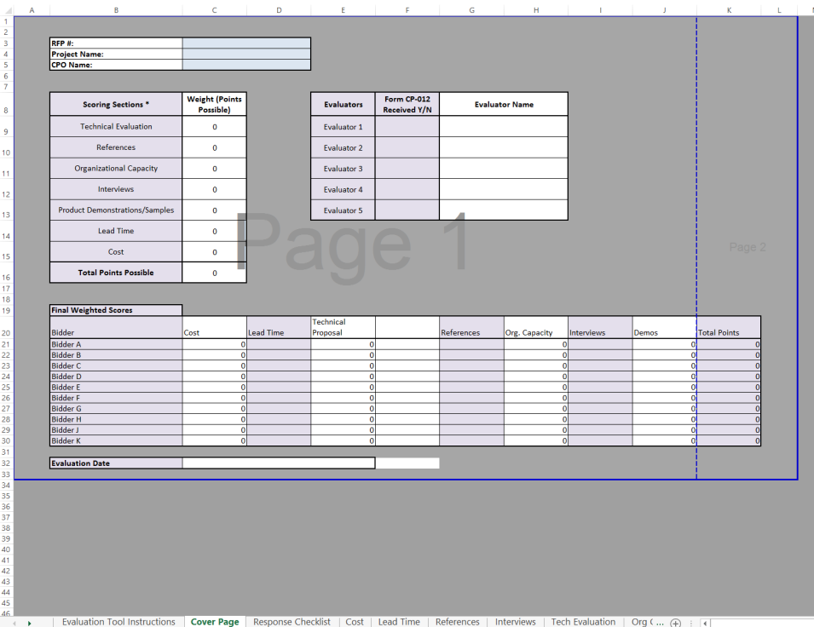
Tool – Cost Summary Tab
Notes:
Since the CPO will be the only one to score the Cost/Price, only one tab in the Evaluation Tool is required for recording of the scores.
The tab can be used for a simple one-sum bid with weight, or this tab can be customized to allow for the evaluation of multiple line items such as warranties, maintenance, different hourly rate services, or other differing line item costs.

Slide 58
Tool – Cost Lump Sum Pricing
Cost Scoring – Example of Mathematical Normalization
Possible weighted points for cost = 40 points
  Vendor A submits a cost of $1,115.
  Vendor B submits a cost of $1,200.
  Vendor C submits a cost of $1,000.
Notes:
If cost is weighted but not scored, how are cost submissions rated?
“Normalization” will be applied to the weighting.
Normalization is simply scaling the score to the total percentage allowed for this scoring category.

Slide 59
Tool – Cost Lump Sum Pricing
Normalized Score = Lowest Proposed/Proposed x Weight
Normalized score for C = $1,000, or the full 40 points.
Normalized score for A = $1,115 or
  $1,000/$1,115 = .8968% x 40 = 35.87 points.
Normalized score for B = $1,200 or
  $1,000/$1,200 = .8333% x 40 = 33.33 points.
Notes:
This slide demonstrates the formula used to “normalize” the actual scores based on the total percentage of the Cost factor in the solicitation evaluation.

Slide 60
Tool – Cost Line Item Weighting
(Example of non-weighted line item cost)
Item | Vendor A | Vendor B
Printer Drum | $ 199.00 | $ 209.00
Printer Toner | $ 39.00 | $ 31.00
Printer Head | $ 6.00 | $ 4.00
Cleaner | $ 1.50 | $ 4.00
TOTAL | $ 245.50 | $ 248.00
Winner is Vendor A by $2.50.
Notes:
Many times the agency has the need for weighting of individual lines within a Cost submission.
This is generally done when items or services on one line are more frequently needed or of more importance than items on another.
When this is done, you weight the items based on volume of spend.
The example above is an example of NOT using Market Basket weighting of items most frequently purchased.

Slide 61
Cost – Line Item Cost Weighting
(Example of Weighted Cost)
Weighted market basket item baseline (strategically sourced):
Item | Volume | Vendor A |  | Vendor B
Printer Drum | 20,000 | $ 199.00 | $ 3,980,000 | $ 209.00 | $ 4,180,000
Printer Toner | 142,000 | $ 39.00 | $ 5,538,000 | $ 31.00 | $ 4,402,000
Printer Head | 13,000 | $ 6.00 | $ 78,000 | $ 4.00 | $ 52,000
Cleaner | 18,500 | $ 1.50 | $ 27,750 | $ 4.00 | $ 74,000
TOTAL |  | $ 245.50 |  | $ 248.00
Weighted Total |  |  | $ 9,623,750 |  | $ 8,708,000
Winner is Vendor B by $915,750.
Volume multiplied by price = weighted market basket item baseline ($20,000 x $199 = $3,980,000)
Notes:
This example shows how the contract is awarded if Market Basket pricing, with the anticipated consumption by item, is used.
As you can see, the contract is far less expensive when the volume is considered in the pricing formula.

Slide 62
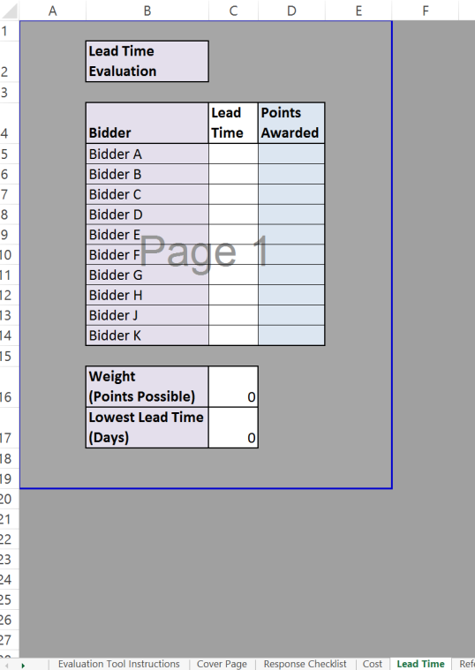
Tool – Lead Time Summary Tab
Notes:
Lead Time may be pass/fail in your evaluation or it may be scored. If you chose to score it, it will need to be weighted and normalized like Cost.

Slide 63
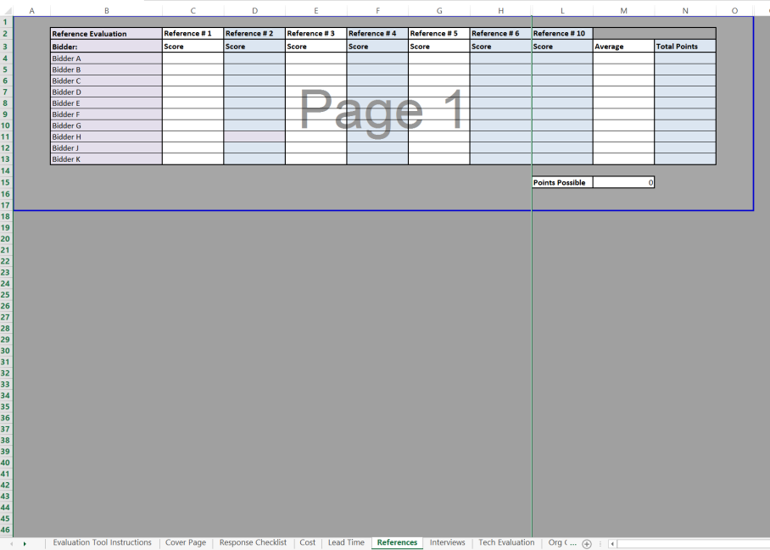
Tool – References Summary Tab
Notes:
If references are asked for in the solicitation, all references must be contacted to evaluate past performance.
An individual who is not scoring the responses will contact the references.
An idea of questions that might have yes/no “quantitative” answers might be five questions for one point each such as:
Did the project completed at or below the contracted price?
Was the project completed on time?
Were response times met per contract?
Were supplier employees used knowledgeable?
Would you hire the supplier again?
The individual will contact the individuals identified in responses, complete forms documenting results and present to the Evaluation Committee for consideration in scoring the responses.
Alternatively, the reference sheets can be provided in the initial RFP and Suppliers can be instructed to return completed references with their proposal.
If references are conducted in this manner, only the awarded Supplier’s references need to be contacted, and only to confirm that they completed the form.

Slide 64
Tool – References
Scored Criteria
Example of weighting:
  Total possible points equal 100
      Experience = 20% (scored, then weighted as scored)
        Includes Experience (15%)
        References (5%)

Slide 65
QUESTION 5
Why should Financial Responsibility only be evaluated as Pass/Fail?
To keep the playing field level

Slide 66
Example of Objectively or
Quantitatively Scored Experience
Criteria of experience is worth 15% (15 points)
  Project manager has 2-5 years experience with similar projects = 5 points.
  Project manager has 6-10 years experience with similar projects = 10 points.
  Project manager has in excess of 10 years experience with similar projects = 15 points.
Notes:
Objectively rate baseline criteria for scoring. This is an example of objective, pre-determined scoring established for scoring experience of a bidder.

Slide 67
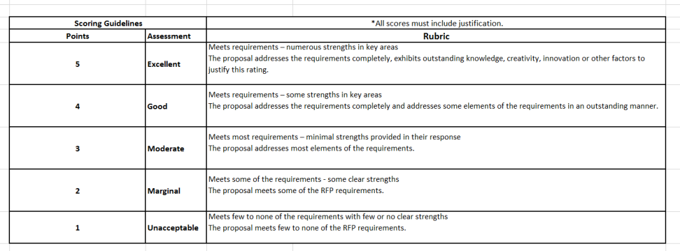
Evaluation Process – Scoring Guidelines for Technical Evaluation
Notes:
This is a good example of a Rubric used in technical scoring by specification line. It should be incorporated and provided as instructions on the top of the form for Technical Scoring to allow guidance for the Evaluation Team members.

Slide 68
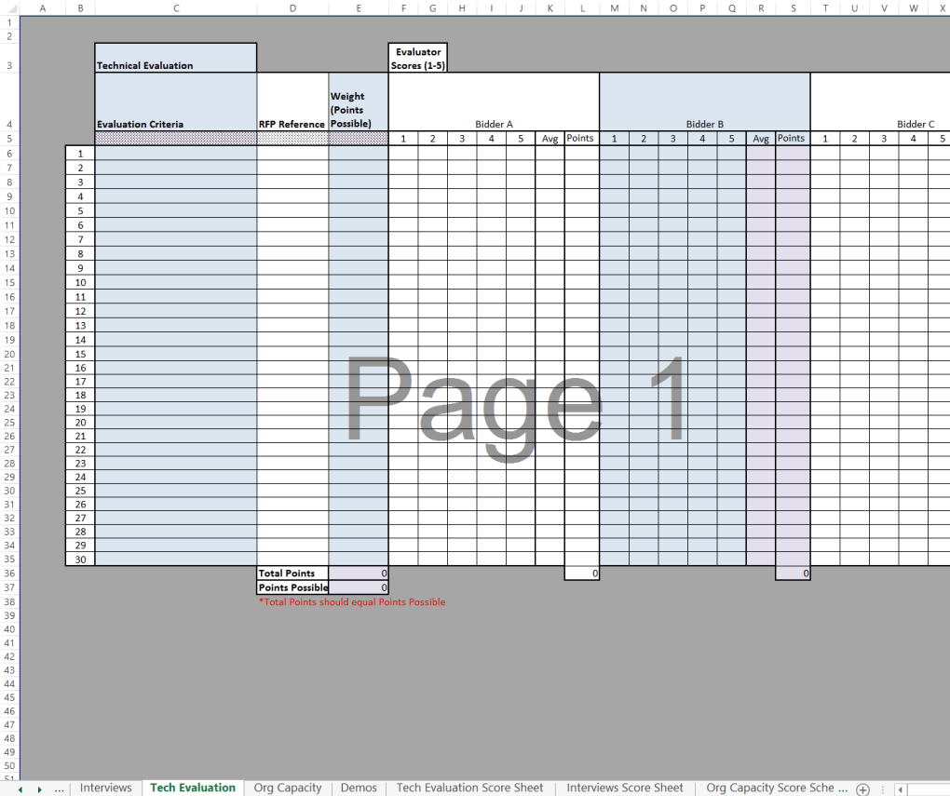
Tool – Technical Evaluation Summary Tab
Notes:
The Technical Evaluations will tie directly back to Section C of the Solicitation Package.
Each requirement can be copied into Column C with the section and subsection reference number in Column D.
Although the evaluation team can assign more point value to some line items over others in Weight Column E, the evaluators will not see the weight on their individual scoring sheets to allow them to focus on just what is listed in the bidders’ responses for those individual line items.

Slide 69
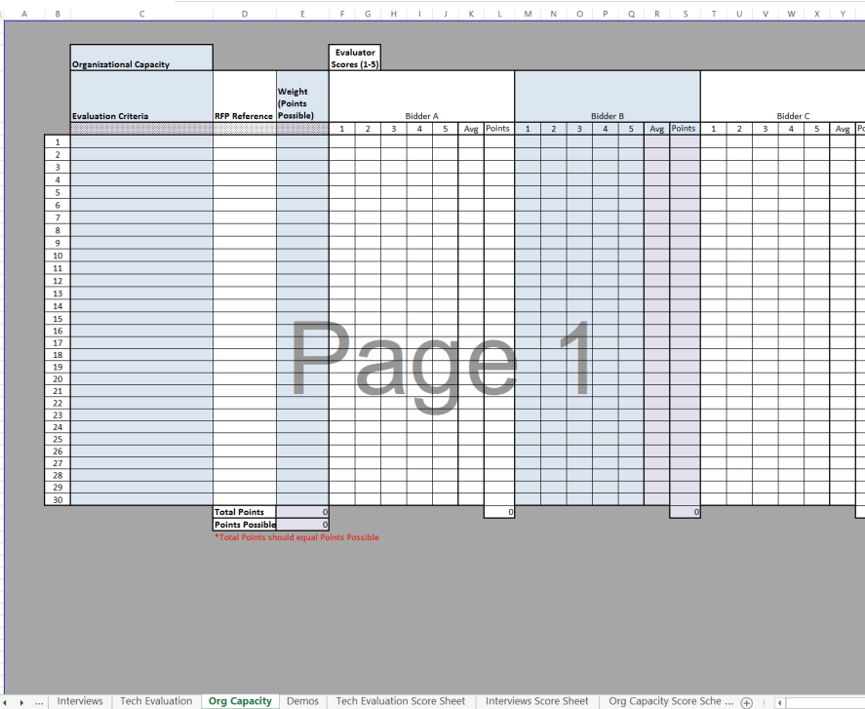
Tool – Organizational Capacity Summary Tab
Notes:
This tab may not be used often, but will function the same as the Technical Evaluation tab with weights that will not be seen on the individual scoring sheets.

Slide 70
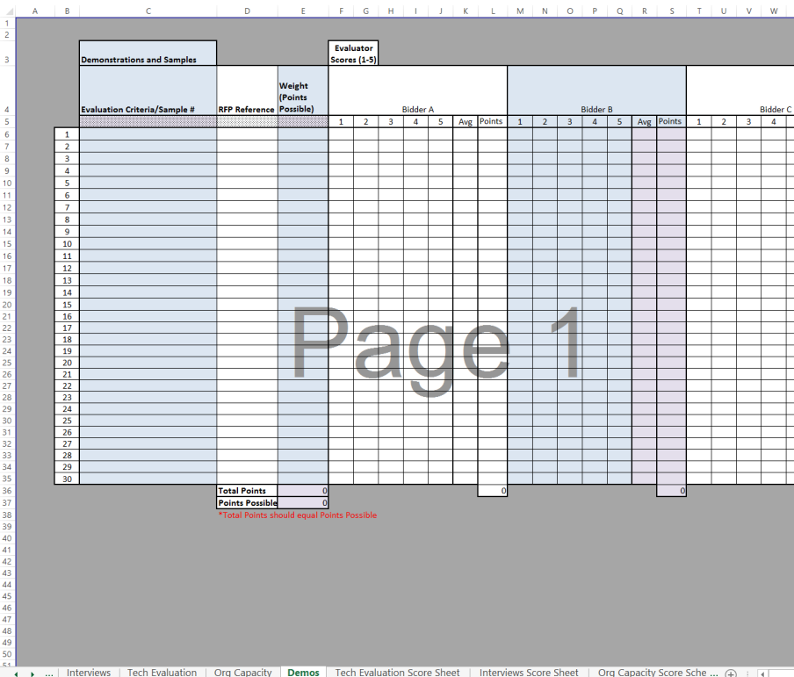
Tool – Demos Summary Tab
Notes:
This is an area where an evaluator may have to give more of a “qualitative” or “subjective” response in lieu of a quantitative response, depending on what sample or product is being demonstrated.
Develop as much quantitative evaluation criteria as possible. Did the product meet size, weight, speed …specifications. Some areas may not seem they could be quantified, such as “ease of use”. But if you translate that into “3 or fewer clicks to get through the registration process”, it becomes quantifiable.
Unfortunately, if you are evaluating the softness of a pillow or the taste of an appetizer, it becomes more difficult.

Slide 71
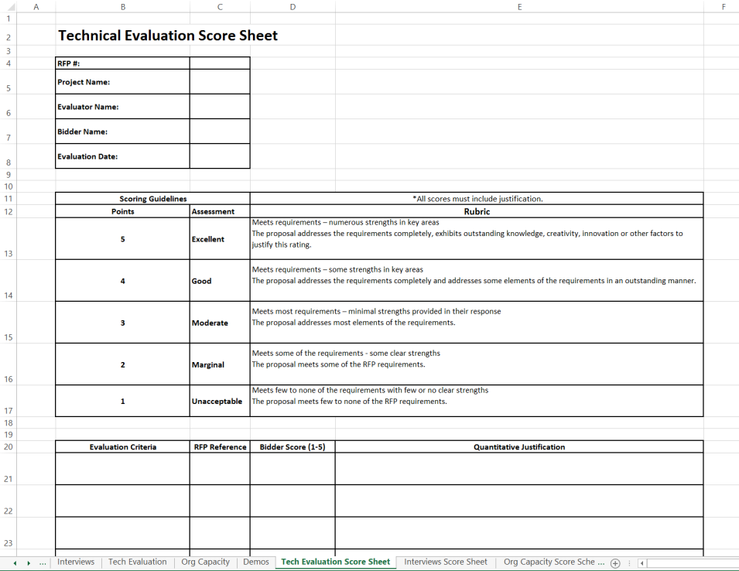
Tool – Technical Evaluation Score Sheet
Notes:
When the evaluator receives this score sheet, it should have the “Evaluation Criteria” and “RFP Reference” sections completed.
The evaluator will look at the Bidder Representative’s answer for this question and evaluate it based on the Rubric numbering system 1-5 above, based only on the information received from the representative’s answer.
The points given to that line must correspond directly with information written in the Quantitative Justification for those points.
Every line must have a Quantitative Justification for that line.

Slide 72
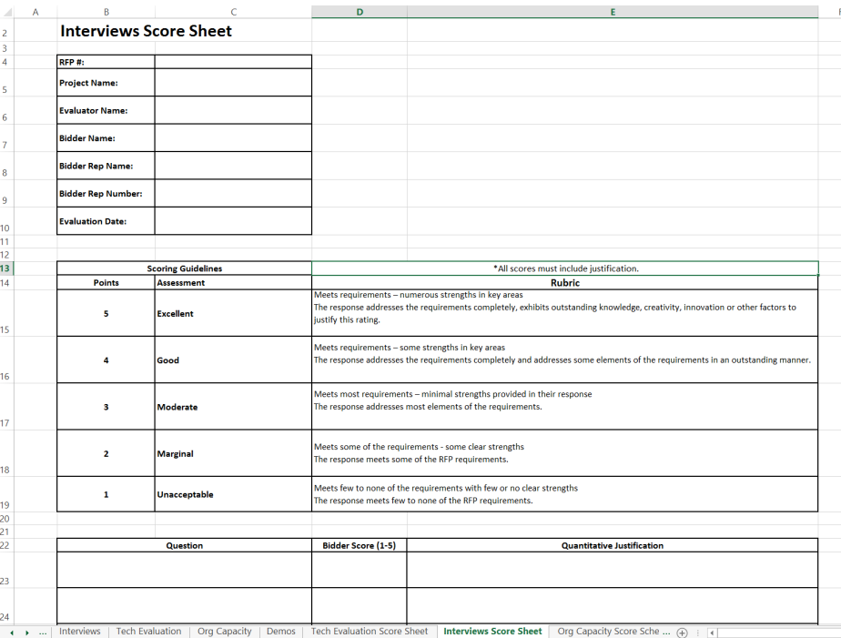
Tool – Interviews Score Sheet
Notes:
When the evaluator receives this score sheet, it should have the “Question” section completed.
It must be scored using the same procedure as used in the Technical score sheet.
REMEMBER: All information contained in the Evaluation Tool is subject to “Open Records” disclosure.
Where any information known to the evaluator, but not given in the interview, is well-documented and in the acquisition file, that information may be considered. All documentation regarding information outside the interview shall be subject to the Open Records Act.
It cannot be scored relative to another interview. No statements will be made regarding the relativity of the response to another bidder’s interview.
Only factual, interview information will be entered in the Quantitative Justification. No emotional statements will be made. No conclusions will be made based on feelings about that information or how it may score relative to another bid.

Slide 73
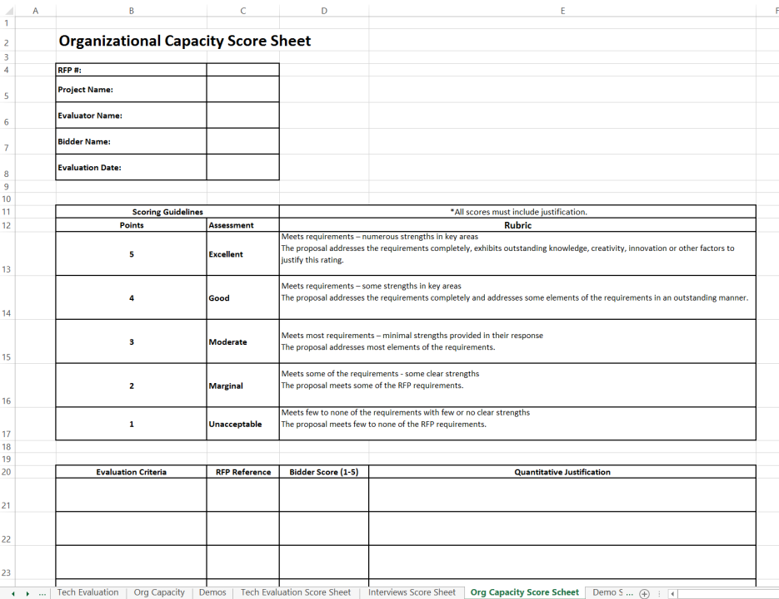
Tool – Organizational Capacity Score Sheet
Notes:
When the evaluator receives this score sheet, it should have the “Evaluation Criteria” and the “RFP Reference” sections completed and is to be scored using the same guidelines as the Technical Score Sheet.

Slide 74
QUESTION 6
All scores require justification.
In almost all cases, should the justification be written from a quantitative or qualitative point of view?
Quantitative

Slide 75
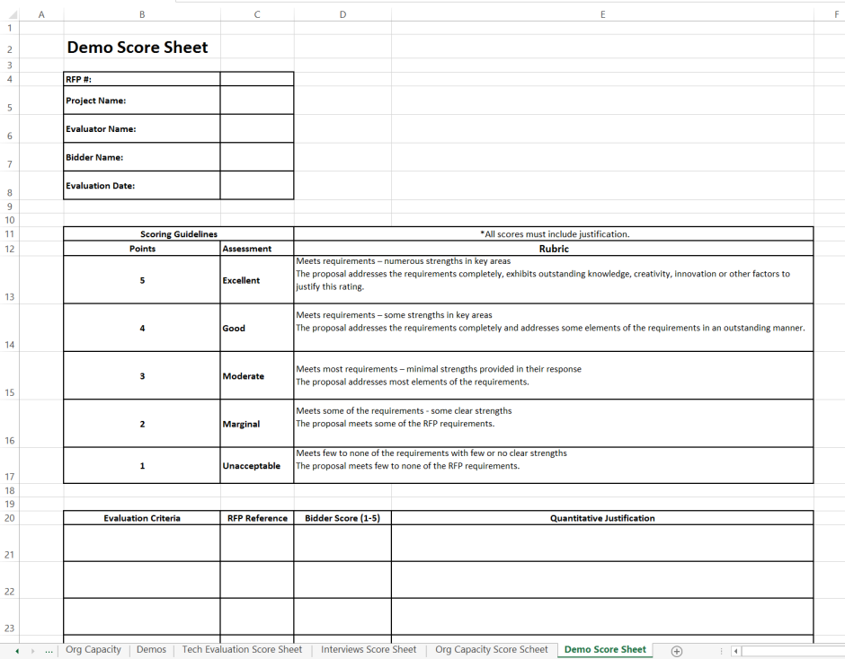
Tool – Demo (or Samples) Score Sheet
Notes:
When the evaluator receives this score sheet, it should have the “Evaluation Criteria” and the “RFP Reference” sections completed.
Depending on what is being evaluated or demonstrated, this category may have some criteria that requires a Qualitative Justification. Samples of air fresheners, caterers, bed sheets, singers may require a qualitative justification. Document as much as possible to justify the points given.
Demos for computer software may seem as though they are not easy to quantify, but with some breakdown of the attribute, there are usually some quantifiable criteria to be written for them.
Every line must have a justification for that line. If the criteria is quantified, the justification must be a quantifiable justification.
No information known by the evaluator not written on the bidder’s response can be used to determine the score.
It cannot be scored relative to another bidder’s sample or demo but against the criteria listed. No statements will be made regarding the relativity of the demo/sample to another bidder’s demo/sample.
Only factual, proposal-based information will be entered in the justification. No emotional statements will be made. A statement such as “The horseradish sauce was horrible.” should have been written “The horseradish sauce used may be too strong for some guest’s pallet.”
Try to evaluate demos and samples from a general public’s point of view unless you are an expert being asked to evaluate something to be used or consumed by experts.
Keep it professional. Keep it defendable. Understand that what is written on an evaluation document is subject to “Open Records” disclosure.

Slide 76
CONTINUE TO MODULE 11

