Slide 1

Solicitation Development
Module 8

Slide 2
Learner Outcomes
Students will:
Recall when contract administration begins and what contract administration assures.
Identify what a template provides in solicitation preparation.
Recall all legal considerations of contracting.
Identify the responsibilities of state agencies in bid protest.
Identify when a responding bidder may protest the award of a contract to the state purchasing director.
Recognize which contract awards can be protested.

Slide 3
Solicitation Tasks and Processes
Let’s take a look at some of the tasks and processes accomplished during the solicitation development process:
Recognize and identify the need.
Form an evaluation team from stakeholders and subject matter experts.
Identify the specifications, statement of work, or statement of objectives.
Prepare the request for proposal, invitation to bid or request for quote.
Prepare the source selection or evaluation tool.
Publicize the solicitation for competition.

Slide 4
Solicitation Tasks and Processes
Let’s take a look at some of the tasks and processes accomplished during the evaluation process:
Conduct a pre-bid meeting or Q&A – which may result in an amendment.
Evaluate the proposals based on the criteria stated in the solicitation.
Check references.
Determine whether the bidder is registered with the state.

Slide 5
Solicitation Tasks and Processes
Determine if negotiations are in order.
  Best and Final Offer may occur.
Award the contract to the bidder whose proposal is in the best interest of the state.
It is a solicitation until an award has been made. After the award has been made, it becomes a contract and everything that takes place after contract award is contract administration. Contract administration assures that a contractor’s total performance is in accordance with the contractual commitments.

Slide 6
Solicitation Development Process
Need Identification
Identify the reason for the acquisition or establishment of a new contract.
Determine if it is consistent with the mission of your agency.
Determine whether the item is exempt, a sole source, under existing contract or from another agency.
Verify any funding restrictions.
Determine whether special approvals or restrictions apply.

Slide 7
Identify the Need
Clearly identifying the need is essential to successfully meeting the need.
In some cases, the need is fairly easy to identify. For example, a printer is worn out and it costs more to keep repairing the printer than it would to replace it.
In other cases, there is an identified problem, but just meeting the obvious need has not resolved it. In this case you need to dig deeper.

Slide 8
Identify the Need
Now that you better understand the need, create a clear, concise statement of need.
The statement of need should include:
The situation, including identified causes or desired outcomes.
The facts supporting your request.
A target date by which the need should be resolved.

Slide 9
Solicitation Preparation
Solicitation Preparation
Identify scope, stakeholders, subject matter experts and critical business requirements. Other agencies or institutions may have subject matter experts who can participate to give you a more objective outcome.
Conduct a market analysis to identify available goods, services and suppliers (remember, it is your job to satisfy the “minimum” needs of the organization which is the primary objective of public procurement policy and results in cost savings).

Slide 10
Solicitation Preparation
Estimate expected contract award value or purchases for the fiscal year and any subsequent renewals.
Identify any possible risks associated with the acquisition or services implementation.
Address market and budget constraints.
Identify the best solicitation method.
Address delegated purchasing authority.
Plan the solicitation.

Slide 11
Solicitation Preparation
Who are my stakeholders?
A stakeholder is:
A recipient of project deliverable(s) and associated benefits.
Anyone whose life and environment will be directly enhanced or affected by the deliverable(s).

Slide 12
Solicitation Preparation
Who are my stakeholders?
A stakeholder is:
Citizen/taxpayer.
Bidder.
Agency personnel.
Department/division head and personnel.
Legislator.
Governor.

Slide 13
Solicitation Preparation
Your solicitation solicitation/evaluation team may include:
Suppliers (not participating in the bid).
End users (state or non-state individuals).
Agency subject matter experts.
Subject matter experts from other agencies or political subdivisions (such as higher ed., cities, counties).
Your solicitation/evaluation team should be informed from the beginning they will be required to sign a Non-Disclosure form (form 019) and a Conflict of Interest Statement (form 012).

Slide 14
Solicitation Preparation
What are Critical Business Requirements?
Critical Business Requirements are those tasks that go into determining the minimum needs or conditions to meet for a new or altered product, taking account of possibly conflicting requirements of various stakeholders.

Slide 15
Solicitation Preparation
Minimum Critical Business Requirements are:
Documented.
Actionable.
Measurable.
Testable.
Traceable.
Related to minimum identified business needs or opportunities.
Defined to a level of detail sufficient for product selection or design.

Slide 16
Solicitation Preparation
Now that you’ve identified and defined your needs and thoroughly researched and analyzed your scope, evaluation team members and critical business requirements, you’re ready to begin putting your solicitation together.

Slide 17
Solicitation Preparation
Here are some tasks you will need to accomplish during this stage of the process:
Identify whether a formal or informal process is needed and the authority level that will conduct the process.
Construct the solicitation and evaluation documents.

Slide 18
Solicitation Preparation
Use a template-A repeatable method for acquisitions provides a uniform solicitation format.
Using templates decreases the time you use looking up information related to solicitation questions.
Using templates saves time when your solicitation must be submitted to Central Purchasing or the CIO for processing.
OMES has several templates on its website to assist with preparation.
Standardization of the solicitation documents saves you time in preparation of the solicitation and allows the bidders a uniform format to work with when bidding with multiple agencies.

Slide 19
Solicitation Preparation
If you are submitting the solicitation to OMES for processing, you need only submit any special terms for Section B, the technical requirements, Statement of Work or Statement of Objective in Section C, your Evaluation Criteria Worksheet (to be used to prepare Section D) and the format desired for pricing (Section H). If you have a list of suggested bidders to be used in addition to the registered bidders, please submit it. Specific bidder contact information is required for you to update them during the process.
These documents should be submitted in one packet electronically in Word or (for pricing and agency forms) Excel formats together with your requisition to the OMES Central Purchasing mailbox.

Slide 20
Making the File Accessible
There are two ways to do this.
Scan plus Adobe method:
  Take the entire package (forms, sections, attachments), put it in order and scan them as a PDF. Save the PDF as accessible and searchable (this process will vary depending on what Adobe products are available). Reduce the file size to shorten the time it takes a bidder to download the package and lessen the possibility of it timing out before download.
Electronic Adobe Professional method:
  Create an accessible PDF from a group of electronically saved documents by assembling them with Adobe Professional, making them accessible, optimizing them for web or mobile publishing, and making them searchable.

Slide 21
Solicitation Preparation
All special approvals (such as AG approval for attorneys, Form 115’s for IT, any waivers to mandatory sources or treasurer’s approval for payment systems), should be sent with the requisition.
Always include the contact information of the procurement professional in your agency who will be the contact for OMES during the solicitation process.
When adding information to the solicitation packages, each paragraph is formatted in Word by “Style” using Heading 1, 2, 3 and so on as needed.
  When you format the paragraphs this way, it allows the document to be accessible and function with accessibility software when converted to a PDF document.

Slide 22
Defining Solicitation Requirements
A thoughtfully prepared solicitation clearly sets forth the agency requirements or desired results.
A thoughtfully prepared solicitation is well-structured.
In the case of a complex category – such as IT projects – where content, functionality and pricing can vary widely between bidders, a well-defined structure is not easy to achieve, but templates make the process easier.
In a case where there may be multiple solutions, the Performance Information Procurement System Best Value process can assist you with the unknowns.

Slide 23
Skills for Writing Solicitations
Write the solicitation so it can be understood by a layperson.
Peer review is recommended.
Edit, edit, edit!
Eliminate redundancies and restatement of same requirements.
Eliminate as many mandatory requirements as possible to allow for greater competition.

Slide 24
Defining Solicitation Requirements
Do not use out-of-date specifications or forms.
Contact other state agencies or entities who might be using the same or similar products/services.
Contact OMES to see if they have recent specifications you can review.
Look at NIGP and other websites for examples of solicitation packages.
Consider benchmarking other states or using a Request for Information to gather requirement information.
Consider using the PIPS Model.

Slide 25
Tips for Successful Buyers
Buyers will be successful in their acquisition activities when they:
Understand and know the approved internal purchasing procedures for their agency.
Know the statutes, understand and follow the rules applicable to public purchasing.
Correctly use the appropriate procurement approach.
Pay attention to the details, regardless of the acquisition method.

Slide 26
Risks of a Poorly Drafted Solicitation
A poorly written solicitation leaves room for:
A supplier to:
  Respond to your requirements and not your desired outcome.
  Fail to do something needed to meet your outcome because you failed to state it in your requirements.
  Misinterpret your desired outcome.
Waste, fraud and abuse.
Failed supplier relationships.

Slide 27
Solicitation Website
There are numerous open, closed and awarded solicitations on the OMES website. They are good reference materials when you are considering what clauses might benefit your solicitation.
The following slides will show how to navigate the solicitation/statewide system.

Slide 28
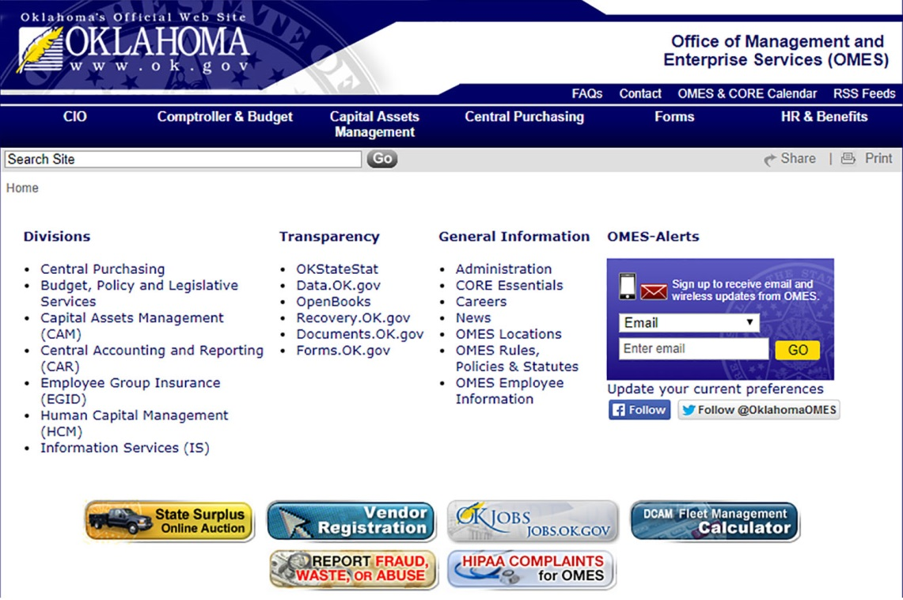
www.omes.ok.gov

Slide 29
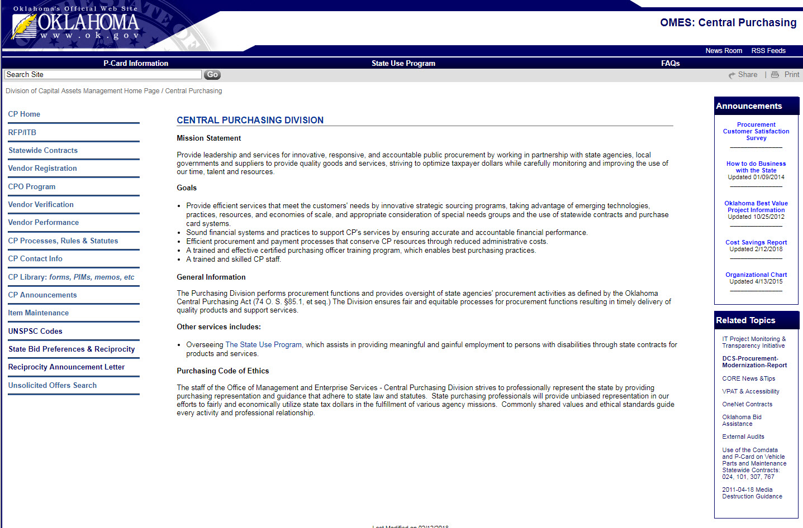
Select RFP/ITB

Slide 30
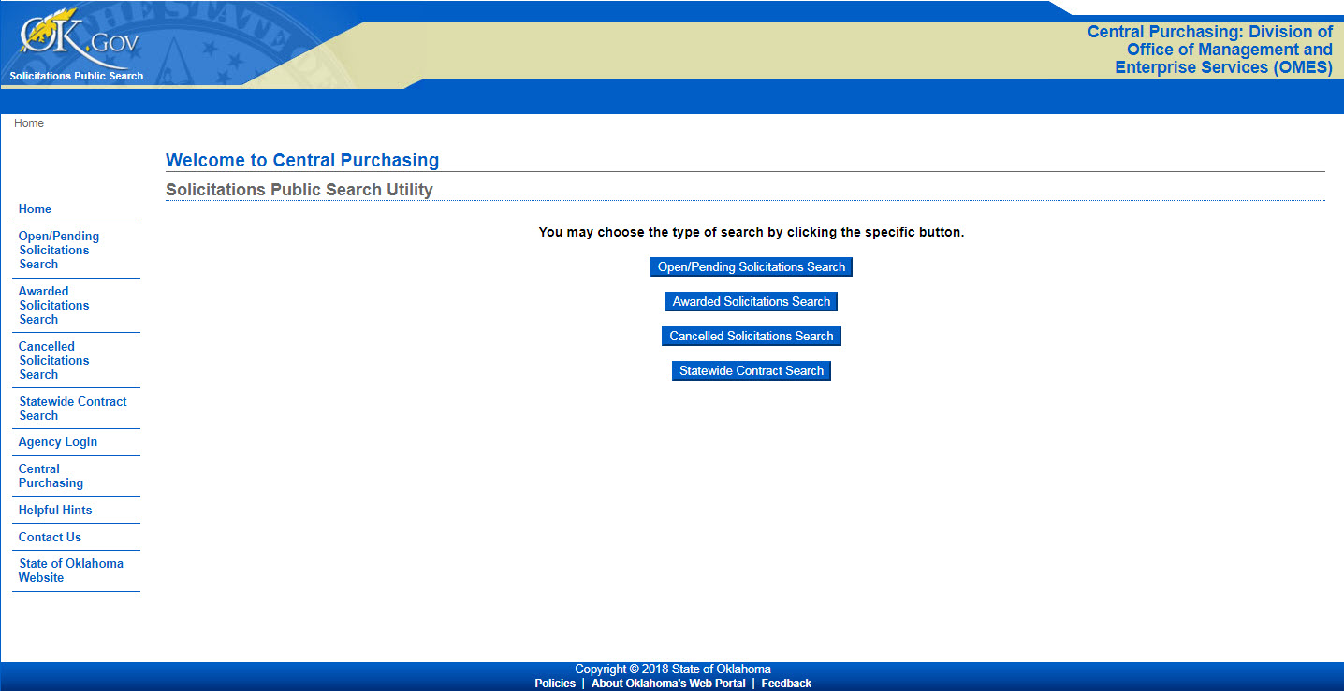
Select Status

Slide 31
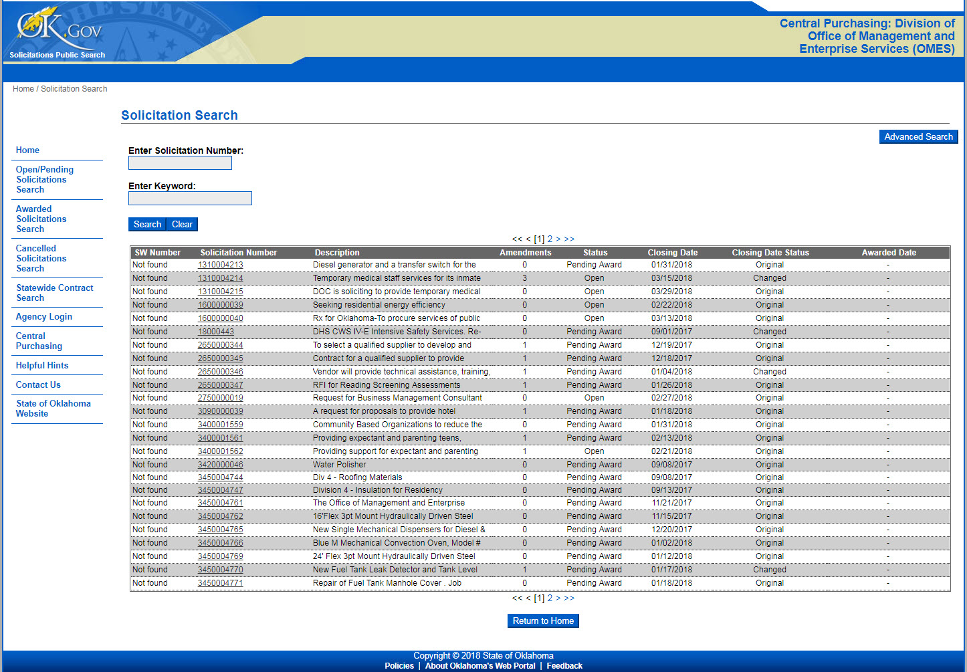
Enter Keyword

Slide 32
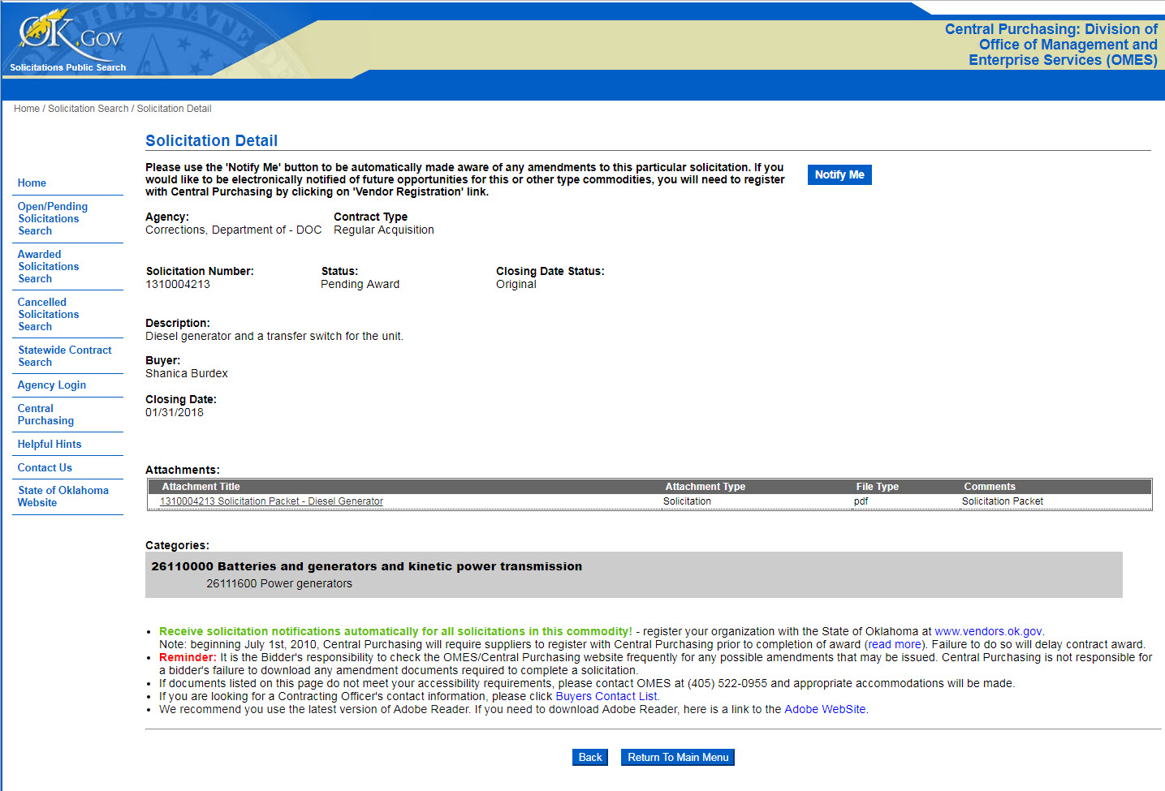
Solicitation Details

Slide 33
Now that you’ve read and understood the previous information, you can begin to develop your solicitation packet. The solicitation packet will be discussed in the next module in further detail; however, we will be moving forward with the procurement process in the following slides.

Slide 34
Solicitation Package
Other general information
  Your agency may chose to develop a suggested package of special terms and conditions to be used in most of your solicitation packages. You can work with your general counsel or administrator on developing a standard terms file or checklist of requested terms for your agency to use depending on the function of your agency.
  You can always call the contracting officer at OMES Central Purchasing assigned to that commodity for assistance or examples of other packages and they may be able to supply you with similar terms used on other projects.

Slide 35
Bidding Process
State Actions:
Publicly advertise solicitations.
Conduct pre-bids or bidder education when needed.
Conduct end-user education when needed.
Manage communications
  Clarify questions, conduct interviews as needed, ensure all bidders receive the same information.
Amend or cancel solicitations as needed.
Receive bidder responses and close the solicitation.

Slide 36
Bidding Process
Bidder Actions:
Access and review solicitations.
Ask for clarification as needed.
Prepare and submit the response.
Revise or withdraw the response.

Slide 37
Evaluation Process
State Actions
Negotiations
  If negotiations are required you must:
    Have included the right to negotiate in your RFP.
    Require the bidder to have someone present with the authority to obligate their company in a contractual situation.
    Develop an agenda of the items to be negotiated and the parties that will be present during the negotiations. Both the state and the bidder should have a copy of the areas of negotiation prior to the meeting.
    Some state terms and conditions cannot be negotiated. Any term required by statute cannot be negotiated, such as Audit and Records or Venue.

Slide 38
Best and Final Offer
In competitive negotiation, the final proposal is submitted after negotiations are completed and contains the proposer’s most favorable terms for price of services and products to be delivered.
The option to negotiate must be provided in the solicitation.

Slide 39
Evaluation Process
Supplier Actions
Respond to requests for clarifications, if any.
Participate in interviews, demonstrations or negotiations, if any.
Participate in contract discussions, if any.

Slide 40
Award Process
Once the evaluation has been completed and a determination has been made, the award process begins …

Slide 41
Award Process
State Actions
Verify your bidder is a registered vendor with OMES. Having a Vendor ID does not mean the bidder has a current registration with OMES. Bidders are required to register annually.
Make sure your bidder is registered with the Secretary of State (if the award exceeds $25,000) and the tax commission and has submitted the insurance requirements before awarding contract.
Provide public notice of solicitation results.
Have all solicitation records available for prompt review by suppliers. Not all information submitted by a bidder is subject to open records. When in question, contact the state purchasing director for a ruling.
Issue contract award.
Participate in protest process if it is submitted.

Slide 42
Award Process
State Actions
There are many types of contracts used, depending on which department of OMES you are contracting through. The type of contract not allowed when you are using federal funds is “Cost Plus Percentage Cost.”

Slide 43
Award Process
Supplier Actions
Receive contract award as applicable.
Contact user agency for Notice to Proceed.
Participate in protest process as applicable.
  Protests should be filed within 10 business days of the award of contract (online posted award).

Slide 44
Bid Protests
What contract awards can be protested?
  Contracts awarded by O.M.E.S.
  Contracts awarded by a state agency.
Bidder has 10 business days following contract award in which to protest to the state purchasing director.

Slide 45
Bid Protests – Responsibilities of State Agencies
Do what the solicitation says you are going to do.
Provide documentation and testimony to defend the bid protest.

Slide 46
Contract Drafting
Say what you mean, and use consistent terminology.
  Donuts, chocolate-glazed donuts or breakfast pastries?
Beware the “and/or.”
  Certification as an officer and/or a gentleman.
Punctuation saves lives.

Slide 47
Legal Considerations in Contracting
Choice of law – what state’s laws will prevail.
Choice of venue – county where the lawsuit will be heard.
Limitation of Liability.
  Hold harmless.
  Ex: Indemnification clause.

Slide 48
Legal Considerations in Contracting
Termination of Contract
Grounds for terminating OMES contracts are found in OMES CP Rules. OAC 580:16-9-8
Known as Termination for Cause or Termination for Default:
  It is the most appropriate termination method to use when a contractor fails to meet contractual performance or delivery requirements.
  Breach of contract, i.e., no bond as required, failure to deliver, faulty goods, misrepresentation, error in performance …
Termination for Convenience is used as the “funding out” clause or it is done because it is in the best interest of the state. These are used very judiciously.

Slide 49
Record Retention
Each state agency shall maintain a document file for each acquisition the state agency makes which shall include, at a minimum, justification for the acquisition, supporting documentation, copies of all contracts, if any, pertaining to the acquisition, evaluations, written reports if required by contract, and any other information the State Purchasing Director requires be kept.

Slide 50
Contract Administration
Now that the contract has been awarded and negotiated, we enter the contract administration phase …

Slide 51
Contract Administration
State Actions
Administer and manage the contract
  Service contracts are required to have someone designated to administer the financial as well as the performance part of a contract.
Work with supplier to resolve any contract disputes.
Complete contract closeout tasks.
Evaluate contractor performance
  Professional service contracts require the OMES evaluation form to be completed within 30 days of the end of a contract and a copy to be retained in the procurement file. If the performance was unsatisfactory, you are required to send a copy to OMES Central Purchasing.
Document cost savings to the state for reporting.

Slide 52
Contract Administration
Supplier Actions
Perform under the contract requirements.
Work with state entity to resolve any contract disputes.
Maintain a current bidder registration to be eligible for any possible renewals.
Deliver any “as builts,” diagrams, reference or training materials and warranties to state agency for future needs.
Return any state-owned property or information at the end of the contract.

Slide 53
CONTINUE TO MODULE 9

