Slide 1


Purchasing Guidelines

Slide 2

2015 CPO Training Course

Slide 3
Ferris Barger
State Purchasing Director
Central Purchasing

Slide 4
Course Overview
Day One:
Opening Remarks –
Purchasing Guidelines –
State Use
Oklahoma Correctional Industries
Ethics, Sole Source, Reciprocity
Solicitation/Statewide Website
Solicitation Development
Solicitation Exercise
Fixed Rate Acquisitions, Agency Internal Purchasing Procedures, Emergency Acquisitions
Review/Evaluations

Slide 5
Course Overview
Day Two:
Construction & Properties
Real Estate & leasing
Fleet
Information Technology
Audit
Legal
P-Card & Travel
Test Review

Slide 6
Course Overview
Day Three:
PIPs
Strategic Sourcing
Specifications
Puzzle
OMES/DCAM Websites, Procurement Information Memorandums(PIMs)
Common Sense Negotiations
Acquisition Evaluation
Legal Research & Online Resources
CEUs/Review/Fill out evaluations

Slide 7
So you want to be a Certified Procurement Officer (CPO)?
Attend 3-day course (all sessions)
Pay $500.00 for CPO course
Pass CPO examination (70%)
Test dates: Sept. 25th, 2015
Bring photo ID
Allow 4 hours for testing
One re-test allowed
Re-test: Oct. 2nd, 2015 (will be re-scheduled on your behalf should it be necessary)
Human Capital Management in
Jim Thorpe Building

Slide 8
Two year CPO Revalidation
Requires 24 hours of Continuing Education Units (CEU) over a two year period beginning at the first of the year following your initial certification.
Form 22 must be completed for all courses not appearing on the approved form.
All classes need to be pre-approved by Central Purchasing prior to attendance
http://www.ok.gov/OSF/
  Central Purchasing
    CPO Training Program
      Courses approved for CPO credit

Slide 9
CENTRAL PURCHASING DIVISION
Mission Statement:
Provide leadership and services for innovative, responsive, and accountable public procurement by working in partnership with state agencies, local governments and suppliers to provide quality goods and services, striving to optimize taxpayer dollars while carefully monitoring and improving the use of our time, talent and resources.
Objectives are to:
Add value and assure compliance with State Laws

Slide 10
What is the primary objective of public procurement?
To satisfy the minimum need
of the organization!

Slide 11
We are Governed by: The Central Purchasing act
Title 74 O.S. § 85.1
All state agency activities relating to purchasing shall be under the direction of Central Purchasing (C.P.) unless otherwise provided by the Oklahoma Central Purchasing Act.

Slide 12
The State Purchasing Director
The State Purchasing Director (SPD) has sole and exclusive authority and responsibility for all acquisitions used or consumed by state agencies, except for Information Technology related goods and services
  Authority is delegated to CPO’s by “Law of Agency”. The Law of Agency states that an agent is someone who acts on behalf of a principal.
Has the authority to certify state
agency purchasing officials as
Certified Procurement Officers
(CPO)

Slide 13
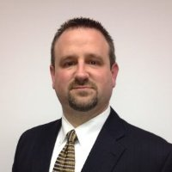
Chief Information Officer
The Chief Information Officer shall have sole and exclusive authority and responsibility for all acquisitions of information and telecommunications technology, equipment, software, products and related peripherals and services used or consumed by state agencies.
Chief Information Officer
Bo Reese

Slide 14
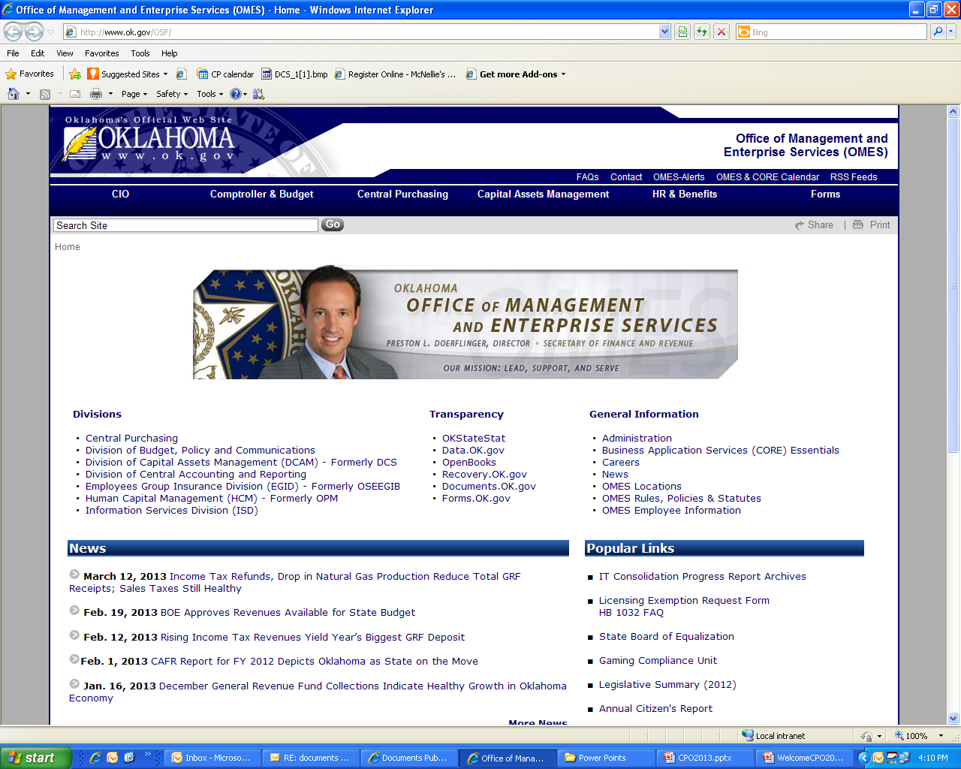

Slide 15
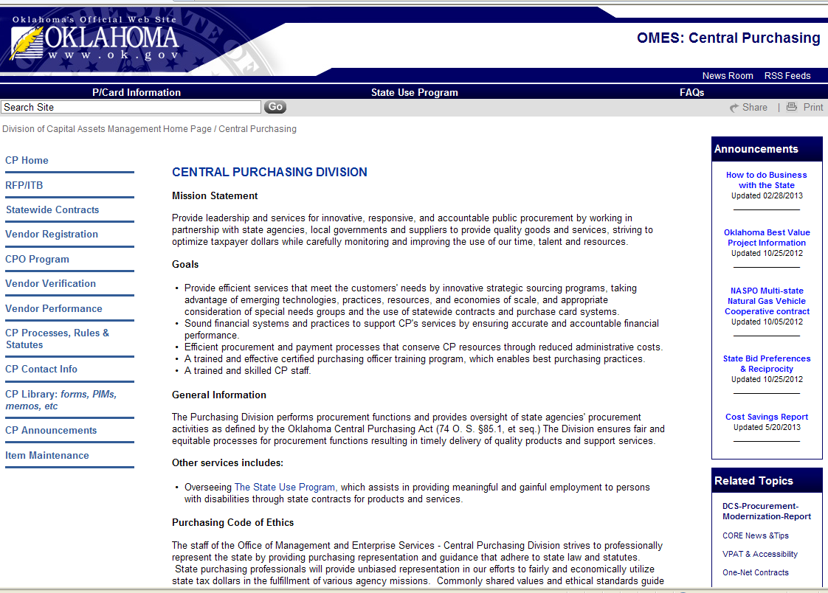

Slide 16
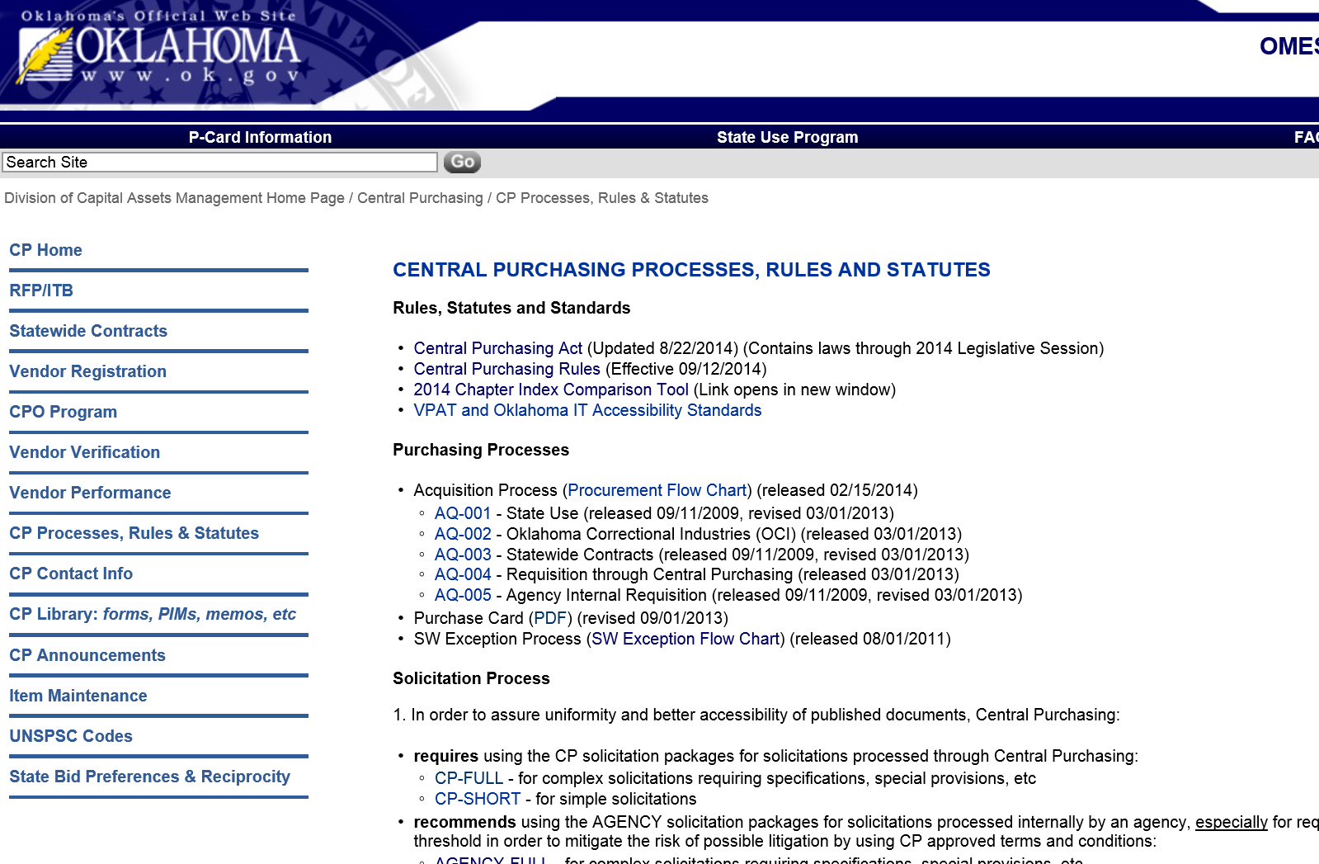
Purchasing Procedures Rules & Statutes
http://www.ok.gov/DCS/Central_Purchasing/CP_Rules_&_Statutes/index.html

Slide 17
Statute and Rule Changes
(HB 1032)
All State Agencies can purchase at least $5,000 ~
Agencies with CPO and Internal Procedures:
Agency < $5,000 (fair & reasonable)
Agency $5,000.01 < $10,000 ( 3 quotes reg. bidders)
Agency $10,000.01 < $25,000 (10 quotes reg. bidders)
Agency $25,000.01 < $50,000 (all registered bidders)
Agency $50,000.01 < $100,000 (by approval of SPD)

Slide 18
Impact of House Bill 1032 on Central Purchasing Act (Title 74) effective August 26, 2009
Section 85.5.C.11.a. – fair and reasonable dollar threshold raised from $2,500 to $5,000
Section 85.5.G.4. – renegotiate existing contracts prior to cancelation, cannot extend term
Section 85.5.L.2. – State P-Card $2,500 to $5,000
Section 85.7.A.1 – Agency limit rose form $25,000 to $50,000 or as authorized by SPD not to exceed $100,000

Slide 19
Impact of House Bill 1032 on Central Purchasing Act (cont.)
    Section 85.43.A. (– D. ) -- The Chief Administrative Officer of an agency shall submit to the SPD and the State Auditor and Inspector by November 1st, a report of all purchases greater than $50,000 but not in excess of $100,000
Section 85.5.T – allows for agency acquisitions in excess of $100,000 provided:
  Subject matter experts on staff
  Necessary legal and procurement staff
  Certification from the Director of the Department of Central Services that acquisition does not conflict with a SW initiative
  Agency responsibilities:
  contract management
  legal fees associated with defense of protests

Slide 20
http://www.ok.gov/DCS/Central_Purchasing/CP_Rules_&_Statutes/index.html

Slide 21
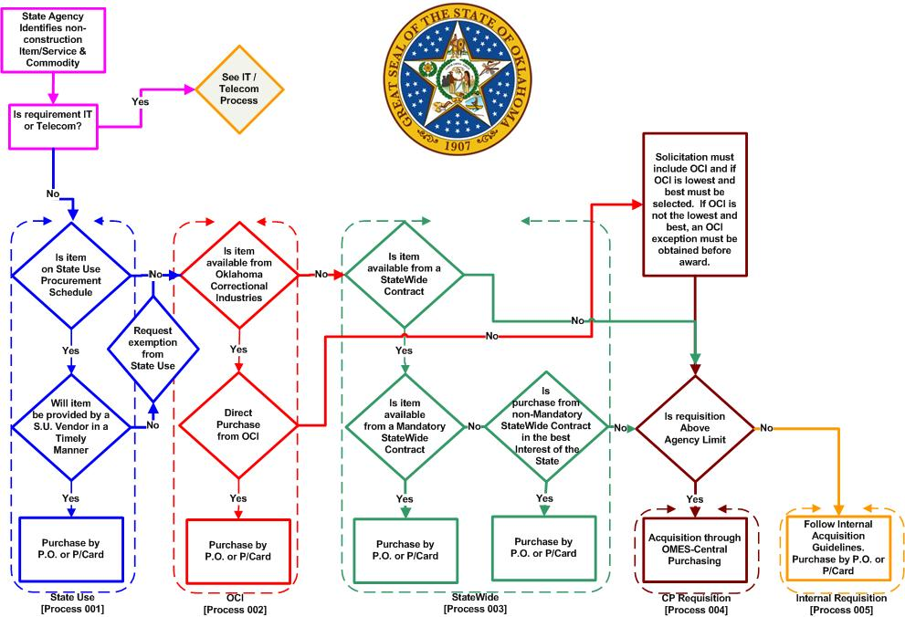

Slide 22
What solicitation process do I utilize????
Agency < $5,000 (fair & reasonable)
  No solicitation required, some market research recommended
Agency $5,000.01 < $10,000 ( 3 quotes, if available)
  Request for Quote (RFQ) phone or fax, document file from registered bidders. Considered informal solicitation process
Agency $10,000.01 < $25,000 (10 quotes, if available)
  Request for Proposal (RFP) or Invitation to Bid (ITB) solicit written proposal from registered bidders.
Agency $25,000.01 < $50,000 (all registered vendors)
  Request for Proposal (RFP) or Invitation to Bid (ITB) solicit written proposal from bidders.
Agency $50,000.01 < $100,000 (by approval of SPD)
  Request for Proposal (RFP) or Invitation to Bid (ITB) solicit requiring written proposal from suppliers.

Slide 23
General Procurement Issues
Requisitions:
  Agency acquisitions processed by C.P. must be initiated by an agency written request (requisition)
Waivers:
  Title 74 § 85.7.A.1.
    The State Purchasing Director may waive or increase the limit authorized for a state agency acquisition by not more than ten percent (10%) to perfect an otherwise valid acquisition in advertently exceeding the limit due to administrative error by the state agency or unforeseeable circumstances.

Slide 24
General Procurement Issues
(continued)
Open Market Purchase
  A one-time purchase that does not exceed the threshold requiring competitive bid
  Split Purchasing
  Dividing a known quantity or failing to consolidate a known quantity for purposes of evading a competitive bid requirement or p-card threshold
  Split purchasing is a felony offense

Slide 25

General Procurement Issues
(continued)
Public Finance
  Title 62 in the Oklahoma State Statutes
Lease-Purchase Agreements
  Title 74 § 85.4.I. 1-4
  No state agency shall enter into a lease-purchase agreement for real property costing LESS than $50,000
  Council of Legislative Bond Oversight shall have the authority to determine the most cost effective method for obtaining financing and is subject to provisions of the OK Bond Oversight & reform act.
  Financing shall be competitively bid through Central Purchasing

Slide 26
General Procurement Issues
(continued)
Public Sale Procedures (74.85.44.C.)
  It is unlawful to enter into a contract in which the agency furnishes materials or equipment to be used by the vendor if the contract allows the vendor to acquire ownership except through competitive bid
Statewide Contracts
  Competitively bid by Central Purchasing
  Specific contract period
  Specific type of acquisition
  Indefinite delivery type
  Reduces agency administrative burden by allowing agencies to place orders as supplies or services are needed

