Slide 1

State of Oklahoma
Office of Management and Enterprise Services
SW Contract 200
Oklahoma State Purchase Card

Slide 2

Why P-card rather than purchase order?
Saves agencies money.
Quicker payment to the supplier.
Rebate to agencies.
Better transparency.

Slide 3
Definitions
AO – Authority Order (very similar to purchase order, PO).
EMV – Stands for Europay, MasterCard and Visa. Also called Chip and PIN card,
EMV and Chip and PIN are used interchangeably.
IT – Information technology. Refers to computers and telephones and all related
services and equipment.
MCC – Merchant Category Code. This code is assigned by the credit card industry
based on the main type of business a merchant conducts.
P-card – Purchase card.
PIN – Personal Identification Number. Four numeric digits assigned for use with
EMV/Chip and PIN cards.
Works – The bank’s web-based transaction system for online reconciliation of purchases.

Slide 4
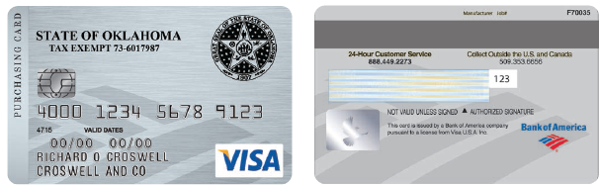

The State of Oklahoma authorized P-card is a corporate liability card Visa purchasing card issued by the Bank of America (BOA).
The P-card is now an EMV or Chip and PIN card (PIN numbers mailed separately); the chips are encrypted and create a unique transaction code that cannot be used again.
Zero liability for unauthorized charges or for lost or stolen cards. (Bank must be notified within 24 hours).
4

Slide 5
Activating and using your card
When you receive your card there is a sticker across the
front with a phone number. Call the number and key in your 16-digit card number. Provide the verification ID that has been provided to you by your P-card administrator.
Your purchases will be declined until your card has been
activated!
Once your card has been activated and registered, you may begin to use your card. You will insert the card into the machine and it will prompt you for your PIN. The card will remain in the machine throughout the checkout process. Using the Chip and PIN card is slower than the quick swipe of a card without the embedded chip.

Slide 6
Card registration and PINs
Card numbers must be registered online at www.bofaml.com/globalcardaccess.
If you forget your PIN you may retrieve it from this website.
If you don’t have access to the internet, you can contact customer service to request a PIN reminder mailer. PINs cannot be provided over the phone. Your PIN can only be retrieved if the card has been registered.
6

Slide 7
Executive Advisory Group
The agency decides who has a card, who the approvers are,
and appoints the
administrator.
State Purchasing Director
State P-card Administrator
Agency P-card Administrator
Agency
Approving Officials
Agency
Approving Officials
P-card Holders
P-card Holders
P-card Holders
P-card Holders
7
Notes:
Approving Officials are one level above the cardholder based on the agency’s organizational chart.

Slide 8

References
All purchases shall be made in accordance with state statutes, rules and these procedures, which include but may not be limited to:
  Central Purchasing Act, 74 O.S. § 85.1 et seq.
  State Travel Reimbursement Act (STRA), 74 O.S. § 500 et seq.
  Central Purchasing Codified Rules, 260:115.
  State Purchase Card procedures.
  Oklahoma State Travel Policy.
  Oklahoma Ethics Commission rules.
  State agency internal purchasing and P-card procedures.
  Other statutes pertaining to specific types of purchases.
8

Slide 9

IT and Telecom purchases
If your agency has set up an IT AO, the following IT purchases may be made with the P-card:
  Transactions up to $5,000 if items are listed on the published hardware/software list.
  Transactions up to $15,000 if items are listed on the published hardware and software list AND items are purchased from a statewide contract supplier.
See Information Services procurement policies and the IT and Telecom ePro requisition procedures for guidance.
See PIM 06302015 and P-card procedures section 5.6
IT contact information: OMES Service Desk 405-521-2444
servicedesk@omes.ok.gov
9

Slide 10

Encumbering funds
Authority Order (AO)
  AOs must have sufficient encumbrance to cover all transactions before making the transaction (Encumbrance Law § 62-34.62).
    Change orders to amend the encumbrance may be processed as necessary.
    A new AO should be issued each new fiscal year.
Funds cannot be spent without this AO in place before making the purchase.
Increases in the encumbrance amount must also be completed BEFORE a purchase exhausts the funds on a given AO line.
10

Slide 11
Employee participation
All participants must read and sign the Purchase Card Employee Agreement.
All P-card participants must complete initial training conducted by OMES.
Financial report submitted annually, available on the Oklahoma Ethics Commission website (for cardholders making purchases of $50,000 or higher). See Links page for link to website.
Refresher training is now determined and conducted internally by your agency P-card administrator. You will need to contact them for additional information and guidance specific to your agency.
Training is still required at least once every two years.
11

Slide 12

Safeguards
Each agency appoints cardholders.
Each agency sets limits on each card.
Approving official review.
Each agency determines disciplinary actions.
Performance and Efficiency Auditing tracks fraud and misuse.
12

Slide 13
Using the card
Purchases can only be made within your single transaction limit and credit limit assigned to your card.
You are responsible for reconciling all transactions.
P-cards cannot be used to avoid or bypass appropriate purchasing or payment procedures.
P-card is not for personal use.
You must ensure prices paid are fair and reasonable.
You should ask the merchants if they accept Visa rather than if they accept the P-cards, since many of them do not know what a P-card is.

Slide 14


Methods of purchase
          Telephone Walk-in
(POS or face-to-face)
Internet
  Make certain internet site is secure, for example:
    “s” on the end of https means it is a secure site.
    Padlock will appear on the site.
SW 690 – Road Oil
SW 670 – Aggregate
SW 081 – Asphalt

Slide 15
Refunds and returns
Return item to merchant in manner agreed upon.
Credits – If the agency is credited for any items or services that were originally paid for with the purchase card, then the credit needs to be processed through the merchant system. The vendor should not be allowed to maintain an in-store credit or use the credit toward other invoices.
Merchant provides credit receipt documentation.
  Place with end-of-cycle transaction documentation for reconciling.
Include with the payment at end of month.
  Credit may not appear until subsequent statement.
15

Slide 16

Prohibited purchases
Split purchasing.
Entertainment.
Per Diem food.
Cash or cash advances.
Purchase of goods or services for personal use or not for official state use.
Any transaction or series of transactions exceeding your P-card limits.
Motor fuel (for state-owned and personal vehicles and equipment) and automotive general maintenance.
Automatic drafts (we do not want them to have the card number on file).
Gift certificates.

Slide 17
Request for exception
A request for exception form can be completed requesting to make a purchase, even if the MCC is blocked.
Contact your entity P-card administrator with the pertinent details of your need.
Your P-card administrator will complete the request for exception form and send to our office. If approved, your administrator will be notified and they in turn will notify you.
Your card will be moved into an exception profile for a short period of time to allow the transaction to be processed.
17

Slide 18
Convenience fees vs. surcharges
Convenience fee: A fee charged to the cardholder for the convenience of
paying online or by phone - the price of the product doesn’t change.
Surcharge: A fee assessed by the merchant when using a credit card for
payment to recoup the merchant fees charged by the card processing company.
Surcharges are prohibited in Oklahoma by law, though convenience fees are not prohibited. If a utility company utilizes a third-party processor for credit card payment processing, this is a convenience fee (not prohibited per OMES legal team).
To avoid convenience fees, agencies may opt to pay companies charging these fees by PO. If a company limits the amount of payment accepted
per transaction, you could incur more than one convenience fee to pay the entire invoice.

Slide 19
Convenience fees vs. surcharges (cont.)
Title 14A O.S. § 2-417 of the Oklahoma Statutes states:
No seller in any sales transaction may impose a surcharge on a cardholder who elects to use a credit card or debit card in lieu of payment by cash, check or similar means.
As used in this section, “debit card” means any instrument or device, whether known as a debit card or by any other name, issued with or without fee by an issuer for the use of the cardholder in depositing, obtaining or transferring funds from consumer banking electronic facility.
For purposes of this section, a private educational institution as defined in paragraph (e) of section 3102 of Title 70 of the Oklahoma Statutes may charge a convenience fee. The convenience fee shall be limited to bank processing fees and financial transaction fees, the cost of providing for secure transaction portal fees, and fees necessary to compensate for increased bandwidth incurred as a result of providing for an online transaction.
While convenience fees are allowable, Okla. Stat. tit. 14A. § 2-211 holds that the seller has to be registered with the United States Treasury Department as a money transmitter pursuant to 31 CFR, § 103.41. You are usually going to see these with an entity providing an electronic funds transmission service, including service by telephone and the internet. (Ex: I pay my cable bill over the phone. My bill doesn’t change. I’m paying a convenience fee for not mailing anything, etc. and doing it over the phone while I’m still in my pajamas.)

Slide 20

Card limits
There is no limit on the amount of a P-card transaction for the following:
  Statewide Contract purchases.
  Utilities (water, electric, gas, sewage).
  Interagency payments.
  Professional services as defined in 18 O.S. § 803.
For all other transactions with a state purchase card, each transaction shall not exceed $5,000.00.

Slide 21

Interagency payments
Interagency is defined according to 74 O.S. § 1003 (Inter-local Cooperation Act) and includes, but is not limited to:
  Political subdivisions.
  Federal government.
  Public trusts.
Interagency payments between state agencies, universities and colleges:
  Should be made by voucher, selecting the payment method “WIR.”
  DCAR Newsletter, Vol. 21, No. 7, dated Feb. 18, 2011 (Page 3).
  Although “WIR” is the preferred method of payment, agencies can choose to accept P-card payments from other agencies, so be sure and ask the agency if they accept the card and what the limits are they’ve placed on interagency payments.

Slide 22
At the time of need, check:
State Use Contract
If not selected obtain an exception from State Use before purchase.
OCI
If not selected obtain an exception from OCI before purchase.
Statewide Mandatory Contract
If not selected obtain an exception from Central Purchasing before purchase. Exception to this is SW817 and SW817-P.
Statewide Non-mandatory Contract.
Open market – best price (fair and reasonable).

Slide 23

State Use
Utilizing Talents/Satisfying Needs/
Empowering Individuals
Oklahoma Statute Title 74,
Chapter 48, Sections 3001-3010
What is State Use?
Set-aside program established in 1974 to provide employment opportunities to
persons with severe disabilities.
Operated through qualified, nonprofit organizations that supply products
and services to the state.

Slide 24
State Use procurement schedule
First source when searching for goods and services.
All registered vendors in the State Use Program listed.
All products and services provided by State Use vendors listed.
Statewide contract number and price.
Remaining items (suitable to procure list) – State Use vendors must be included in any bid or quote.

Slide 25
State Use contacts
Not included in workbook
Daron Hoggatt – State Use administrator
405-521-4474
Cell 405-568-6108
Daron.Hoggatt@omes.ok.gov
Teresa Sherwood – administrative assistant
405-522-3367
Teresa.Sherwood@omes.ok.gov
Mary Brown – procurement officer
405-521-2128
Mary.Brown@omes.ok.gov
Amanda Wagaman – State Use liaison
Cell 405-626-0973
Amanda.Wagaman@omes.ok.gov

Slide 26
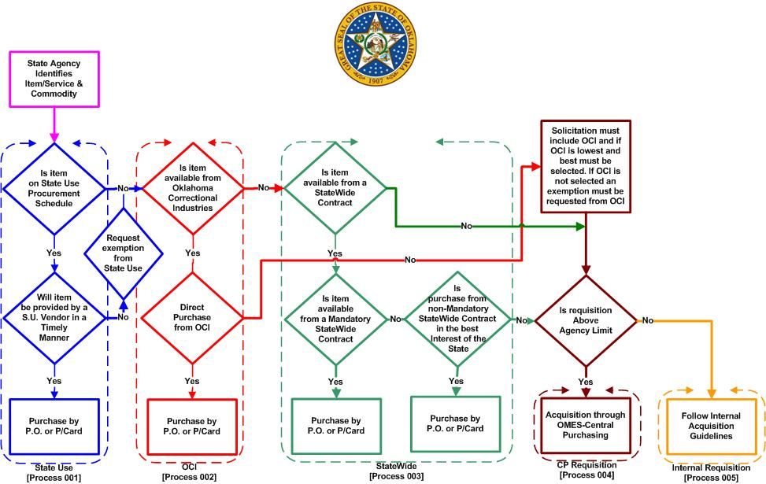
Central Purchasing procurement flow
Not included in workbook

Slide 27

Card security
P-card is only for use by the person whose name is on the card.
Do not loan your card to anyone.
Do not use another person’s card.
If possible, file card in a secure, locked place when not in use.
  Immediately report any lost, stolen or compromised cards to BOA at 888-449-2273.
  Entity is responsible for purchases on lost, stolen or compromised P-
  cards until Bank of America is notified.

Slide 28

Temporarily gone from work
What happens if I am gone for a
period of time from work?
The P-card administrator can put your card in “suspense” $0.00 available while you are away.
You should leave your card locked up at the office.
If the end-of-cycle statement option is selected, your cardholder statement must still be signed and turned in at the end of the month.
P-card holder is responsible for making sure the statement is complete with all required documentation.
Contact your P-card administrator to arrange end-of-cycle process if away during the end-of-cycle timeframe.

Slide 29
Fraud vs. misuse/abuse
How does fraud happen?
An outside entity uses my card information for personal use.
How do I know it’s happened to my card? The bank will call or email the cardholder or you will see the charge in Works.
What do I do about it? Contact the bank and your P-card administrator to have your card closed, the charge credited and a new card issued.
How long does card replacement take? Replacement cards can be overnighted; however, regular delivery time is about four days.
Misuse – A violation of procedures/policies for personal gain.
Abuse – A violation of procedures/policies for work-related gain.

Slide 30
When fraud is identified by the bank, Bank of America may send an email to the cardholder, if there is an email address listed in Works, or call the cardholder.
The agency P-card administrator may receive a phone call.
The bank will confirm which transactions are allowed to be paid vs. those that they will reject.
The bank will close the card and reissue a new card.
Note: Accurate information is required to be in Works since if the bank calls the state P-card office, the card will automatically be closed and reissued. This could be a problem for frequent travelers or travel arrangers.

Slide 31
Data breaches
Not included in workbook
Data breaches are different than fraudulent transactions as they generally
do not result in an immediate fraudulent transaction on the P-card.
Data breaches happen when a merchant’s database is infiltrated by a
hacker. Usually a cardholder doesn’t see a purchase as a result of a
data breach for several months or even years. Those who acquire card
information this way will ‘sit’ on the information for a while and then
begin using it after the ‘panic’ has subsided. Bank of America is proactive
in these situations and will issue a new card. Along with the receipt of the
new card, a notice of the deactivation date for the card involved in the
data breach will be received.
You should take action to activate and register the new card before the
specified deactivation date of the old card.

Slide 32

Audit!
  All transactions are subject to audit by
    State Auditor and Inspector.
    OMES Performance and Efficiency Audit unit.
    OMES – Comptroller’s Office.
  Detailed transaction documentation supporting P-card transactions shall be retained by the state entity and made available upon request.
  OMES Performance and Efficiency Audit unit conducts continuous monitoring of transactions. Emails are sent to the entity P-card administrators from the Visa Intellilink Compliance Management (VICM) System. Requested information should be provided to the Audit unit within five business days.

Slide 33
What an auditor looks for
All invoices/receipts signed and dated (if receipt contains a Chip Ref ID, signature isn’t required).
Packing slips for items shipped as proof of receipt.
Asset numbers for items over the asset dollar thresholds (IT $500; non-IT $2,500).
Cross-referenced credits to original purchase (list TXN of credit transactions on original purchase).
Training is current.
You are aware of your internal policies and procedures.

Slide 34
What an auditor looks for (cont.)
Approvers must be at least one level above cardholder based on the agency’s organizational chart.
Employees listed in Works as users can actually sign into Works.
Multiple transactions to the same supplier in a short period of time totaling more than $5000 to a non-contract supplier.
They will ask for:
  Signed/dated employee agreements (you should have a copy).
  Internal purchasing and P-card procedures.
  Copies of exceptions granted during the audit period.

Slide 35
Receiving goods and services
Goods or services received at the time of purchase – The receipt for purchase shall serve as the receiving document. The receipt must contain the P-card holder’s signature and date if receipt does not indicate the transaction was processed using a Chip and PIN card. A carbon copy of the receipt containing the P-card holder signature meets this requirement (the date is already printed on the receipt).
All remaining transactions – The receiving employee must provide the packing slip to the cardholder.
The cardholder’s and approving official’s signatures on the cardholder’s statement indicate that these products and services were received and approved to be paid with the purchase card.
(Example: An email containing a download link for software. A copy of the email should be placed with the statement documentation.)

Slide 36
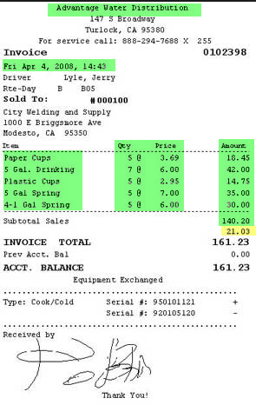
Receipts
Itemized receipt must be obtained for all purchases.
  Name of merchant.
  Date of purchase
  Description.
  Unit price and quantity.
  Transaction total (make sure no tax is charged for in-state purchases).
Sign each receipt that doesn’t have a Chip ID or Chip Ref ID and include with the cardholder statement at the end of the cycle.

Slide 37
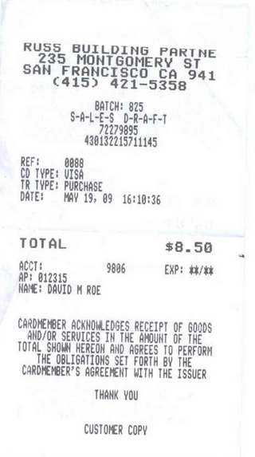
Valid or invalid?
Not in workbook
This receipt is
invalid and would
not be accepted.
Items missing are
Description.
Quantity.
Item price.
Extended amount.
This is sometimes
called a batch slip or
terminal receipt.
Required
Merchant name
Date
Description
Quantity
Item price
Extended price
Total amount

Slide 38
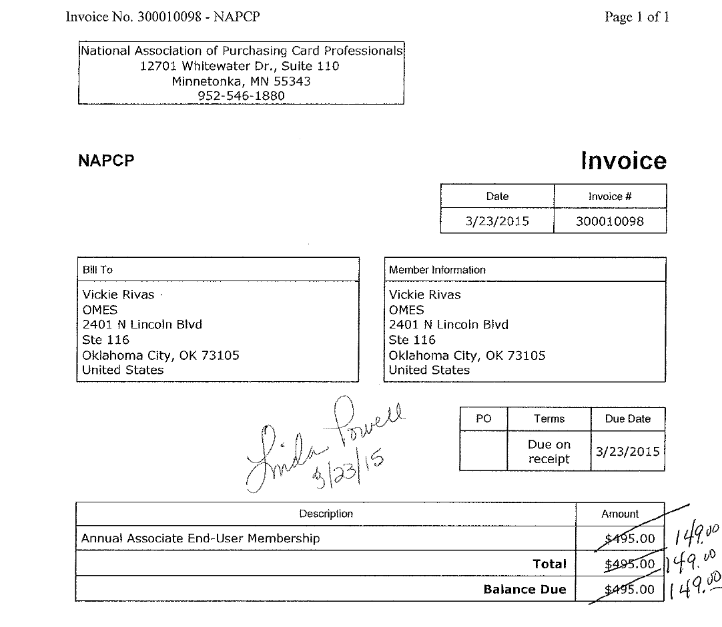
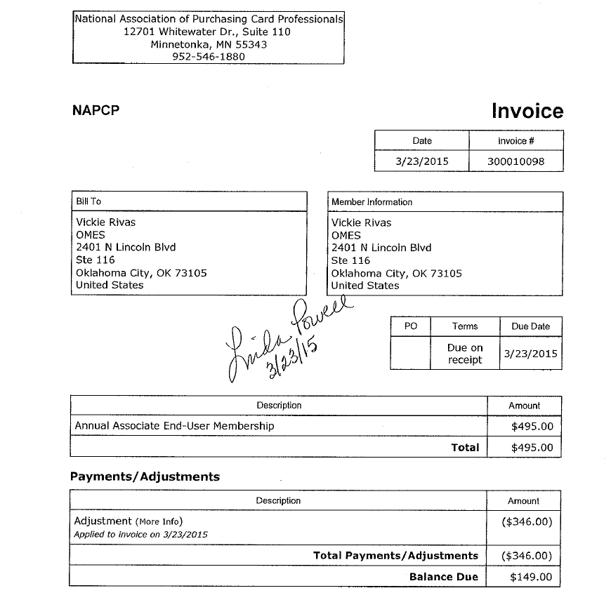
Unacceptable
Acceptable
Invoices and receipts cannot be manually modified. The merchant must be contacted for a corrected invoice
or receipt. The invoice on the left was received for the incorrect amount. The receipt on the right is the corrected invoice received from the merchant after contacting them.
Not in workbook

Slide 39
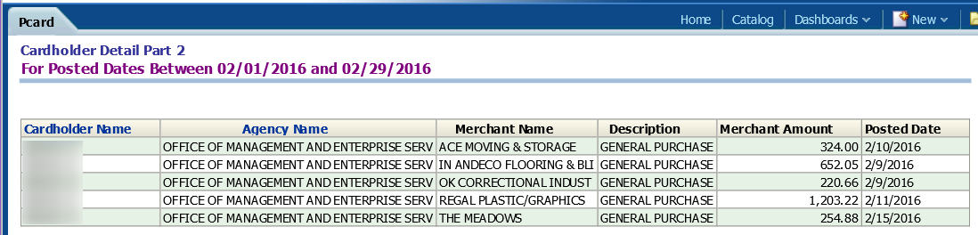
Open books
  All transactions made with the P-card are public record and are listed on the State of Oklahoma Open Books website, with:
    Cardholder’s last name, first initial.
    Agency name.
    Merchant name.
    Amount of transaction.
    Descriptions are provided through tiered-level reporting, which, if not available, shows as general purchase.
Not in workbook

Slide 40

Construction and Properties (CAP)
Q. Is there a maximum dollar project amount where an agency is not required to go through CAP to enter into a contract and pay by P-card?
A. Yes, public construction contracts for less than $5,000.00 for minor maintenance or minor repair work may be negotiated with a qualified contractor by the agency. However, no work shall be started until a written contract is executed and proof of insurance has been provided by the contractor to the awarding public agency. DCAM-FORM-CAP-M601 is available for use.
Questions? Call 405-521-2112

Slide 41
Agency assets
Each agency has an asset or inventory manager.
Please check with them for the specifics of your agency
for reporting assets.
Many agencies currently utilize the asset management module
in PeopleSoft; for those that do, the following information
is required to be entered into the Works transaction:

Slide 42
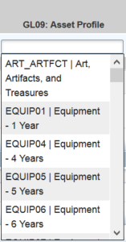
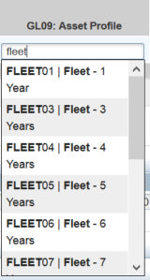
Non-IT assets
Asset account codes begin with 541 (refer to the Statewide Accounting Manual Appendix 4).
For assets costing less than $25,000, use a profile ending in 01 in the GL09 field.
For assets costing $25,000 or more, use a profile ending in 05 or higher in the GL09 field.
Reporting threshold for non-IT assets is $2,500.00.

Slide 43
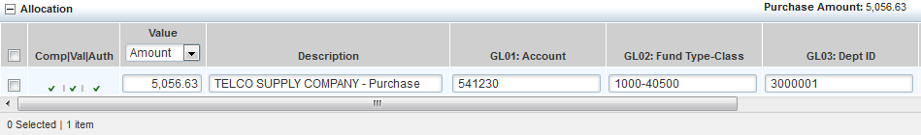
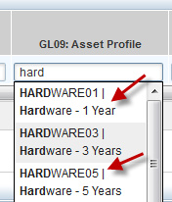
IT assets
IT asset account numbers also begin with 541 (refer to the Statewide Accounting Manual Appendix 4). CORRECT account codes are very important as all IT purchases are reported to IS each month.
For assets costing less than $25,000, use HARDWARE01 or
SOFTWARE01 in the GL09 field.
For assets costing $25,000, or more use HARDWARE05 or
SOFTWARE05 in the GL09 field.
Reporting threshold for IT assets is $500.00.
An accurate description of the item purchased, such as software, laptop, network switch,
etc., will help IS verify the GL09 field information.

Slide 44

Registration payments
P-card purchases are subject to the Statewide Accounting Manual, Chapter 50.10.06, Section J Advance (Pre-) Payments
Can use P-card for advance conference registration when:
  Discount is provided for paying in advance;
  Can substitute a participant; AND
  If event is canceled, cardholder receives a full refund.
  Registration fees for conferences, meetings, seminars and similar events whereby in special situations an organization requires pre-registration along with payment and by standard policy will not accept a state purchase order/contract in lieu of payment, documentation on the vendor's stationary describing this fact must be sent together with the claim to OMES for consideration and approval or disapproval.

Slide 45
Additional cardholder responsibilities
Cardholder responsibilities will vary by agency. Agencies that use the purchase request feature must also be trained internally by their P-card administrator.
These responsibilities may include:
Editing in Works to include verifying the funding information and providing an accurate description of goods/services purchased.
Attaching invoices/receipts.
Assembling end-of-cycle statements or moving all documentation to a specified electronic file.

Slide 46

Approving official responsibilities
The approving official reviews cardholder’s reconciled statement and transaction documentation for:
    Accuracy.
    Completeness.
    Appropriateness of the purchase.
    Verifying transactions were conducted according to statutes, rules, State P-card Procedures and the agency’s internal purchasing procedures.
  To indicate concurrence and that all required documentation is included, approving official shall sign and date the statement and forward the statement and documentation to entity P-card administrator.

Slide 47

P-card administrator responsibilities
State entity P-card administrator is responsible for performance or appropriate delegation of the following duties:
  Processing and retaining P-card program reports:
    Monthly invoice.
    Monthly cardholder statements.
    Other reports are available in Works and we urge P-card administrators to utilize these as well.
  Scheduling and monitoring participant training.
  Processing and retaining P-card employee agreements.
  Establishing written agency P-card program policies and procedures.
  Ordering new cards and deactivating cards no longer needed.
Notes:
It is the P-card administrator’s responsibility to make sure that all cardholders, approving officials, and themselves are trained every 2 years either through Skill Soft, the OMES class, or approved agency training. For questions, email the State P-Card administrator.

Slide 48
P-card administrator responsibilities (cont.)
  Establishing and maintaining usage controls and determining cardholder’s need for the P-card.
  Review of statements and transactions to identify unauthorized use.
  Auditing a random selection of cardholder’s monthly statements for accuracy.
  Setting lodging- or travel-only P-cards in “suspense” status in Works with credit limits at $0.00 when not in use.
  Establishing internal procedures for maintaining necessary data before card is removed from Works.
    Paper copies.
    Electronic copies, must meet:
      OMES Information Security policies, procedures and guidelines.
      Oklahoma Archive Commission Rules.

Slide 49
Records retention
Records include any transaction documentation, such as statements, receipts, disputes, correspondence, etc.
Includes documentation in paper or electronic form and must meet:
  OMES Information Services policies, procedures and guidelines.
  Oklahoma Archive Commission Rules.
Must be maintained for seven years or
  If audit occurs, the records are required to be retained for two years after issues are resolved or until the end of the seven-year period, whichever is longer.
  If litigation occurs, records must be kept indefinitely.

Slide 50
Charge disputes
Disputes may be reported by the entity P-card administrator to BOA who will assist the state in resolving the dispute.
Must be initiated within 30 days of the transaction post date.
Always try to resolve with the merchant first before contacting the bank if possible.
Disputed amount will be paid at the end of the month and a credit will appear on a subsequent statement if credit process is not completed prior to the end of the cycle in which the original purchase was made.
Notes:
All attempts for resolution with the merchant should be exhausted before a formal dispute to the bank.

Slide 51

Travel purchases on the P-card
Except for airfare, lodging, taxi, shuttle, parking and rental car, all other travel-related expenses are prohibited on the P-card, such as:
  Meals, including room service.
  Hotel telephone (not business-related).
  Internet (not business-related).
Traveler must pay out of pocket for all other travel-related expenses.
Travel claim may be submitted by the traveler for reimbursement of travel-related purchases prohibited on the P-card using the OMES Reimbursement Form 19, available on the OMES website.

Slide 52

Travel purchases on the P-card (cont.)
Airfare and lodging are considered separate transactions ($5,000.00 limit on each).
Travel can be purchased for:
  Active state employees or officials of the state.
  Non-state employees (as allowed by STRA) when:
    Performing substantial and necessary services to the state; and
    Directed or approved by appropriate department official.
Must follow the STRA statutes and OMES state travel procedures:
  OMES may audit travel documentation (100 percent audited at this time).
  Non-compliance may result in loss of P-card travel privileges and/or additional travel training being required.
Travel for contractors and/or their agents cannot be booked with the P-card.

Slide 53
Notes
Title 74-500.9 now allows the OMES director to approve an in-state lodging stay up to 150 percent of the current GSA rate if it is determined that no lodging is available at the current maximum rate. Request for exception (OMES Form 035) must be approved before booking the lodging.
Traveler Information required to be entered in
Works for travel transactions is listed in the State
Purchase Card Procedures, section 5.13.

Slide 54

Reservations
Reservations may be made by:
  Agency travel arranger
    Card is in travel arranger’s name.
    Must complete lodging letter and send to hotel (Lodging letter template is located on the P-card page of the OMES website under P-card Forms).
  Traveler
    Card is in the traveler’s name.
    NOTE: FCM is the mandatory contracted travel agent. The online booking tool is Concur.

Slide 55
Sales tax
State of Oklahoma is exempt from Oklahoma State Sales Tax.
State TAX ID # 73-6017987.
State entities also have immunity from taxes imposed by Oklahoma municipalities, which includes, but is not limited to:
  City sales tax.
  Occupancy tax.
  Tourism tax.
See DCAR Newsletter Vol 20, No. 6, dated 03/11/2010 regarding immunity from local taxes.
The State of Oklahoma is not exempt from tribal taxes.

Slide 56

Travel no-shows
If an employee is signed up to attend a conference, stay at a hotel or has scheduled a flight and does not show up for the event, it is up to the employee to pay back the money to the agency.
Please check the Statewide Accounting Manual and your agency’s internal purchasing procedures.

Slide 57
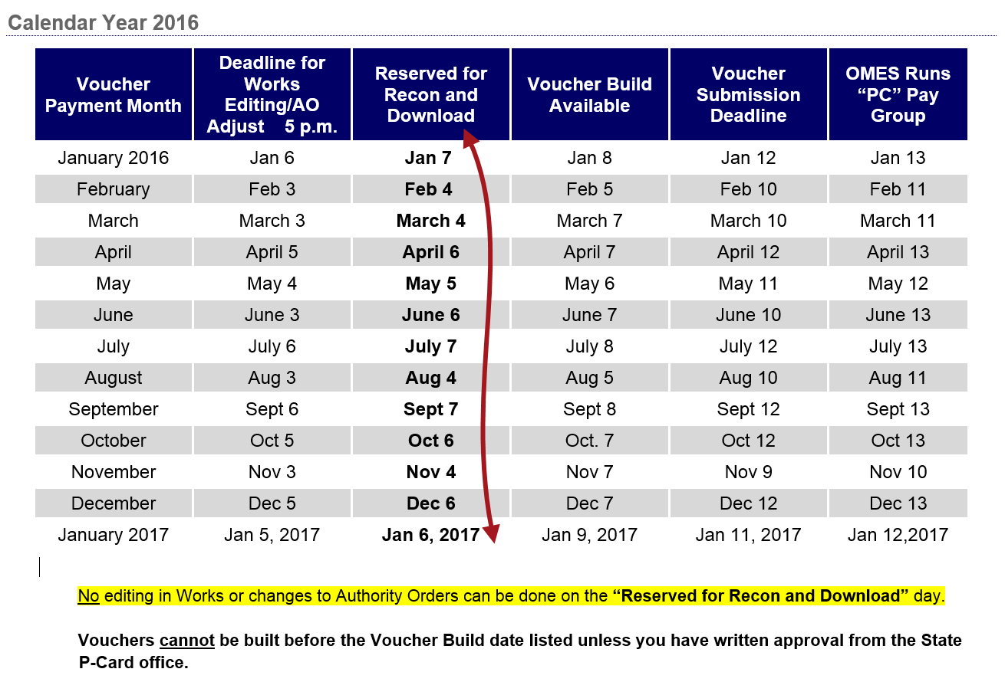
Not included in workbook

Slide 58
End-of-cycle deadlines
Deadline schedule on website is the final editing deadline for completion of all changes to Works transactions, which means that all transactions are to be CLOSED by the posted deadline. (This is done by the Works accountant.)
Agencies should set internal deadlines in order to meet the posted deadline.
This includes closing all flagged transactions.
This also means that all authority orders (AOs) must be approved and dispatched.
The state P-card office must be advised of any emergency AO revisions that may conflict with the posted schedule.
It is extremely important that ALL editing be completed PRIOR to the deadline date/time listed here.
Do NOT edit in Works or process a change order on the date next to the red arrow. Any changes made in Works will not be transferred to PeopleSoft. Changes to the AO will cause the load from Works to PeopleSoft to fail.

Slide 59
Program codes
All transactions require the five-digit program code at the end of the department code.
The governor identified five major programs and all purchases are related to either one of these programs or are unrelated to any specific program, in which case the program code will be NP000.
Format example: 1010000-B0100 or 1010000-NP000
See CAR Newsletter, June 2015, for more information.

Slide 60
GL06: Operating unit field
All agencies (if using the operating unit field) will need
-N/A at the end.
Example: 7215000-N/A
Only the Department of Education will see an actual value
following the operating unit.
Example: 0015000-391

Slide 61
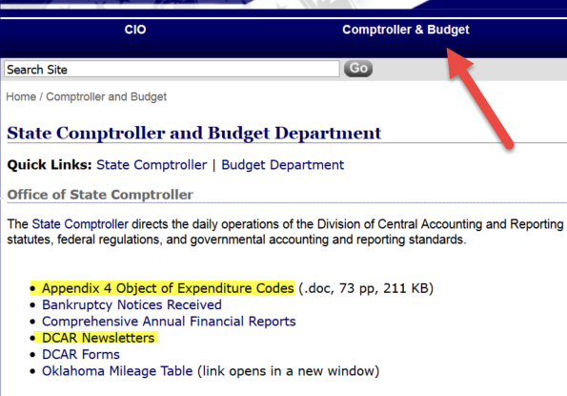
Account codes
(Object of expenditure codes)
If you will be editing your P-card transactions in Works, you will need to check the account code (GL01 field) for accuracy. While the account code defaults based on the MCC of the merchant, this code may not be accurate for all purchases from that merchant.
Valid account codes can be found in the Statewide Accounting Manual, Appendix 4 located at www.omes.ok.gov under Comptroller and Budget. Updates to this manual, including new or revised account codes, can be found in the CAR newsletters also available at this same location.
Account codes can also
be accessed in Works by
using the drop-down list
in the GL01 field.

Slide 62
The following slides are additional information and screenshots of the OMES website and Works, as well as the travel contact information for reference.
This information is not on the test.
If you have any questions, please contact your
agency P-card administrator.

Slide 63
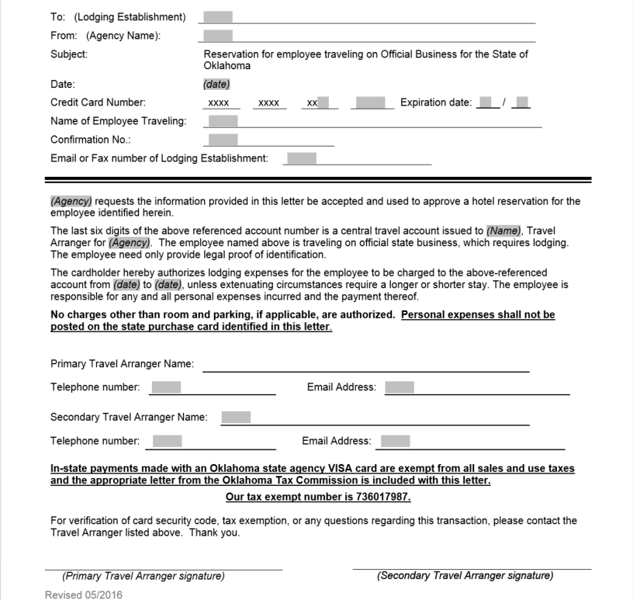
Lodging letter OMES CP Form 032
Template is available
online for use with
agency letterhead.
(not included in Workbook)
Notes:
For in-state lodging we recommend that you add the State’s Tax exempt # to this letter.

Slide 64
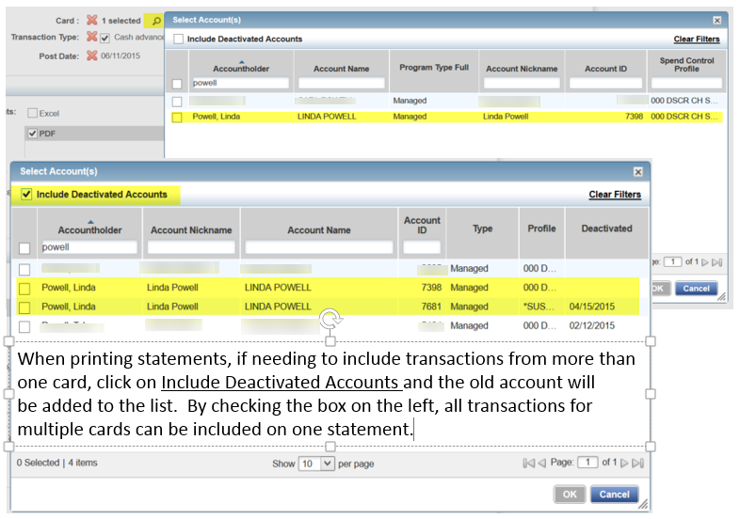

Slide 65
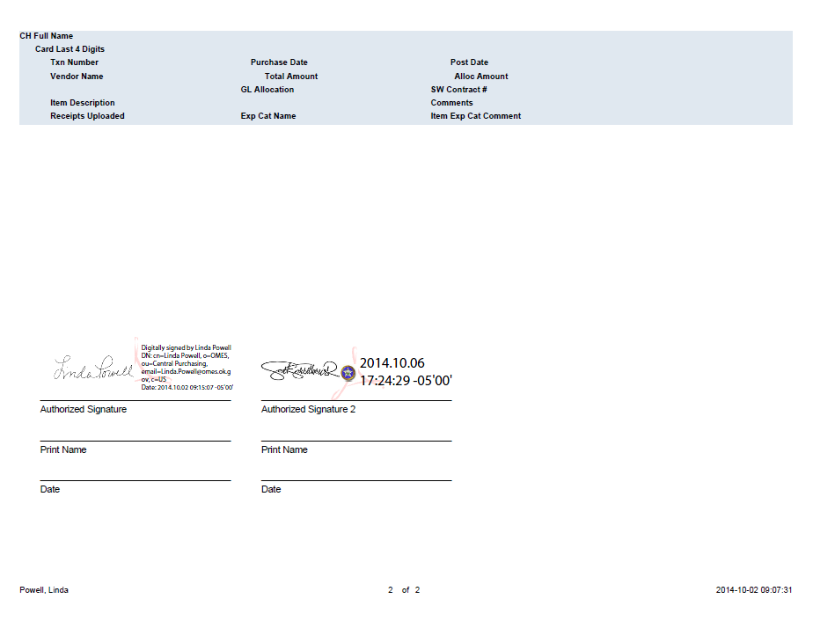
Statement electronic signature page
If your agency utilizes electronic signature they are acceptable for statements,
signing electronic invoices and other P-card-related documents.

Slide 66
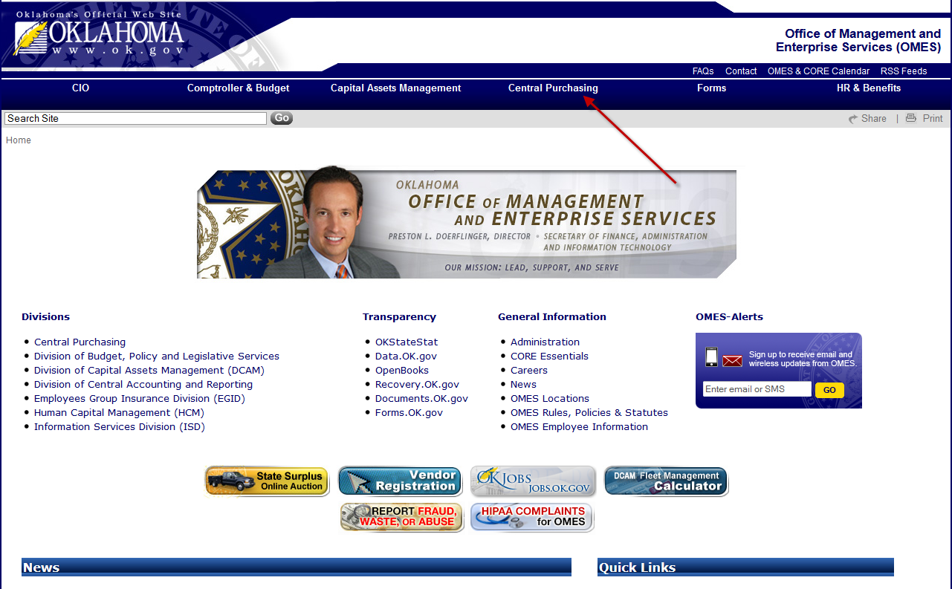
www.omes.ok.gov
Locating information on the OMES home page

Slide 67
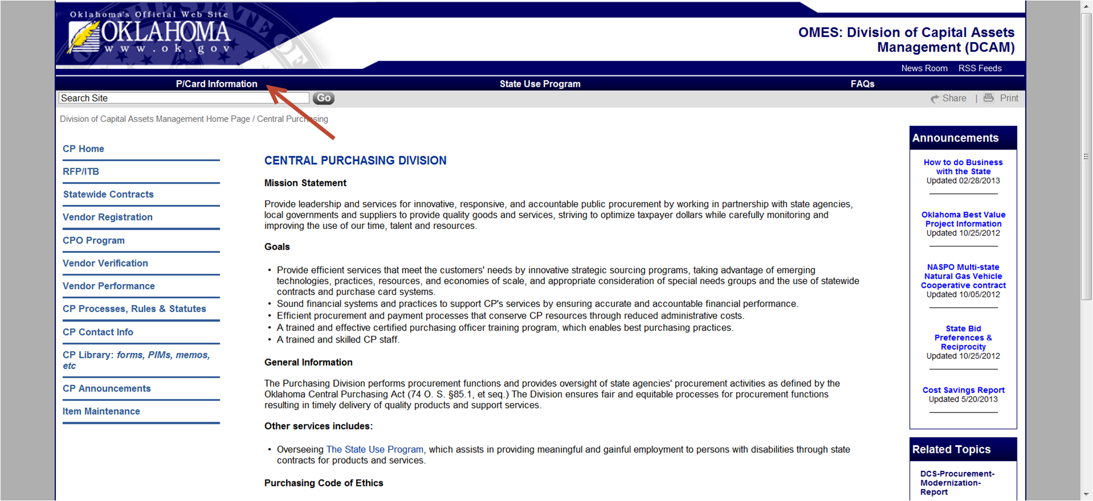
Statewide Contracts, Central Purchasing Rules and Central Purchasing forms
are all available from this page.

Slide 68
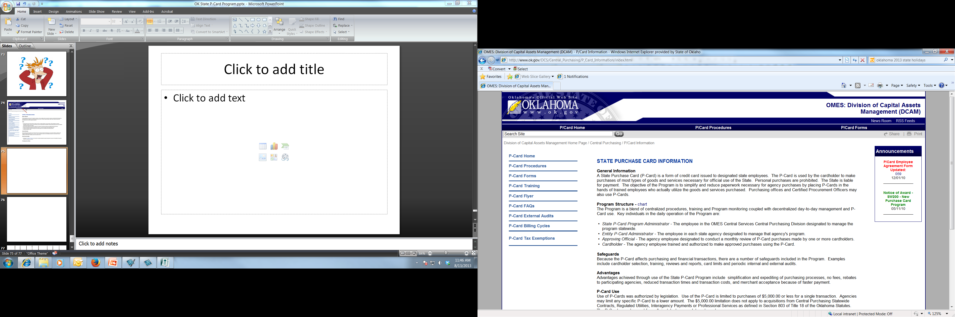
The list on the left side
of this page provides access
to all P-card forms, training
schedule, Tax Exempt letters,
and the procedures and
cardholder training
presentation and
workbook.

Slide 69
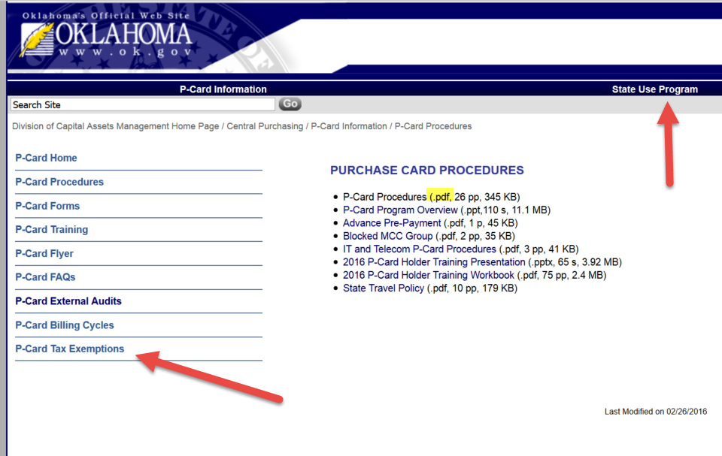
To access the procedures, click on .pdf to
open the document under P-card Procedures.
Tax letters are located at the bottom
of the list under Tax Exemptions.
State Use Program information is also available from the Central Purchasing and P-card pages.

Slide 70
State P-card team
P-card administrator – Linda Powell, CPO
  Linda.Powell@omes.ok.gov
  405-522-1654
Back-up P-card administrator - Vickie Rivas, CPO
  Vickie.Rivas@omes.ok.gov
  405-522-4970
Central P-card Office email
pcard@omes.ok.gov

Slide 71
Additional training
Works:
If you require Works training, you will either attend a hands-on class
provided by OMES or attend agency-specific training with your
agency P-card administrator or designated Works trainer.
Travel Arranger:
If you are designated as a travel arranger for your agency, hands-on
training in the Concur online booking tool (OBT) is available through
OMES. Contact your P-card administrator for additional information.

Slide 72
Additional information and links
Works: https://payment2.works.com/works
OMES website: www.omes.ok.gov
P-card site: https://www.ok.gov/DCS/Central_Purchasing/P-Card_Information/index.html
Statewide Accounting Manual and accounting information: https://www.ok.gov/OSF/Comptroller_and_Budget.html
State Use: https://www.ok.gov/DCS/Central_Purchasing/State_Use_Program/index.html
P-card Forms: https://www.ok.gov/DCS/Central_Purchasing/P-Card_Information/P-Card_Forms/
PIMS: https://www.ok.gov/dcs/searchdocs/app/index.php?CATEGORY_ID=22andUNIT_ID=8andSTART_DATE=MM%2FDD%2FYYYYandEND_DATE=MM%2FDD%2FYYYYandDATE_TYPE=0andKEYWORD=andLISTINGS_PER_PAGE=5andbutton=Search
Ethics Commission website: Financial Disclosure
https://www.ok.gov/ethics/
Secretary of State website: Executive Legislation
https://www.sos.ok.gov/gov/default.aspx

Slide 73
State Travel contact information
STATE TRAVEL MANAGER TRAVEL PROGRAM ADMINISTRATOR
Richard Williams Linda Powell
405-522-4812 405-522-1654
richard.williams@omes.ok.gov linda.powell@omes.ok.gov
CENTRAL TRAVEL MAILBOX
agency.travel@omes.ok.gov

Slide 74
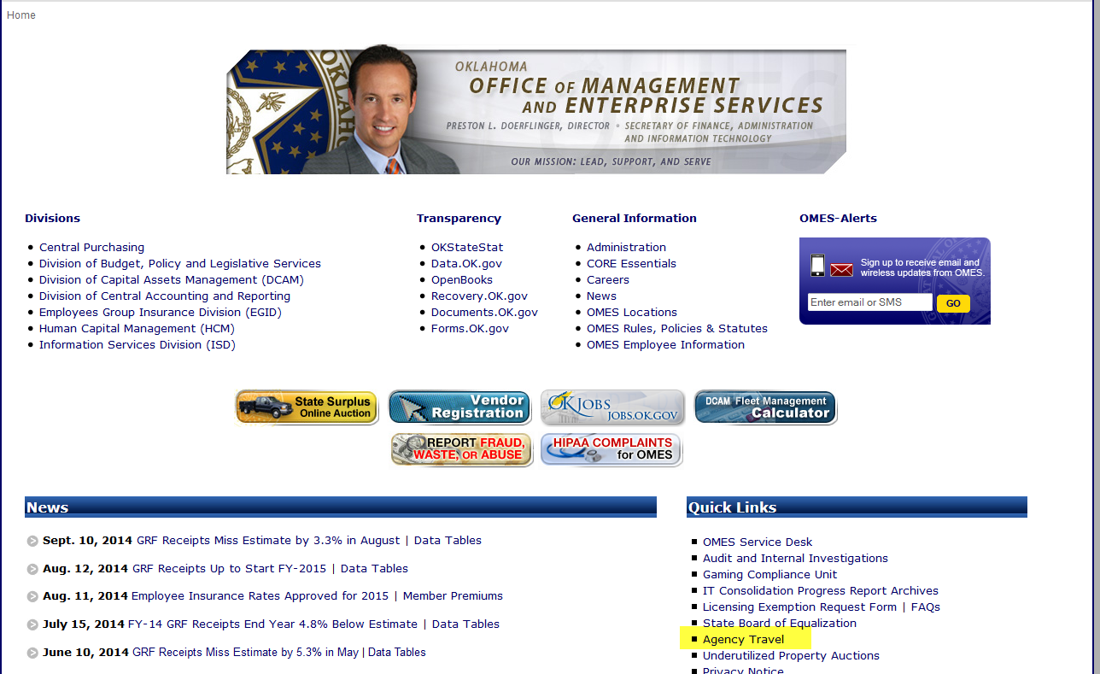
www.omes.ok.gov
State Travel website

Slide 75
Mandatory Contract SW210
FCm travel solutions
Your designated FCm team
Hours: Monday - Friday
8:00am to 5:30pm CST
T: 855-763-9257
T: 713-300-1641
E: Oklahoma@us.fcm.travel
8 Greenway Plaza
Suite 615 Houston, TX 77046
Team Leader
Alisia Coetzee
Team Members
Chantalle Oyardo
Mari Soto
After-hours Emergency Travel Center (ETC)
Calling from within USA:
855-763-9257
Calling from overseas:
+1-847-597-6195
FCm Online Helpdesk, Concur Helpdesk
For technical assistance, please contact the Concur helpdesk
Hours: Monday - Friday
8:00am to 8:00pm ET
T: 888-308-3288
E: online@corp.fcm.travel
Concur
www.concursolutions.com

Slide 76
Fees
Online booking tool (OBT) with NO agent assist $9
Agent assistance with booking flight $25
Agent assistance after 5:30 p.m., weekends, holidays $20
Emergency after-hours assistance $20
If booking is started through the OBT, and any required information is missing from the profile, an agent may complete the booking and then charge the difference of $16, bringing the cost up to an agent fee.
Calling an agent after 5:30 p.m. or before 8:00 a.m., weekends, or any time on holidays will incur not only the $25 agent fee, but also the after-hours fee of $20.

Slide 77
All questions or comments about this training material should be
directed to the P-card team at pcard@omes.ok.gov.
This presentation, accompanying workbook and test, along with
reading the current State Purchase Card Procedures, has been
approved for two CEUs for the Certified Procurement Officer (CPO)
program.
Works class has been approved for two CEUs for the CPO program.
Travel training has been approved for one CEU for the CPO program.
No printed certificates are provided, all classes and training are
listed on the CPO CEU Report (OMES-Form-CP-006).

