Slide 1
State of Oklahoma Office of Management and Enterprise
Services (OMES)
SWC 200
State P-Card
Welcome to the P-Card Program

Slide 2
Today we will cover…………..
EMV Cards and PINs Mandatory Suppliers/SW contracts
P-Card governance Fraud/data breaches
IT Purchases Invoices/Receipts/Receiving
Auditing Searching Contracts
Role Responsibilities Works

Slide 3
Why P-Card rather than PO?
Saves agencies money
Quicker payment to the supplier
Rebate to agencies
Better transparency

Slide 4
Definitions
AO – Authority Order (very similar to a PO or purchase order)
EMV – stands for Europay, MasterCard, and Visa. Also called Chip & Pin card
EMV and Chip & Pin are used interchangeably
IT – Information technology (refers to computers and telephones and all related
services and equipment
MCC – Merchant Category Code. This code is assigned by the credit card industry
based on the main type of business a merchant conducts
P-Card – Purchase Card
PIN – Personal Identification Number (4 numeric digits assigned for use with
EMV/Chip & Pin cards)
Works – the banks web-based transaction system for online reconciliation of
purchases

Slide 5
The State of Oklahoma authorized P-Card is a Visa Purchasing Card issued by the Bank of America (BOA), corporate liability card
The P-Card is now an EMV or Chip & Pin card (PIN numbers mailed separately)- the chips are encrypted and create a unique transaction code that cannot be used again
Zero liability for unauthorized charges or for lost/stolen cards (Bank must be notified within 24 hours)

Slide 6
Activating your card
When you receive your card there is a sticker across the
front with a phone number.
Call the number and key in your 16-digit card number
Provide the verification ID that has been provided to you
by your P-Card Administrator
Your purchases will be declined until your card has been
Activated!

Slide 7
PIN numbers
PIN numbers must be registered online at www.baml.com/PINCheck
If you forget your PIN you may retrieve it from this website
If you don’t have access to the internet, you can contact customer service to request a PIN reminder mailer. PINs cannot be provided over the phone.

Slide 8
Executive Advisory Group
The agency decides who has a card, who the approvers are,
and appoints the
Administrator.
State Purchasing Director
State P-Card Administrator
Agency P-Card Administrator
Agency
Approving Officials
Agency
Approving Officials
P-Cardholders
P-Cardholders
P-Cardholders
P-Cardholders
Notes:
Approving Officials are one level above the cardholder based on the agency’s organizational chart.

Slide 9
References
All purchases shall be made in accordance with State statutes, rules, and these Procedures, which include but may not be limited to:
Central Purchasing Act, 74 O.S. § 85.1 et seq.
State Travel Reimbursement Act (STRA), 74 O.S. § 500 et seq.
Central Purchasing Codified Rules, 260:115
State Purchase Card Procedures
Oklahoma State Travel Policy
Oklahoma Ethics Commission Rules
State Agency Internal Purchasing and P-Card Procedures
Other statutes pertaining to specific types of purchases

Slide 10
IT & Telecom Purchases
IF your agency has set up an IT AO, the following IT purchases may be made with the P-Card:
Transactions up to $5000 if items are listed on the published hardware/software list;
Transactions up to $15,000 if items are listed on the published hardware/software list AND items are purchased from a statewide contract supplier
See ISD Procurement Policies and the IT and Telecom ePro requisition procedures for guidance.
See PIM 06302015 and P-Card procedures section section 5.6

Slide 11
Contact Information for IT questions
OMES Service Desk
405-521-2444
servicedesk@omes.ok.gov

Slide 12
Encumbering Funds
Authority Order (AO)
AO should have sufficient encumbrance to cover all transactions prior to making the transaction (Encumbrance Law §62-34.62)
Change Orders to amend the encumbrance may be processed as necessary
A new AO should be issued each new fiscal year
Funds cannot be spent without this AO in place PRIOR
to making the purchase.
Increases in the encumbrance amount must also be
completed BEFORE a purchase exhausts the funds on a
given AO line.

Slide 13
Employee Participation
All participants must read and sign the Purchase Card Employee Agreement.
All P-Card participants must complete initial training conducted by OMES Central Purchasing;
Form F-1R or F-3R submitted annually, available on the Oklahoma Ethics Commission website (for cardholders making purchases of $50,000 or higher) see Links page for link to website
Refresher Training is now determined and conducted internally by your agency P-Card Administrator. You will need to contact them for additional information and guidance specific to your agency.

Slide 14
SAFEGUARDS
Agency appoints cardholders
Agency sets limits on each card
Approving official review
Agency determines disciplinary actions
Performance & Efficiency Auditing tracks fraud and misuse

Slide 15
Using the Card
Purchases can only be made within your Single Transaction Limit and Credit Limit assigned to your card;
You are responsible for reconciling all transactions;
P-Cards cannot be used to avoid or bypass appropriate purchasing or payment procedures;
P-Card is not for personal use
You must ensure prices paid are fair and
reasonable

Slide 16
Methods of Purchase
Walk-in;
Telephone; (POS or face-to-face)
Internet
Make certain internet site is a secure location, for example:
“s” on the end of https means it is a secure site; or
Padlock will appear on the site
SW 690 – Road Oil
SW 670 – Aggregate
SW 081 – Asphalt

Slide 17
Return item to merchant in manner agreed upon
Credits- If the agency is credited for any items or services that were originally paid for with the purchase card, then the credit MUST be processed through the merchant system. The vendor should not be allowed to maintain a store credit or use the credit toward other invoices.
Merchant provides credit receipt documentation
Place with end of month transaction documentation for reconciling
Include with the payment at end of month
Credit may not appear until subsequent statement
Notes:
Refund checks, store credit, cash, are NOT acceptable forms of refunds. If the store won’t refund in the proper manner, you’ll need to seriously consider not using them in the future.

Slide 18
Prohibited Purchases
Split Purchasing;
Entertainment;
Per diem food;
Cash or cash advances;
Purchase of goods or services for personal use or not for official State use;
Any transaction or series of transactions exceeding your P-Card limits;
Motor fuel and automotive general maintenance;
Automatic Drafts (we do not want them to have the card # on file);
Gift Certificates

Slide 19
Request for Exception
A “Request for Exception” form can be completed requesting to make a purchase, even if the MCC is blocked.
Contact your agency P-Card Administrator with the pertinent details of your need.
Your P-Card Administrator will complete the request for exception form and send to our office. If approved, your Administrator will be notified and they in turn will notify you.
Your card will be moved into an exception profile for a short period of time to allow the transaction to be processed.

Slide 20
Convenience Fees vs. Surcharges
Convenience fee: a fee charged to the cardholder for the convenience of
paying online or by phone - the price of the product doesn’t change
Surcharge: a fee assessed by the merchant when using a credit card for
payment to recoup the merchant fees charged by the card processing company
Surcharges are prohibited in Oklahoma by law, though convenience fees are not prohibited. If a utility company utilizes a third-party processor for credit card payment processing, this is a convenience fee (not prohibited per OMES legal team)
To avoid convenience fees, agencies may opt to pay companies charging these fees by PO. If a company limits the amount of payment accepted
per transaction, you could incur more than one convenience fee to pay the entire invoice.

Slide 21
Convenience Fees vs. Surcharges (cont’d)
Title 14A O.S. §2-417 of the Oklahoma statutes states:
No seller in any sales transaction may impose a surcharge on a cardholder who elects to use a credit card or debit card in lieu of payment by cash, check, or similar means.
As used in this section, “debit card” means any instrument or device, whether known as a debit card or by any other name, issued with or without fee by an issuer for the use of the cardholder in depositing, obtaining or transferring fund from consumer banking electronic facility.
For purposes of this section, a private educational institution as defined in paragraph (e) of section 3102 of Title 70 of the Oklahoma Statutes may charge a convenience fee. The convenience fee shall be limited to bank processing fees and financial transaction fees, the cost of providing for secure transaction portal fees, and fees necessary to compensate for increased bandwidth incurred as a result of providing for an online transaction.
While convenience fees are allowable, Okla. Stat. tit. 14A. §2-211 holds that the seller has to be registered with the United States Treasury Department as a money transmitter pursuant to 31 CFR, §103.41. You are usually going to see these with an entity providing an electronic funds transmission service, including service by telephone and the internet (Ex: I pay my cable bill over the phone. My bill doesn’t change. I’m paying a convenience fee for not mailing anything, etc. and doing it over the phone while I’m still in my pajamas.)

Slide 22
Card Limits
There is no limit on the amount of a P-Card
transaction for the following:
Statewide Contract purchases
Utilities (water, electric, gas, sewage)
Interagency Payments
Professional Services as defined in 18 O.S. § 803
For any other transaction with a state purchase card, the transaction shall not exceed $5,000.00

Slide 23
Interagency Payments
Interagency is defined according to 74 O.S. § 1003 (Inter-local Cooperation Act) and includes, but not limited to:
Political subdivisions
Federal Government
Public Trusts
Interagency payments between State Agencies, Universities, and Colleges:
Should be made by voucher, selecting the payment method “WIR”
DCAR Newsletter, Vol. 21, No. 7, dated February 18, 2011 (page 3)
Agencies can choose to accept P-Card payments from other agencies.

Slide 24
At the time of need, check……
#1 State Use Contract (if not selected obtain an exception from State Use prior to purchase)
#2 OCI (if not selected obtain an exception from OCI prior to purchase)
#3 Statewide Mandatory Contract
(if not selected obtain an exception from Central Purchasing prior to
purchase) Exception to this is SW817 and SW817-P
#4 Statewide Non-Mandatory Contract
#5 Open market- best price

Slide 25
State Use
Utilizing Talents
Satisfying Needs
Empowering Individuals
Oklahoma Statute Title 74, Chapter 48, Sections 3001-3010

Slide 26
What is State Use?
Set-aside program established in 1974 to provide employment opportunities to persons with severe disabilities.
Operated through qualified, nonprofit organizations that supply products and services to the state.

Slide 27
State Use Procurement Schedule
First source when searching for goods and services.
All registered vendors in the State Use Program listed.
All products and services provided by State Use vendors listed.
Statewide contract number and price.
Remaining items (suitable to procure list) – state use vendors must be included in any bid or quote.

Slide 28
Contact Us
Daron Hoggatt – State Use Administrator
405-521-4474
Cell 405-568-6108
Daron.Hoggatt@omes.ok.gov
Teresa Sherwood– Administrative Assistant
405-522-3367
Teresa.Sherwood@omes.ok.gov
Mary Brown – Procurement Officer
405-521-2128
Mary.Brown@omes.ok.gov
Amanda Wagaman – State Use Liaison
Cell 405-626-0973
Amanda.Wagaman@omes.ok.gov

Slide 29
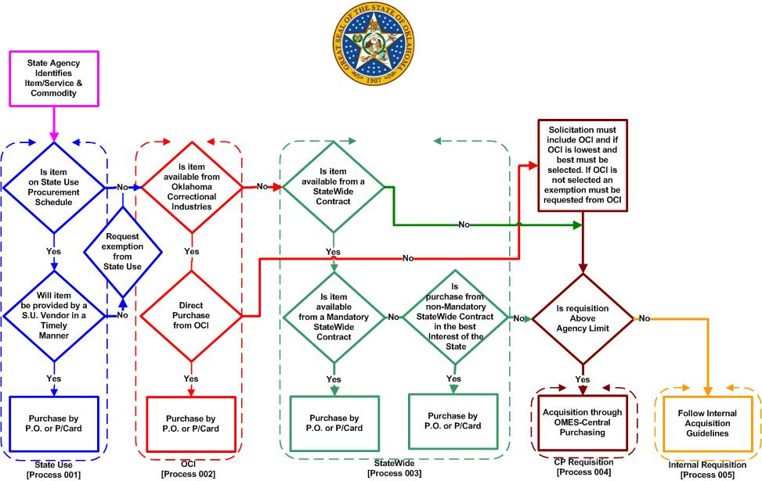
Central Purchasing Procurement Flow

Slide 30
Road and Highway Contracts
Card Security
P-Card is limited to person whose name is on the card;
Do not loan your card;
Do not use another person’s card;
If possible, file card in a secure, locked place when not in use;
Immediately report any lost, stolen or compromised cards to BOA at (888) 449-2273; Entity is responsible for purchases on lost, stolen or compromised P-Cards until BOA is notified

Slide 31
What happens if I am gone for a period of time from work?
The P-card Admin. can put your card in “suspense” $0.00 while you are away.
You should leave your card locked up at the office.
If the end-of-cycle statement option is selected, your cardholder statement must still be signed and turned in at the end of the month.
P-card holder is responsible for making sure the statement is complete with all required documentation.

Slide 32
How does fraud happen? (An outside entity uses card information for personal use)
How do I know it’s happened to my card? (The bank will call the cardholder or you will see the charge in Works)
What do I do about it? (Contact the bank and you P-Card Administrator to have your card closed, the charge reversed, and a new card issued)
How long does card replacement take? (replacement cards can be overnighted, normal time is about 4 days)
Fraud vs. Misuse (violation of procedures/policies for personal gain)
Fraud vs. Abuse (violation of procedures/policies for work-related gain)

Slide 33
When fraud is identified by the bank, Bank of America will send an email to the cardholder IF there is an email address listed in Works or call the cardholder.
The agency P-Card Administrator may receive a phone call.
The bank will confirm which transactions are allowed to
be paid vs. those that they will reject.
The bank will close the card and reissue a new card
Note: Accurate information is required to be in Works since if the bank calls the State P-Card Office, the card will automatically be closed and reissued. This could be a problem for frequent travelers.

Slide 34
All transactions are subject to audit by
State Auditor and Inspector
OMES Performance and Efficiency Audit Unit
OMES- Comptrollers Office
Detailed transaction documentation supporting P-Card transactions shall be retained by the State Entity and made available upon request
OMES Performance & Efficiency Audit Unit has monitoring software that digitally performs multiple tests on each P-Card transaction.

Slide 35
What does the auditor look for?
All invoices/receipts signed and dated (if receipt contains a Chip Ref ID, signature isn’t required)
Packing slips signed by the receiving employee for items shipped
Asset numbers for items over the asset dollar thresholds
Cross-referenced credits to original purchase (list TXN of credit transactions on original purchase)
Training is current
You are aware of your internal policies and procedures

Slide 36
What does the auditor look for? (cont’d)
Approvers are one level above cardholder base on the agency’s organizational chart
Employees listed in Works as users can actually sign into Works
Multiple transactions to the same supplier in a short period of time totaling more than $5000 to a non-contract supplier
They will ask for:
Signed/dated employee agreements (you should have a copy)
Internal purchasing and P-Card procedures
Copies of exceptions granted during the audit period

Slide 37
Receiving Goods and Services
Goods or services received at the time of purchase- The receipt for purchase shall serve as the receiving document. The receipt must contain the P-Card holder’s signature and date. A carbon copy of the receipt containing the P-Cardholder signature meets this requirement.
(the date is already printed on the receipt)
All remaining Transactions- The receiving employee needs to sign the packing slip and provide to the cardholder.
The cardholder’s and approving official’s authori- zation on the cardholder’s statement indicates that these products and services were received and approved to be paid with the purchase card.

Slide 38
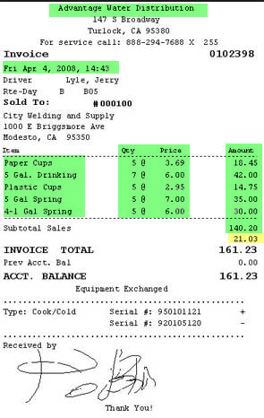
Receipts
Itemized Receipt must be obtained for all purchases
Name of merchant
Date of Purchase
Description
Unit price and quantity
Transaction total
Sign each receipt and include with Statement at end of cycle

Slide 39
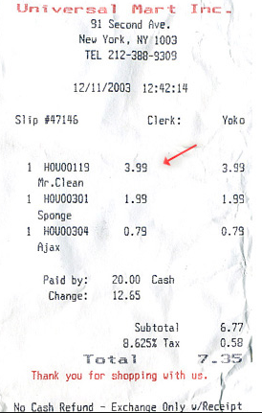
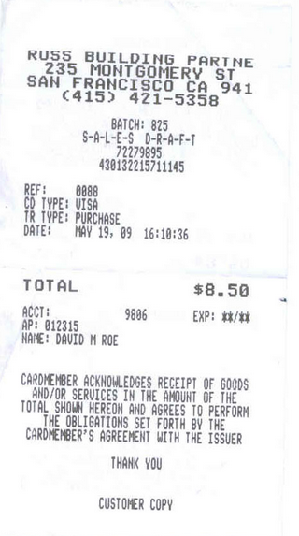
Valid? Or not valid?
Merchant name
Date
Description
Quantity
Item price
Extended price
Total amount
Even though there
is tax charged (which of
course the cardholder
would notice and have
credited before leaving
the store) it has all the
required information.

Slide 40
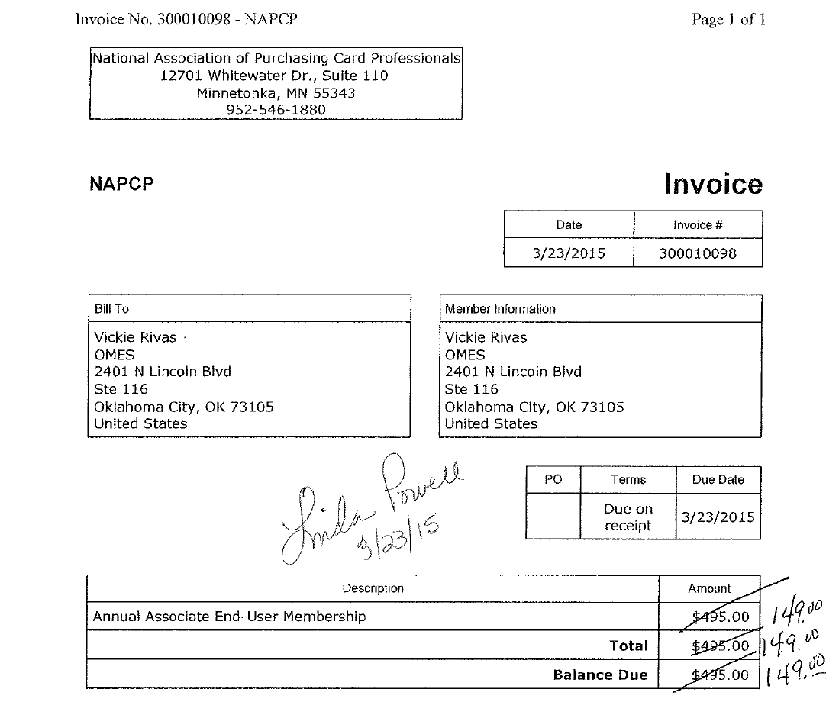
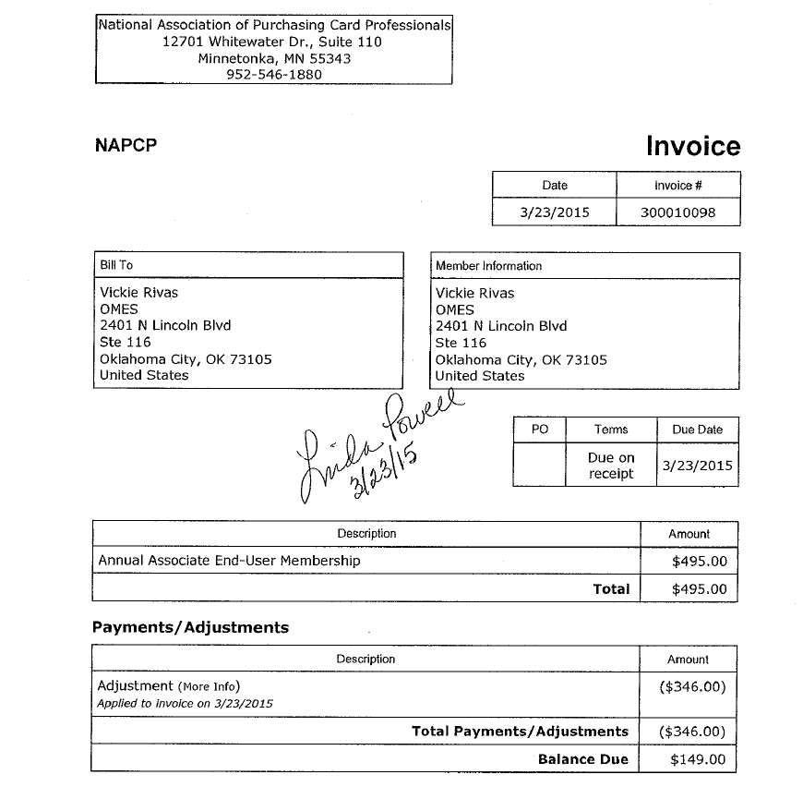
Unacceptable
Acceptable
Invoices and receipts cannot be manually modified. The merchant must be contacted for a corrected invoice
or receipt. The invoice on the left was received for the Incorrect amount. The receipt on the right is
the corrected invoice received from NAPCP.

Slide 41
Open Books
All transactions are listed on the State of Oklahoma Open Books website, listing
Cardholder’s last name, first initial
Merchant Name
Amount of transaction

Slide 42
Construction & Properties (CAP)
Is there a maximum dollar project amount where an agency is not required to go through CAP to enter into a contract and pay by P-Card?
Yes, public construction contracts for less than Five Thousand Dollars ($5,000.00) for minor maintenance or minor repair work may be negotiated with a qualified contractor by the agency. However, no work shall be started until a written contract is executed and proof of insurance has been provided by the contractor to the awarding public agency. DCAM/CAP – Form M601 Contract for Minor Construction Work is available for use.
Questions? call 521-2112

Slide 43
Agency Assets
Each agency has an Asset or Inventory Manager
Please check with them for the specifics of your agency
for reporting assets
Many agencies currently utilize the asset management module
in People Soft – for those that do, the following information
is required to be entered into the Works transaction:

Slide 44
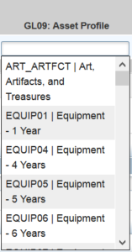
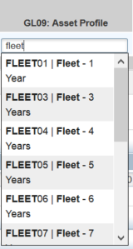
Non-IT Assets
Asset account codes begin with 541 (refer to the Statewide Accounting
Manual Appendix 4)
For assets costing less than $25,000 use a profile ending in 01
in the GL09 field.
For assets costing $25,000 or more use a profile ending in 05
or higher in the GL09 field.
Reporting threshold for non-IT assets is $2,500.00

Slide 45
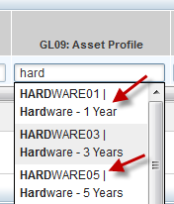
IT Assets
IT asset account numbers are: 541120 (hardware), 541130 (software) and 541230 (telecom
equipment). CORRECT CODING IS VERY IMPORTANT.
For assets costing less than $25,000 use HARDWARE01 or
SOFTWARE01 in the GL09 field.
For assets costing $25,000 or more use HARDWARE05 OR
SOFTWARE05 in the GL09 field.
Reporting threshold for IT assets is $500.00
An accurate description of the item purchased such as software, laptop, network switch,
etc., will help ISD keep track of reportable assets if the GL09 field is left blank.

Slide 46
Registration Payments
P-Card purchases are subject to the Statewide Accounting Manual, Chapter 50.10.06, Section J Advance (Pre-) Payments
Can use P-Card for advance conference registration when:
Discount is provided for paying in advance;
Can substitute a participant; AND
If event is canceled, cardholder receives a full refund
Registration fees for conferences, meetings, seminars, and similar events whereby in special situations an organization requires pre-registration along with payment and by standard policy will not accept a state purchase order/contract in lieu of payment, documentation on the vendor's stationary describing this fact must be sent together with the claim to OMES for consideration and approval or disapproval.

Slide 47
Additional Cardholder Responsibilities
Cardholder responsibilities will vary by agency. Agencies who use the purchase request feature must also be trained internally by their P-Card Administrator
These responsibilities may include:
Editing in Works to include verifying the funding information and providing an accurate description of goods/services purchased
Attaching invoices/receipts
Assembling end of cycle statements or moving all documentation to a specified electronic file

Slide 48
Approving Official
Responsibilities
Approving Official reviews Cardholder’s reconciled statement and transaction documentation for:
Accuracy;
Completeness;
Appropriateness of the purchase;
Verifying transactions were conducted according to Statutes, Rules and Procedures
To indicate concurrence and that all required documentation is included, Approving Official shall sign and date the statement and forward the statement and documentation to Entity P-Card Administrator

Slide 49
P-Card Administrator Responsibilities
State Entity P-Card Administrator is responsible for performance of, or appropriate delegation of the following duties:
Processing and retaining P-Card Program Reports:
Monthly Invoice
Monthly cardholder statements
Other reports are available in Works and we urge P-Card Administrators to utilize these as well
Scheduling and monitoring participant training
Processing and retaining P-Card Employee Agreements
Establishing written agency P-Card program policies and procedures
Ordering new cards and deactivating cards no longer needed
Notes:
It is the P-Card Administrator’s responsibility to make sure that all cardholders, approving officials, and themselves are trained every 2 years either through Skill Soft, the OMES class, or approved agency training. For questions, email the State P-Card Administrator.

Slide 50
P-Card Administrator Responsibilities
Establishing and maintaining usage controls and determining cardholder’s need for the P-Card
Auditing of reports and transactions to identify unauthorized use
Auditing a random selection of cardholder’s monthly statements for accuracy
Setting Lodging or Travel Only P-Cards in “Suspense” status in Works with Credit Limits at $0.00 when not in use
Establish procedures for maintaining necessary data before it is removed from Works
Paper Copies
Electronic Copies, must meet:
OMES Information Security Policies, Procedures and Guidelines
Oklahoma Archive Commission Rules

Slide 51
Records Retention
Records include any transaction documentation, such as, statements, receipts, disputes, correspondence, etc.;
Includes documentation in paper or electronic form and must meet:
OMES Information Security Policies, Procedures & Guidelines
Oklahoma Archive Commission Rules
Must be maintained for seven (7) years;
If audit occurs, the records are required to be retained for two (2) years after issues are resolved or until the end of the seven (7) year period, whichever is longer
If litigation occurs, records must be kept indefinitely

Slide 52
CHARGE DISPUTES
Disputes may be reported by the Entity P-Card
Administrator to BOA who will assist the State in resolving
the dispute;
Must be initiated within 30 days of the transaction date;
Always try to resolve with the merchant first prior to
contacting the bank if possible;
Disputed amount will be paid at the end of the month and
a credit will appear on a subsequent statement.
Notes:
All attempts for resolution with the merchant should be exhausted before a formal dispute to the bank.

Slide 53
Travel Purchases – P-Card
Except for airfare, lodging, taxi, shuttle, parking, & rental car all other travel-related expenses are prohibited on the P-Card, such as:
Meals, including room service
Hotel Telephone (not business related)
Internet (not business related)
Traveler must pay out of pocket for all other travel related expenses
Travel Claim may be submitted by the Traveler for reimbursement of travel related purchases prohibited on the
P-Card (OMES Reimbursement Form 19)

Slide 54
Airfare and Lodging are considered separate transactions ($5,000.00 limit on each)
Travel can be purchased for:
Active State Employees or Officials of the State
Non-State Employees (as allowed by STRA) when
Performing substantial and necessary services to the State and
Directed or approved by appropriate department official
Must follow the STRA statutes and OMES State Travel Procedures
OMES may audit travel documentation (100% audited at this time)
Non-compliance may result in loss of P-Card travel privileges and/or additional travel training being required
Travel for contractors and/or their agents cannot be booked with the P-Card

Slide 55
Notes:
Title 74-500.9 now allows the OMES Director to approve an in-state lodging stay up to 150% of the current standard rate if it is determined that no lodging is available at the current maximum rate. Request for exception (OMES Form 035) must be approved prior to booking the lodging.
Traveler Information required to be entered in
Works for travel transactions is listed in the State
Purchase Card Procedures, section 5.13.

Slide 56
Reservations may be made by:
Agency Travel Arranger
Card is in Travel Arranger’s name
Must complete Lodging Letter and send to hotel
Traveler
Card is in the Traveler’s name

Slide 57
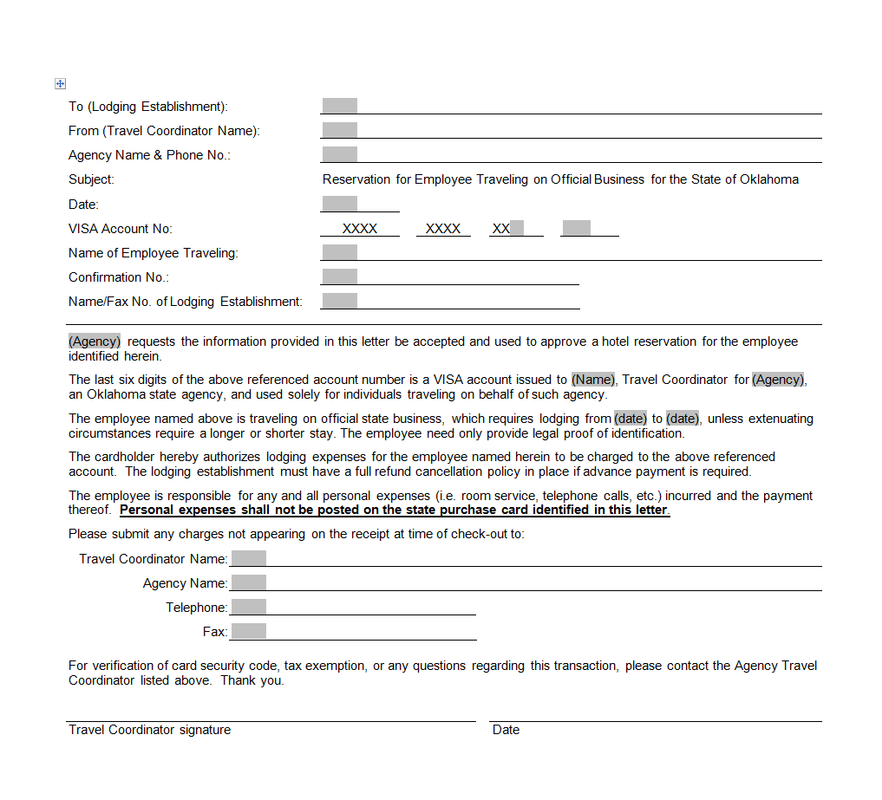
Lodging Letter
Be sure and add the Tax ID number on
this letter for
in-state lodging.
Notes:
For in-state lodging we recommend that you add the State’s Tax exempt # to this letter.

Slide 58
State of Oklahoma is exempt from Oklahoma State Sales Tax
State TAX ID # 73-6017987
State Entities also have immunity from taxes imposed by Oklahoma municipalities, which includes, but not limited to:
City Sales tax;
Occupancy tax;
Tourism tax;
See DCAR Newsletter Vol 20, No. 6, dated 03/11/2010 regarding immunity from local taxes
The State of Oklahoma is not exempt from Tribal Tax.

Slide 59
Travel no-shows
If an employee is signed up to attend a Conference, stay at a hotel, or has scheduled a flight and does not show up for the event it is up to the employee to pay back the money to the agency.
Please check with your agency’s internal purchasing procedures.

Slide 60
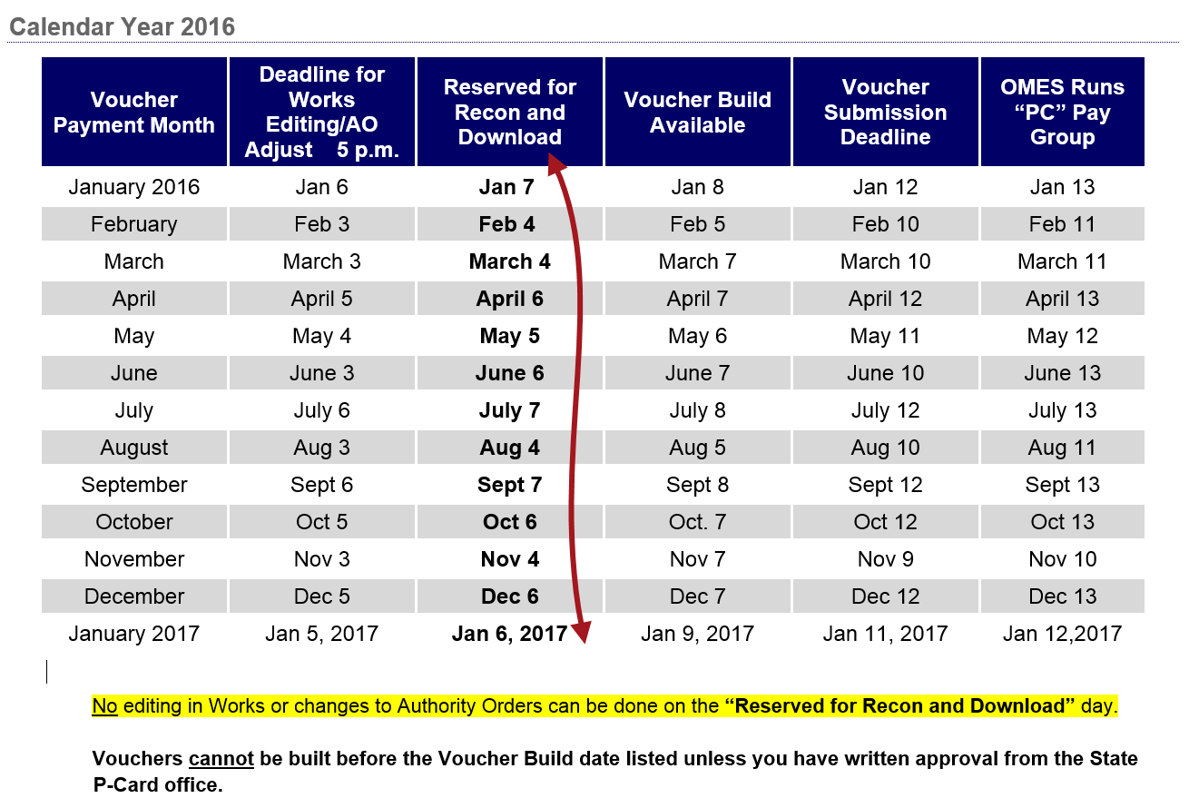
It is extremely important that ALL editing be completed PRIOR to the deadline date/time listed here.
Do NOT edit in Works or process a change order on the date next to the red arrow. Any changes made in Works will not be transferred to People Soft. Changes to the AO will cause the load to fail from Works to People Soft.

Slide 61
End of cycle deadlines
Deadline schedule on website is the final editing deadline for completion of all changes to Works transactions, which means that all transactions are to be CLOSED by the posted deadline.
Agencies should set internal deadlines in order to meet the posted deadline.
This includes clearing all flagged transactions.
This also means that all Authority Orders (AOs) must be approved and dispatched.
The State P-Card Office must be advised of any emergency AO revisions that may conflict with the posted schedule.

Slide 62
Program Codes
As of July 1, 2015 the Dept ID-Program code field became a
13-digit field. All FY16 AND FY 15 transactions require the
5-digit program code.
The Governor identified 5 major programs and all purchases are related to either one of these programs or are unrelated to any specific program in which case the program code will be NP000.
Format example: 1010000-B0100 or 1010000-NP000
DCAR Newsletter June 2015

Slide 63
GL06: Operating Unit Field
This field also changed effective July 1, 2015.
All agencies (if using the Operating Unit field) will
see –N/A at the end.
Example: 7215000-N/A
Only the Department of Education will see an actual value
following the Operating Unit.
Example: 0015000-391

Slide 64
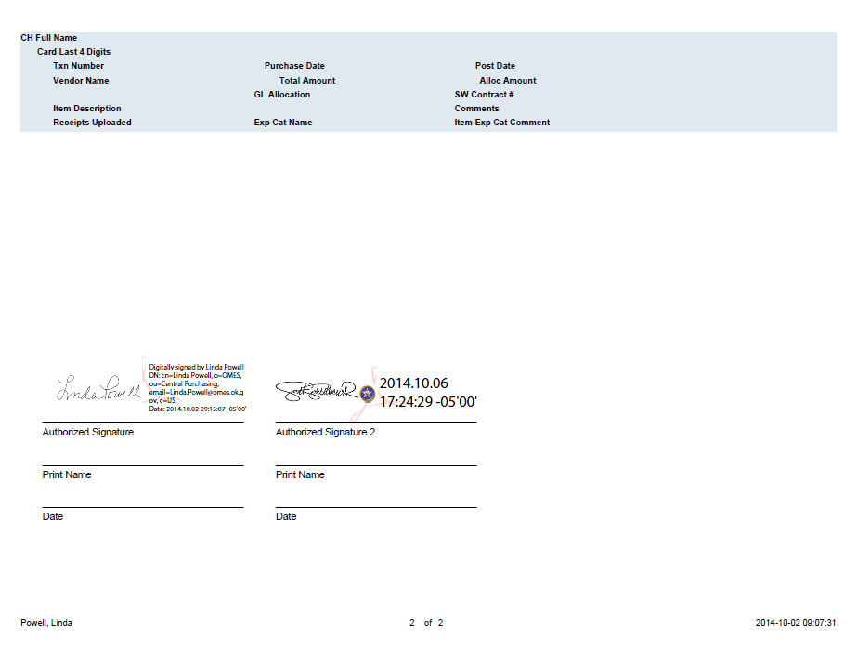
Statement electronic signature page
If your agency utilizes electronic signatures, they are acceptable for statements,
signing electronic invoices, and other P-card related documents.

Slide 65
State P-Card Team:
P-Card Administrator – Linda Powell, CPO
Linda.Powell@OMES.ok.gov
405-522-1654
Back-up P-card Administrator - Vickie Rivas, CPO
Vickie.Rivas@OMES.ok.gov
405-522-4970
Central P-Card Office email
pcard@omes.ok.gov

