Slide 1
Whiteboard Zoom Out
Surveying Year One of the Oklahoma
Value-Added Model

Slide 2
Whiteboard Zoom In
Purpose of Today’s Session
To review responses to a series of questions submitted by district VAM trainers through an online survey in January 2015 and allow time for additional questions by any participant. The questions we will address in the next part of today’s session fall into the following areas:
Understanding Model design
Understanding VAM reports
Timing of results
Accessing VAM reports
Notes:
The purpose of today’s session is to review responses to a series of questions submitted by district VAM trainers through an online survey in January 2015 and allow time for additional questions by any participant. The questions we will address in the next part of today’s session fall into the following areas:
Understanding Model design
Understanding VAM reports
Timing of results
Accessing VAM reports
Please note that this session is designed for school and district leaders with at least a basic familiarity with the value-added model and have questions based on previous and upcoming value-added reports results. For a basic introduction to the value-added model, please refer to the training materials on the TLE website.

Slide 3
Whiteboard Zoom Mid
Agenda
Current TLE Policy Information
Understanding Model Design and VAM Reports
Q & A interval
Timing of VAM Results and Accessing Reports
Process for Distributing PDF Reports to Teachers
and Administrators
Q & A interval
Next Steps
Notes:
Agenda
Current TLE Policy Information
Understanding Model Design and VAM Reports
Q & A interval
Timing of VAM Results and Accessing Reports
Process for Distributing PDF Reports to Teachers
and Administrators
Q & A interval
Next Steps

Slide 4
Whiteboard Zoom In
How questions will be handled
During the presentation, we encourage questions that are related to the agenda items. These questions will be addressed in one of three ways:
In the question box
Verbally by the presenter
Via email
Questions outside of the scope of the presentation or that require additional information will be addressed via email.

Slide 5
Whiteboard Zoom In
How to submit questions
To submit a question, find the box labeled Questions on the right side of your screen, then enter your question in the text box and click the Submit button
Notes:
To submit a question, find the box labeled Questions on the right side of your screen, then enter your question in the text box and click the Submit button

Slide 6
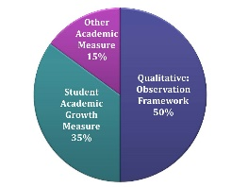
Whiteboard Zoom In
Current TLE Policy Information
March 3, 2015:
“As a result of current recommendations from the TLE Commission on February 19 and a decision by the State Board of Education on February 26, SLOs/SOOs will be postponed for the 2014-2015 school year. Student Academic Growth measures for teachers of non-tested grades and subjects (SLOs/SOOs) will not be reported to the Oklahoma State Department of Education for the 2014-2015 school year.”
Notes:
Current TLE Policy information
March 3, 2015:
“As a result of current recommendations from the TLE Commission on February 19 and a decision by the State Board of Education on February 26, SLOs/SOOS will be postponed for the 2014-2015 school year. Student Academic Growth measures for teachers of nontested grades and subjects (SLOs/SOOs) will not be reported to the Oklahoma State Department of Education for the 2014-2015 school year.”

Slide 7
Whiteboard Zoom In
Current TLE Policy Information
March 3, 2015:
TLE implementation and reporting requirements still in effect for the 2014-2015 school year are:
1. The Qualitative framework will be implemented and reported to the Oklahoma State Department of Education. Reporting guidelines will be communicated at a later date.
2. Other Academic Measures (OAM) will be implemented and reported to the Oklahoma State Department of Education. Reporting guidelines will be communicated at a later date.
Notes:
Current TLE Policy Information
TLE implementation and reporting requirements still in effect for the 2014-2015 school year are:
[CLICK]
The Qualitative framework will be implemented and reported to the Oklahoma State Department of Education. Reporting guidelines will be communicated at a later date.
[CLICK]
2. Other Academic Measures (OAM) will be implemented and reported to the Oklahoma State Department of Education. Reporting guidelines will be communicated at a later date.

Slide 8
Whiteboard Zoom In
Current TLE Policy Information
March 3, 2015:
TLE implementation and reporting requirements still in effect for the 2014-2015 school year are (continued):
3. Value Added Measures (VAM) results will be calculated for the 2014-2015 school year:
• Grades 4-8 Reading/ELA
• Grades 4-8 Math
• Algebra I
• Algebra II
• Geometry
• English III
Roster verification is mandatory for the teachers of the tested subjects listed.
Notes:
Current TLE Policy Information
TLE implementation and reporting requirements still in effect for the 2014-2015 school year are:
[
[CLICK]
3. Value Added Measures (VAM) results will be calculated for the 2014-2015 school year for the following tested grades and subjects: [CLICK AS EACH ONE IS READ]• Grades 4-8 Reading/ELA • Grades 4-8 Math • Algebra I • Algebra II • Geometry • English III
[CLICK]
Roster verification is mandatory for the teachers of the tested subjects listed.

Slide 9
Whiteboard Zoom Mid
Understanding the Value-Added Model
Q1.What are some suggestions about how to highlight key information most efficiently regarding value-added reports for teachers and other staff when time is limited?
Use training materials on the TLE website. Here are a few to start with…
Notes:
Understanding the value-added model
Q1.What are some suggestions about how to highlight key information most efficiently regarding value-added reports for teachers and other staff when time is limited?
[CLICK]
Use the training materials on the TLE website. Here are a few to start with…

Slide 10
Whiteboard Zoom In
Use the sample results reports on the TLE website

Slide 11
Whiteboard Zoom In
Direct staff to video training modules

Slide 12
Whiteboard Zoom In
Explore the FAQ document on the TLE website

Slide 13
Whiteboard Zoom Mid
Understanding the Value-Added Model
Q2. How is it possible that teachers with high-scoring students can receive a value-added result that is below average?
Notes:
CLICK TO READ ANSWER ON NEXT SLIDE

Slide 14
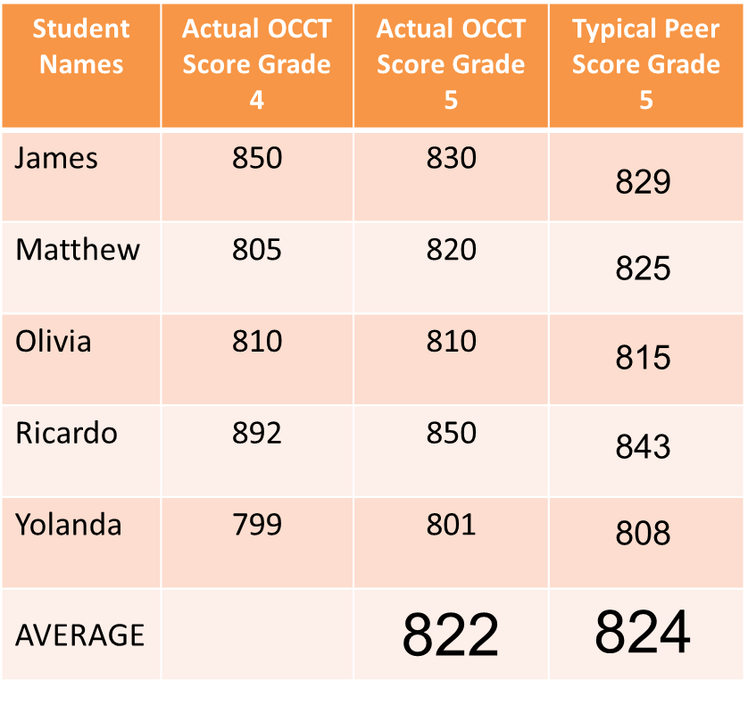
Whiteboard Zoom In
Average Actual Score | Average-Typical Score | Value Added Result
822 – 824 = -2
Notes:
Value added is calculated as the difference between the average typical peer score [Click] and the average actual score [CLICK] of a teacher’s students. A teacher whose students performed well on the post-test can receive a low value-added result even if the typical scores of his or her students were high. This would occur if a teacher taught students who performed very well on the previous tests used in the value-added model, [CLICK] but then did not make as much progress during the year as other students in the state with similar scores on the pre-tests. [CLICK] Because they compare actual and typical scores, value-added models enable any teacher to be identified as a high performer, regardless of the baseline achievement levels or background characteristics of the teacher’s students.

Slide 15
Whiteboard Zoom Mid
Understanding the Value-Added Model
Q3. Why do students’ typical-peer scores take into account race/ethnicity and gender?

Slide 16
Whiteboard Zoom In
At present, the student characteristics used to determine typical-peer scores for the OK Value-Added Model include:
Prior Achievement
Free/Reduced Lunch Status
Limited English Proficiency
Individualized Education Plan (IEP)
Race/Ethnicity
Gender
Mobility
Prior year attendance
Notes:
At present, the student characteristics used to determine typical-peer scores for the OK Value-Added Model include:
Prior Achievement
Free/Reduced Lunch Status
Limited English Proficiency
Individualized Education Plan (IEP)
Race/Ethnicity
Gender
Mobility
Prior year attendance

Slide 17
Whiteboard Zoom Mid
Q3. Cont…Why do students’ typical-peer scores take into account race/ethnicity and gender?
Based on the recommendation of educator working groups, the TLE Commission and Oklahoma State Board of Education, the value-added model should account for factors outside a teacher’s control, including a variety of student background characteristics, when estimating typical scores.
This approach is designed to enable any teacher to be identified as a high performer, regardless of the baseline achievement levels or background characteristics of the teacher’s students.
Notes:
Why do a student’s typical-peer scores take into account the student’s race/ethnicity and gender?
[CLICK] Based on the recommendation of educator working groups, the TLE Commission and Oklahoma State Board of Education determined that the value-added model should account for factors outside a teacher’s control, including a variety of student background characteristics, when estimating typical scores. [CLICK] This is important because the average student with a certain background characteristic might make less progress during the year than other students will, even among students who have the same scores on previous assessments. If the value-added model did not account for student background characteristics, teachers of disadvantaged students could receive low value-added results.
This approach is designed to enable any teacher to be identified as a high performer, regardless of the baseline achievement levels or background characteristics of the teacher’s students. It is a worthy goal for all educators in the state to work collectively to eliminate disparities in the growth achieved by students with different background characteristics. The value-added model recognizes and rewards the progress educators make toward this goal, but does not set an expectation that individual educators single-handedly eliminate long-standing achievement gaps.

Slide 18
Whiteboard Zoom Mid
Q4. Why isn’t current year attendance factored into the model as one of the characteristics?
The student characteristics included in the model are factors that are considered to be outside a teacher’s control, such as Limited English Proficiency.
Current year attendance is not included in the model because a highly effective teacher can have a positive impact on student attendance.
Value-Added Results for teachers whose students’ attendance increases significantly should reflect that increased positive impact.
Notes:
Why isn’t current-year attendance of students factored into the model as a background characteristic?
The model does not account for the percentage of the current school year attended. [CLICK] The student characteristics included in the model are factors that are considered to be outside a teacher’s control, such as Limited English Proficiency. [CLICK] Current year attendance is not included in the model because a highly effective teacher can have a positive impact on student attendance. [CLICK] Value-Added Results for teachers whose students’ attendance increases significantly should reflect that increased positive impact.

Slide 19
Whiteboard Zoom Mid
Q4. Cont…Why isn’t current year attendance factored into the model as one of the characteristics?
Average Typical-Peer Score -model does not account for current year attendance
Average Typical-Peer Score when the model does account for current year attendance
Average Actual Score
683
688
685
683
688
Notes:
Why isn’t current-year attendance of students factored into the model as a background characteristic?
Consider the example illustrated in the visual shown here, displaying results from a teacher whose class showed significantly improved attendance over the course of the year she taught them. The column on the left represents the average actual OCCT score for this teacher’s students. [CLICK] The second column represents the average typical peer score calculated by the model, which does not account for current year attendance as a characteristic. [CLICK]. Note that here, the teacher’s students’ actual score is slightly above the typical peer score, representing a positive value-added result for the teacher. The column on the far right represents the calculated typical-peer score for the same students if the model does account for current year attendance. [CLICK] Notice that the score is slightly higher. By treating the improved attendance as if it were outside the teacher’s control, as the model does with other background characteristics such as English language learner status, the typical-peer scores include increases in achievement that arise from increases in attendance, so they are not attributed to the teacher. Here, the higher typical peer score results in a lower value-added result for a teacher who had a positive influence on his or her students’ attendance.

Slide 20
Whiteboard Zoom Mid
Understanding Results Reports
Q5. How does roster verification impact value-added results included on the reports?
Notes:
How does roster verification impact value-added results included on the reports?
Information from roster verification is used to measure dosage [CLICK TO CIRCLE]—the amount of instructional time a teacher spends with each student. When the teacher indicates that the student was not in the class full time, less weight is applied to that student in the value-added calculation than to a student who was in the class full time [CLICK TO CIRCLE]. In calculating value-added results, roster verification helps ensure that teachers receive the appropriate amount of credit for each student’s performance. Please refer to the Value-Added technical report on the TLE website for additional information.

Slide 21
Whiteboard Zoom Mid
Understanding Results Reports
Q6. I have seen some student rosters on value-added results reports with dosages of over 100%. Why does this happen?
Notes:
I have seen some student rosters on value-added results reports with dosages of over 100%. Why does this happen?
CLICK
The value-added model used the best available information about teacher-student-course links but due to inconsistencies with how course-taking data was provided to the state some rosters have displayed unexpectedly high dosages. There are several explanations for this. Two common issues the SDE staff have discovered while reviewing the data are as follows:
When self-contained course codes were loaded into the Battelle for Kids application, multiple rosters were generated. If a teacher performed roster verification on the rosters that applied to his/her teaching assignment but did not delete or did not have their administrator delete rosters that did not apply to him/her, they may be associated with subjects they do not teach on their value-added results reports.
Another relatively common issue is that if a teacher was associated with rosters for multiple courses in one Value-Added subject area for the same group of students (for example, a Reading course and Language Arts course), the student dosages on the report will essentially be "doubled", reflecting the fact that the teacher contributed twice to a student's progress in that area.
It is important to note that if all students in a teacher’s course had their dosages doubled, this would have no impact on the teacher’s value-added result. This is because each student’s relative weight in the estimate is unchanged. Please contact the SDE help desk with additional questions at (405) 521-3301.

Slide 22
Whiteboard Zoom In
Pause for Questions
Notes:
At this time, we would like to pause and allow all participants to process the information previously presented. Please take a moment and submit a question related to the information presented. If time allows, we will verbally read and answer question(s) submitted by participants.

Slide 23
Whiteboard Zoom Mid
Timing of Results
Q7. Why aren’t the value-added reports available immediately after the state test results are reported?
Preparing the value-added results includes rigorous quality control.
Rushing the process could lead to inaccurate results.
Notes:
Why aren’t the value-added reports available immediately after the state test results are reported?
Each step in the process of preparing the value-added results includes rigorous quality control. [CLICK] Rushing the process could lead to inaccurate value-added results. [CLICK] This is the most important reason why value-added reports are not available immediately after the state test results are reported. For example, quality control is a critical part of preparing the test score data for use in the calculation of value-added results and then preparing the value-added results for publication in educators’ score reports.

Slide 24
Whiteboard Zoom Mid
Timing of Results
Q8. Is there a way for teachers to calculate their own VAM results to verify accuracy?
No, educators would need access to information that is not currently available to them, including assessment results for students across the state and access to value-added results for all teachers.
Notes:
Is there a way for teachers to calculate their own value-added results to verify accuracy and track progress ?
[CLICK] Unfortunately this is not possible at this time. Educators would need access to information that is not currently available to them, including the range of background information about students that is used in the value-added model. Also, some calculations require access to value-added results for all teachers. These include adjustments to account for different numbers of students and to make the results comparable between grades.

Slide 25
Whiteboard Zoom Mid
Accessing Results Reports
Q9. When will the new Value-Added Results reports for the 2013-14 school year be available?
As of Friday, March 13th, new Value-Added Results Reports based on the 2013-14 school year became available through the SSO2 portal.
The reports are available to those with the appropriate permissions, primarily district and school leaders.
Notes:
When and where will the new Value-Added Results reports for the 2013-14 school year be available?
[CLICK]
The new Value-Added Results Reports based on the 2013-14 school year currently available through the SSO2 portal.
[CLICK]
The reports are available to those with the appropriate permissions, primarily district and school leaders.

Slide 26
Whiteboard Zoom In
Accessing Results Reports
Q10. How do I access the new Value-Added
Results reports for the 2013-14 school year?
Notes:
Lets walk through the process of accessing reports for your district. Log into the SSO2 portal and find the application called “TLE Reports”.

Slide 27
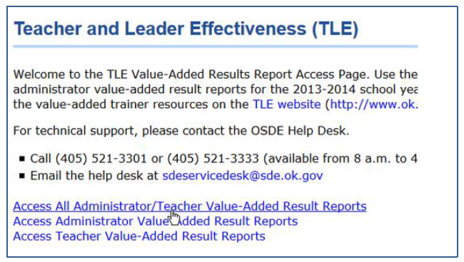
Whiteboard Zoom In
Accessing Results Reports
Q10. Cont... How do I access the new Value-Added Results reports for the 2013-14 school year?
Notes:
When you log in you will be taken to the reports landing page shown here. District leaders can choose to view teacher reports only, administrator reports only, or both.

Slide 28
Whiteboard Zoom In
Accessing Results Reports
Q10. Cont... How do I access the new Value-Added Results reports for the 2013-14 school year?
Notes:
You will need to select which school or schools and which teachers or administrators you want to view. You can select all schools and/or all teachers but be aware that for larger districts, this may take several minutes to load in the application.

Slide 29
Whiteboard Zoom In
Accessing Results Reports
Q10. Cont... How do I access the new Value-
Added Results reports for the 2013-14 school year?
2013-
Notes:
After clicking “view report”, the reports should appear in the viewer automatically.

Slide 30
Whiteboard Zoom In
Accessing Results Reports
Q10. Cont... How do I access the new Value-
Added Results reports for the 2013-14 school year?
2013-
Notes:
If the reports don’t appear automatically, which happens in certain browser versions, you can pull up the reports by clicking on the disc icon and selecting PDF as the option to export the reports. They will then appear in the format you selected.

Slide 31
Whiteboard Zoom In
Process for Distributing PDF Reports to Teachers and Administrators
Q11. What are some suggestions on how to distribute the report?
Secure Portal Access for Teachers
Printed PDF Reports Distributed via Mail
Printed PDF Reports Distributed at Training
PDF Reports Emailed to Teachers Directly
PDF Reports Emailed to School Leaders for Distribution
Notes:
Here are a few suggestions for how to distribute reports…

Slide 32
Whiteboard Zoom In
Option A:
Secure Portal Access for Teachers
District training lead manually provides individual teachers and administrators with direct access to the PDF reports on Single Sign On
Notes:
Your district may choose to secure portal access for teachers. This requires a district leader with appropriate permissions in the SSO2 portal to manually provide access to the report application to teachers and/or administrators.

Slide 33
Whiteboard Zoom In
Option B:
Printed PDF Reports Distributed at Training
District training lead downloads reports from the secure portal and provides printed reports to teachers and administrators who attend a training session
Notes:
Another option is to print the PDF reports and distribute them at a training, faculty meeting or other professional development session.

Slide 34
Whiteboard Zoom In
Option C:
Printed PDF Reports Distributed via Mail
District training lead downloads reports from the secure portal and mails them directly to teachers or to school leaders for distribution
Notes:
You may choose to distribute the PDF reports through the mail, rather than in person.

Slide 35
Whiteboard Zoom In
Option D:
PDF Reports Emailed to Teachers Directly
District training lead downloads reports from the secure portal and manually emails them to each teacher and administrator directly
Notes:
Instead of printing your district may opt to email the reports through a secure server to teachers or…

Slide 36
Whiteboard Zoom In
Option E:
PDF Reports Emailed to School Leaders for Distribution
District training lead downloads reports from the secure portal and emails them in groups (via a zip file) to school leaders for distribution
Notes:
Via a zip file for school leaders.

Slide 37
Whiteboard Zoom Mid
For a full description of how to access results reports, visit the document “Accessing and Distributing Value-Added Results Reports for Teachers and Administrators” on the TLE page of the OSDE website.
Notes:
For a full description of how to access results reports, visit the document “Accessing and Distributing Value-Added Results Reports for Teachers and Administrators” on the TLE page of the OSDE website.

Slide 38
Whiteboard Zoom Mid
Accessing Results Reports
Q12. What role do the following staff play in rolling out value-added reports in my district?
Superintendent
District value-added trainer
Principal
Teacher
Districts will customize the roll-out of VAM results in ways that best align with their processes to support teacher-leader effectiveness. Here is a basic breakdown of some key responsibilities.
Notes:
What role do the following staff play in rolling out value-added reports in my district?
Superintendent
District value-added trainer
Principal
Teacher
[CLICK]
Districts will customize the roll-out of VAM results in ways that best align with their processes to support teacher-leader effectiveness. Here is a basic breakdown of some key responsibilities.

Slide 39
Whiteboard Zoom In
ROLES | Train all relevant staff on the Value –Added Model | Review Value-Added Teacher reports | Review Value-Added Principal report | Provide access to the SSO site to District Trainers | Direct staff to the TLE website for more Information on VAM
Teacher |  | X
District Value-Added Trainer | X |  |  |  | X
Principal |  | X | X |  | X
District Leader |  |  |  | X | X

Slide 40
Whiteboard Zoom In
Pause for Questions
Notes:
At this time, we would like to pause and allow all participants to process the information previously presented. Please take a moment and submit a question related to the information presented. If time allows, we will verbally read and answer question(s) submitted by participants.

Slide 41
Whiteboard Zoom In
Next Steps
The presentation from today’s session will be made available on the TLE website.
The FAQ document on the TLE website will be updated after all webinar sessions have been held.
For additional information on how value-added results are calculated, please review the technical report located on the TLE website, Measuring Teacher and School Value Added in Oklahoma, 2013-14 School Year.
If you posted a question during today’s webinar and have not received a response, someone from the TLE office will review your question and send a response via email.
For additional support and information regarding the Value-Added Model, please contact the SDE Help Desk at (405) 521-3301.
Notes:
Next Steps
The presentation from today’s session will be made available on the TLE website.
The FAQ document on the TLE website will be updated after all webinar sessions have been held.
For additional information on how value-added results are calculated, please review the technical report located on the TLE website, Measuring Teacher and School Value Added in Oklahoma, 2013-14 School Year.
If you posted a question during today’s webinar and have not received a response, someone from the TLE office will review your question and send a response via email.
For additional support and information regarding the Value-Added Model, please contact the SDE Help Desk at (405) 521-3301.

