Slide 1
Council on Law Enforcement
Education and Training

Slide 2
Oklahoma District Attorneys, District Judges, Municipal Judges, U. S. Attorneys, and Attorneys General Firearms Training and Course of Fire

Slide 3
Oklahoma Statutes
Title 19 O.S. § 215.29, Title 20 O.S. § 129, Title 21 O.S. § 1289.29 and Title 70 §3311.14, allow District Attorneys, qualified retired District Attorneys, Assistant District Attorneys, District Judges, qualified Retired District Judges, Municipal Judges, U. S. Attorneys, Assistant U. S. Attorneys, the State of Oklahoma Attorney General, and Assistant Attorneys General to carry a concealed firearm for the purpose of personal protection. Provided first, that they have completed a CLEET approved handgun qualification course.

Slide 4
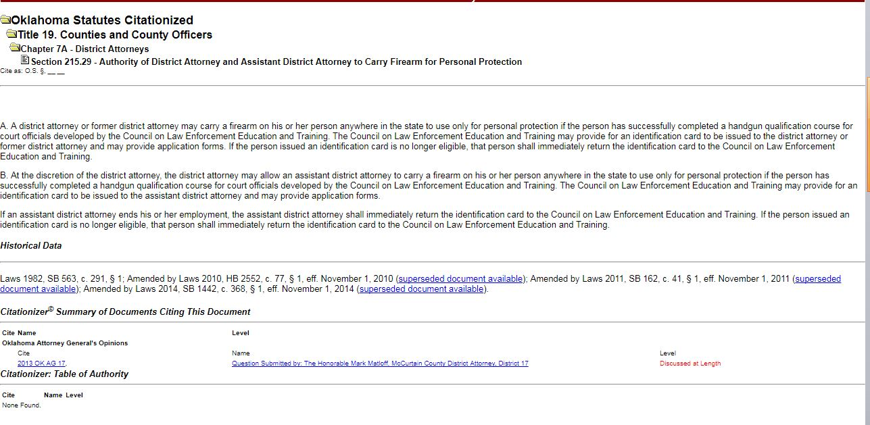
Title 19 § 215.29 – District Attorney

Slide 5
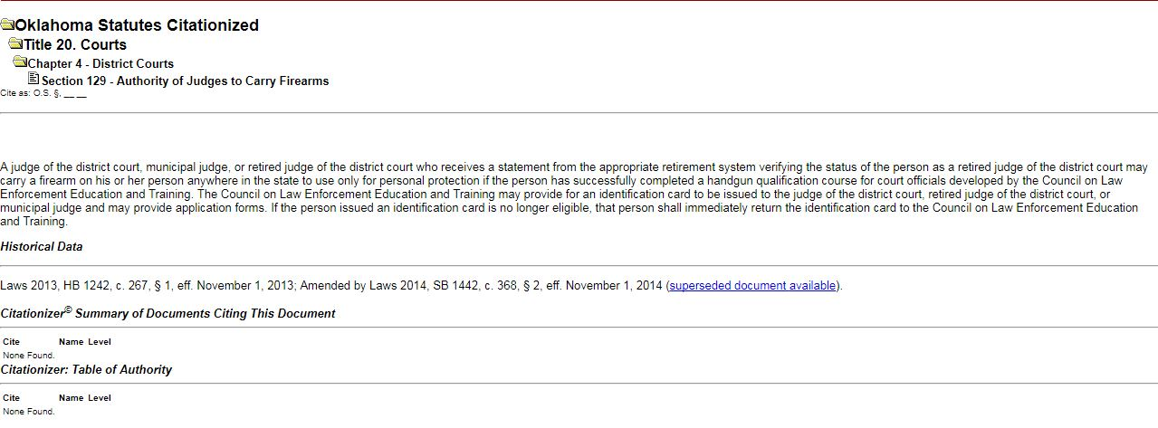
Title 20 § 129 – Judges

Slide 6
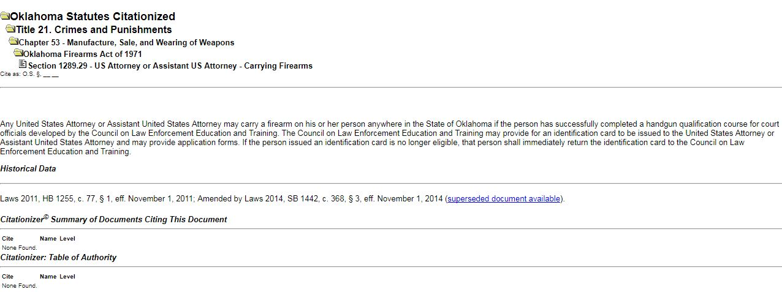
Title 21 § 1289.29 – US Attorneys

Slide 7
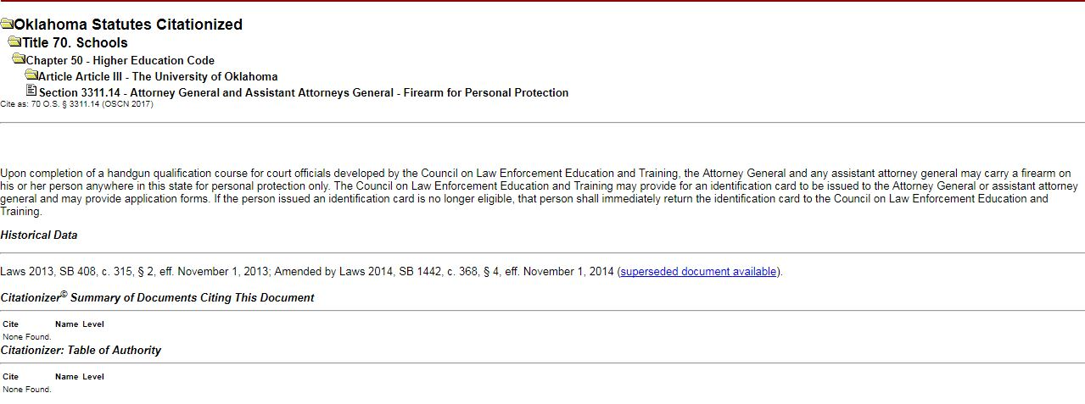
Title 70 § 3311.14 – Attorney General

Slide 8
Required Training
The handgun qualification course for court officials must be prior to carrying a firearm pursuant to the applicable portion Oklahoma Statutes. To aid in the administration of the course, this power point should be downloaded and utilized during the classroom instruction, if provided.

Slide 9
Once the handgun qualification is successfully completed, and a completed report of training is received, CLEET will mail the participating District Attorneys, qualified retired District Attorneys, Assistant District Attorneys, District Judges, qualified Retired District Judges, Municipal Judges, U. S. Attorneys, Assistant U. S. Attorneys, the State of Oklahoma Attorney General and Assistant Attorneys General a certification card.
The following slides show the forms required, and the language on the certification card.

Slide 10
Forms
There is a form available on the CLEET website to report the course completion of the participating District Attorneys, qualified retired District Attorneys, Assistant District Attorneys, District Judges, qualified Retired District Judges, Municipal Judges, U. S. Attorneys, Assistant U. S. Attorneys, the State of Oklahoma Attorney General, and Assistant Attorneys General.
This form needs to be filled out completely and returned to CLEET.

Slide 11
Example – Assistant District Attorney
Firearms Qualification Certificate for
District Attorney
JOHN DOE
This is to certify that CLEET has on file documentation that the named person is a District Attorney for the State of Oklahoma and has successfully completed an approved handgun qualification course conducted by a certified firearms instructor. The named person is in compliance with, and authorized to carry a firearm for personal protection pursuant to 19 O.S. § 215.29 as of the date of issuance of this card.
_________________________________ _______________
Executive Director, CLEET Date Issued

Slide 12
Example – Assistant District Attorney
Firearms Qualification Certificate for
Retired District Attorney
JOHN DOE
This is to certify that CLEET has on file documentation that the named person is a Retired District Attorney for the State of Oklahoma and has successfully completed an approved handgun qualification course conducted by a certified firearms instructor. The named person is in compliance with, and authorized to carry a firearm for personal protection pursuant to 19 O.S. § 215.29 as of the date of issuance of this card.
_________________________________ _______________
Steve Emmons, Executive Director, CLEET Date Issued

Slide 13
Example – Assistant District Attorney
Firearms Qualification Certificate for
Assistant District Attorney
JOHN DOE
This is to certify that CLEET has on file documentation that the named person is an Assistant District Attorney for the State of Oklahoma and authorized by the District Attorney to carry a firearm, and has successfully completed an approved handgun qualification course conducted by a certified firearms instructor. The named person is in compliance with, and authorized to carry a firearm for personal protection pursuant to 19 O.S. § 215.29 as of the date of issuance of this card.
_________________________________ _______________
Executive Director, CLEET Date Issued

Slide 14
Example – District Judge
Firearms Qualification Certificate for
District Judge
JOHN DOE
This is to certify that CLEET has on file documentation that the named person is a District Judge in the State of Oklahoma, and has successfully completed an approved handgun qualification course conducted by a certified firearms instructor. The named person is in compliance with, and authorized to carry a firearm for personal protection pursuant to 20 O.S. § 129 as of the date of issuance of this card.
_________________________________ _______________
Executive Director, CLEET Date Issued

Slide 15
Example – District Judge
Firearms Qualification Certificate for
Retired District Judge
JOHN DOE
This is to certify that CLEET has on file documentation that the named person is a Retired District Judge in the State of Oklahoma, and has successfully completed an approved handgun qualification course conducted by a certified firearms instructor. The named person is in compliance with, and authorized to carry a firearm for personal protection pursuant to 20 O.S. § 129 as of the date of issuance of this card.
_________________________________ _______________
Executive Director, CLEET Date Issued

Slide 16
Example – Municipal Judge
Firearms Qualification Certificate for
Municipal Judge
JOHN DOE
This is to certify that CLEET has on file documentation that the named person is a Municipal Judge in the State of Oklahoma, and has successfully completed an approved handgun qualification course conducted by a certified firearms instructor. The named person is in compliance with, and authorized to carry a firearm for personal protection pursuant to 20 O.S. § 129 as of the date of issuance of this card.
_________________________________ _______________
Executive Director, CLEET Date Issued

Slide 17
Example – U. S. Attorney
Firearms Qualification Certificate for
U. S. Attorney
JOHN DOE
This is to certify that CLEET has on file documentation that the named person is a U. S. Attorney, and has successfully completed an approved handgun qualification course conducted by a certified firearms instructor. The named person is in compliance with, and authorized to carry a firearm for personal protection pursuant to 21 O.S. § 1289.29 as of the date of issuance of this card.
_________________________________ _______________
Steve Emmons, Executive Director, CLEET Date Issued

Slide 18
Example – U. S. Attorney
Firearms Qualification Certificate for
Assistant U. S. Attorney
JOHN DOE
This is to certify that CLEET has on file documentation that the named person is an Assistant U. S. Attorney, and has successfully completed an approved handgun qualification course conducted by a certified firearms instructor. The named person is in compliance with, and authorized to carry a firearm for personal protection pursuant to 21 O.S. § 1289.29 as of the date of issuance of this card.
_________________________________ _______________
Executive Director, CLEET Date Issued

Slide 19
Example – Attorney General
Firearms Qualification Certificate for
Attorney General
JOHN DOE
This is to certify that CLEET has on file documentation that the named person is the Attorney General for the State of Oklahoma, and has successfully completed an approved handgun qualification course conducted by a certified firearms instructor. The named person is in compliance with, and authorized to carry a firearm for personal protection pursuant to 70 O.S. § 3311.14 as of the date of issuance of this card.
_________________________________ _______________
Executive Director, CLEET Date Issued

Slide 20
Example – Attorney General
Firearms Qualification Certificate for
Assistant Attorney General
JOHN DOE
This is to certify that CLEET has on file documentation that the named person is an Assistant Attorney General for the State of Oklahoma, and has successfully completed an approved handgun qualification course conducted by a certified firearms instructor. The named person is in compliance with, and authorized to carry a firearm for personal protection pursuant to 70 O.S. § 3311.14 as of the date of issuance of this card.
_________________________________ _______________
Executive Director, CLEET Date Issued

Slide 21
The required Qualification Report may be downloaded from the CLEET web site at www.ok.gov/cleet.
After the qualification has been completed, it should be sent to CLEET at the following address:
Council on Law Enforcement Education and Training
2401 Egypt Rd.
Ada, Oklahoma 74820

Slide 22
Firearms Training Course
Firearms Safety

Slide 23
There are three (3) areas of Firearms Safety
1. General Safety Rules
2. Range Safety Rules
3. Home Safety

Slide 24
General Safety Rules or Universal Safety Rules (USR)
USR 1 Treat all firearms as though they are loaded.

Slide 25
General Safety Rules (USR)
USR 2 Never point a firearm at anyone unless you are ready and willing to kill that person.

Slide 26
General Safety Rules (USR)
USR 3 Keep your finger (primary safety) off the trigger until your sights are
ON THE TARGET.

Slide 27
General Safety Rules (USR)
USR 4 Always make positive target identification, and be sure of the area behind your target.

Slide 28
Range Rules
Firearms safety on the range begins with the following four (4) basic premises:

Slide 29
1. The shooter is in sound physical and mental condition.
2. The firearm is of sound design, and has been well-maintained.

Slide 30
3. The ammunition is both safe and fresh.
4. The shooter’s holster is properly designed and constructed to fit that shooter’s handgun.

Slide 31
Range Rules
1. When you first pick up a firearm, insure it is unloaded. Never lay a firearm down without first unloading it.
Instructor: demonstrate the 4 steps of unloading a revolver and a semi-automatic pistol.

Slide 32
Range Rules
2. All firearms brought to the range must be unloaded.
(ammunition must be removed from magazines/speedloaders prior to entering the range)

Slide 33
Range Rules
3. Firearms will be loaded on the range only after position has been taken on the firing line, and only after the command to load has been given.

Slide 34
Range Rules
4. No firearm will be taken out of the holster other than when on the firing line, or in a designated dry-fire area.

Slide 35
Range Rules
5. All firearms will be checked for cylinder, chamber, and barrel obstructions before firing.
Instructor will demonstrate the proper procedure for this rule.

Slide 36
Range Rules
6. Never place your finger on the trigger until the firearm is clear of the holster and safely pointed down range.
Safely = target identified, sights on the target, a conscious decision to shoot has been made, and the shooter is sure of their backstop.

Slide 37
Range Rules
7. In the event of a malfunction the shooter will keep their muzzle down range and raise their off-gun hand.
Keep the firearm down range until a line officer assists you.
The instructor will describe the three most common cartridge malfunctions. (misfire, squib load, and hang-fire)

Slide 38
Range Rules
8. The shooter should not proceed from the firing line to the target area until all firearms are unloaded and holstered, the line has been cleared, and you are instructed to do so by the tower operator or instructor.

Slide 39
Range Rules
9. If you are spoken to while on the firing line, listen, but do not turn around.

Slide 40
Range Rules
10. When transferring a revolver, or a semi-automatic pistol the action should be open, the muzzle toward the ground and it should be presented to the recipient grip first.
Instructor: demonstrate

Slide 41
Range Rules
11. If a round, magazine or any other item is dropped, leave it on the ground and raise your non-gun hand for assistance.
The shooter should keep their muzzle down range while waiting for assistance. DO NOT bend down and pick up the item unassisted.

Slide 42
Range Rules
12. Do not permit the muzzle of a firearm to touch the ground.
In the event the shooter looses control of their firearm it is safer to let the firearm fall to the ground rather than attempt catching the firearm mid-air. Once the firearm is on the ground leave it, raise your off-gun hand, and wait for assistance from the line officer.

Slide 43
Range Rules
13. All shooters will wear eye and ear protection while on the firing line.

Slide 44
Range Rules
14. Participants are not allowed beverages while on the firing line. Smoking, dipping, or chewing is also not permitted while on the firing line.

Slide 45
Range Rules
15. No Alcoholic Beverages; Narcotic Drugs; or drugs that alter perception or judgment are permitted on the range at any time.

Slide 46
Home Safety
A loaded firearm left unguarded, poses a physical threat to:
You
Your family
Your visitors

Slide 47
Home Safety
To properly store your firearm(s), and reduce potential liability they must be made:
Inaccessible
Inoperable

Slide 48
Home Safety
Inaccessible to unauthorized persons
Store firearms in an area where unauthorized person(s) do not have access. (gun cabinet, vault, lock box etc.)
Only the gun owner can determine who should have access to their firearm, as they will bear the potential liability if the firearm is misused.

Slide 49
Home Safety
Inoperable to unauthorized person(s).
There are numerous commercial locks available to secure your firearm. Even without the purchase of a commercial lock it is still possible to make the firearm inoperable by field stripping the firearm and locking the subassemblies in separate locked containers.

Slide 50
Home Safety
The safe handling and safeguarding of a firearm is a firearm owner’s personal responsibility. Violations of these principles can lead to injuries, or death and the civil liability which will follow.

Slide 51
Basic
Shooting
Fundamentals

Slide 52
Six (6) Basic Shooting Fundamentals
1. Stable Shooting Platform (aka Stance)
2. Grip / Locked Wrist
3. Sight Alignment/Sight Picture

Slide 53
Six (6) Basic Shooting Fundamentals
4. Breath Control
5. Trigger Control
6. Follow Through

Slide 54
Course
of
Fire

Slide 55
This course consists of five (5) shooting positions from which 25 rounds will be fired.
You will have three (3) opportunities to shoot a qualifying score. The qualification score required is 72 of 100 points, or 18 rounds impacting scoring rings (17 body shots, 1 face shot).
All shooting will be done from a standing position, and all rounds will be fired to the center chest of the target.

Slide 56
During the qualification event, the shooter will be expected to keep their weapon loaded and ready, unless otherwise directed.
(i.e. a hot-range during the qualification)
Shoulder holsters shall not be permitted.
While qualifying, it is recommended that the shooter use the type of holster they would normally carry. (ankle, pocket holster, IWB, etc)

Slide 57
Stage 1
At the one-yard (1) line the shooter will draw their pistol and fire 3 rounds into the center chest of their target from a one hand Close Quarter position.
The time limit for the course of fire will be 4 seconds.
After completing the course of fire, the shooter should scan for additional targets once the targets edge or face away. Once the shooter is satisfied there are no additional targets, they will, on command, re-holster. After re-holstering the shooter will return to a parade rest position and await further instruction.

Slide 58
Stage 2
At the 3-yard line the shooter will present their pistol down range in a two hand shooting position and fire 5 rounds to the center chest of their target.
TIME LIMIT 6 seconds
Once the shooter completes the course of fire and the targets edge away, they should scan for additional targets. Once they are satisfied there are no additional targets the shooter will re-holster and come to parade rest.

Slide 59
Stage 3
At the 5-yard line, on the turn of the targets, the shooter will present their pistol down range and fire 6 rounds into the center chest of their target.
TIME LIMIT 12 seconds
Once the shooter completes the course of fire and the targets edge away, they should scan for additional targets. If no additional targets are found, the shooter will re-holster and come to parade rest.

Slide 60
Stage 4
At the 7-yard line, on the turn of the targets, the shooter will present their firearm down range in a two hand shooting position and fire 6 rounds into the center chest of their target.
TIME LIMIT 12 seconds
Once the shooter completes the course of fire and the targets edge away, they should scan for additional targets. Once they are satisfied there are no additional targets the shooter will re-holster and come to parade rest.

Slide 61
Stage 5
Shooters at the 15-yard line, on the turn of the targets will present their firearm down range in a two hand shooting position and fire 5 rounds to the center chest of the target.
TIME LIMIT 15 seconds
Upon completion of the course of fire and the targets edge away, the shooter will scan for additional threats. Once the shooter is satisfied there are no additional threats they will, on the command of the line officer, completely unload their firearm, lock the slide to the rear or open the cylinder. A range officer/instructor will inspect the weapon to insure it is unloaded. Once the weapon has been confirmed unloaded the shooter will re-holster their weapon and come to parade rest.

