Slide 1
SAFETY
MANAGEMENT

Slide 2
OBJECTIVES
To better prepare you for your role in Safety Management as a member of the State government team
To familiarize you with techniques used to manage risk
To familiarize you with basic terms used in Safety Management
To demonstrate the connection between Risk Management activities and your agency

Slide 3
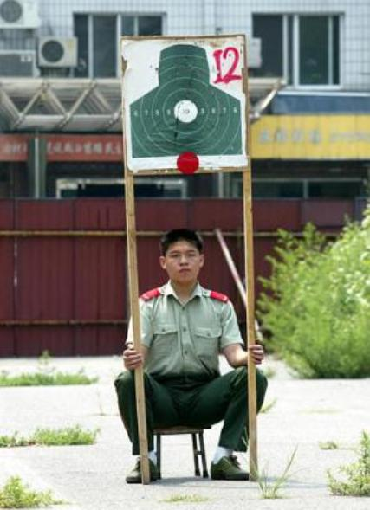

Slide 4
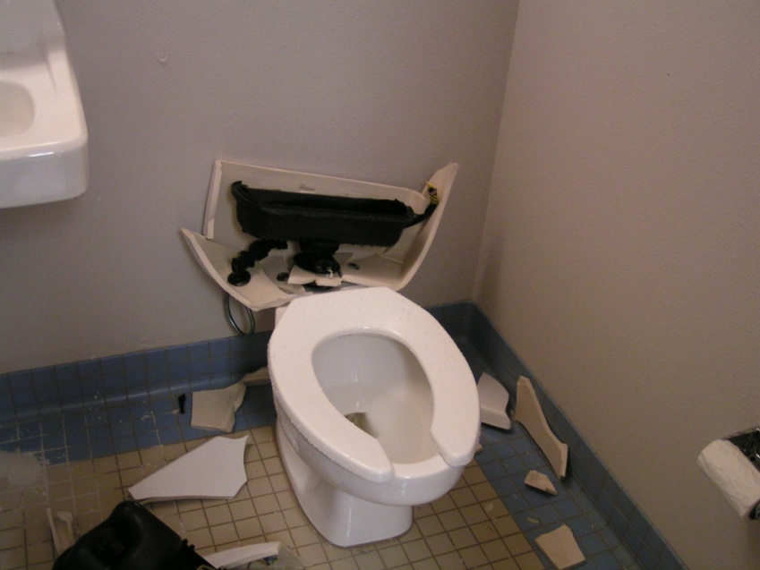

Slide 5
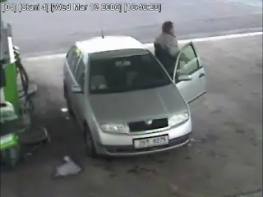

Slide 6
Safety as Insanity
Insanity defined is:
“doing what you have always done and expecting different results”
This is “traditional safety”
Therefore, are we all nuts?

Slide 7
The Risk Management
Process
Identify loss exposures (hazards)
Analyze and measure hazards
Examine Risk Management techniques
Implement the RM techniques
Monitor the results

Slide 8
Risk Management
Techniques
Avoidance
  abandonment
Control
  Prevention (lower frequency)
  Reduction ((lower severity)
  Separation
  duplication
Transfer
  Non insurance contractual transfer
  insurance

Slide 9
Definitions:
Risk Identification
Identifying potential causes of loss (hazards) to the people and property under the control of your agency

Slide 10
Risk Identification
  Loss exposure:
    condition or situation presenting the possibility of experiencing a loss

Slide 11
Risk Identification
  Loss:
    any reduction in value of assets
    a decrease in the ability to earn money
    injury to a person

Slide 12
Definitions:
Risk Assessment
Analyzing and evaluating the potential for injury to employees, damage to property, loss of business and financial consequences if a loss occurs
Monitoring the financial impact of losses

Slide 13
Definitions:
Risk Control
(Loss Prevention/Loss Control)
A two part function to reduce the frequency and severity of losses:
  Loss Prevention/Safety=Managing the work environment to prevent losses from occurring (impacts frequency)
  Loss Control=Mitigating the cost of losses if they do occur (impacts severity)

Slide 14
Definitions:
Near-Miss Incident and Accident Investigation
Process of determining loss causation for the purpose of:
  Identify information allowing for the development of programs that can prevent future incidents or accidents (frequency)
  Identify information necessary for managing potential claims (severity)

Slide 15
Definitions:
Near-Miss Incident, Accident, Claim
Near-Miss Incident: an unexpected, unintended, undesirable event that does not result in financial loss or bodily injury
Incident/Accident: an unexpected, unintended, undesirable event that does result in financial loss and/or bodily injury
Claim:
  Liability: a formal monetary demand by a third party as a result of bodily injury or property damage
  Property: damage to State owned property.

Slide 16
Claims Management
State Risk Management’s Role
Establish a claim file
Assess the claim for damages
Review with AG
Establish reserves
Update reserves if necessary
Communicate with all involved parties
Manage claim to closure including payment or denial

Slide 17
Definitions:
Risk Finance
The means of addressing potential losses in a cost effective manner to financially stabilize the organization

Slide 18
Programs
State Agencies and Higher Education
Property: (Insured/Self-Insured)
  Equipment Breakdown
  Business Interruption
  GRDA
  OMPA
Fine Arts (Insured)
Aviation Hull and Liability (Insured)
General Liability (GTCA) (Self-Insured)
Business Auto Liability (GTCA) (Self-Insured)
Specialty Vehicle Damage (Insured)
Out of State Liability (Insured)
Foreign Liability (Insured)
Employee Dishonesty (Insured)

Slide 19
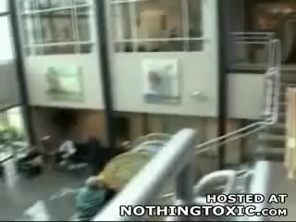

Slide 20
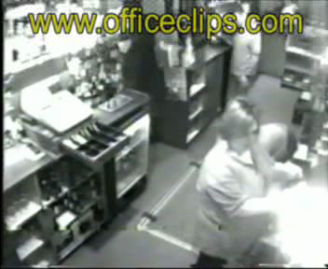

Slide 21
Methods of Identifying and Analyzing Loss Exposures
Internal
Common Sense
Review Agency Internal Documents
Analysis of losses, incidents and near misses
Questionnaires/checklists
News Media
People

Slide 22
Internal Inspections
(Formal)
Check lists
Identify responsible party
  Managers
  Supervisors
Establish time frame
Review
Action steps
  Responsibility
Follow-up
Consequences

Slide 23
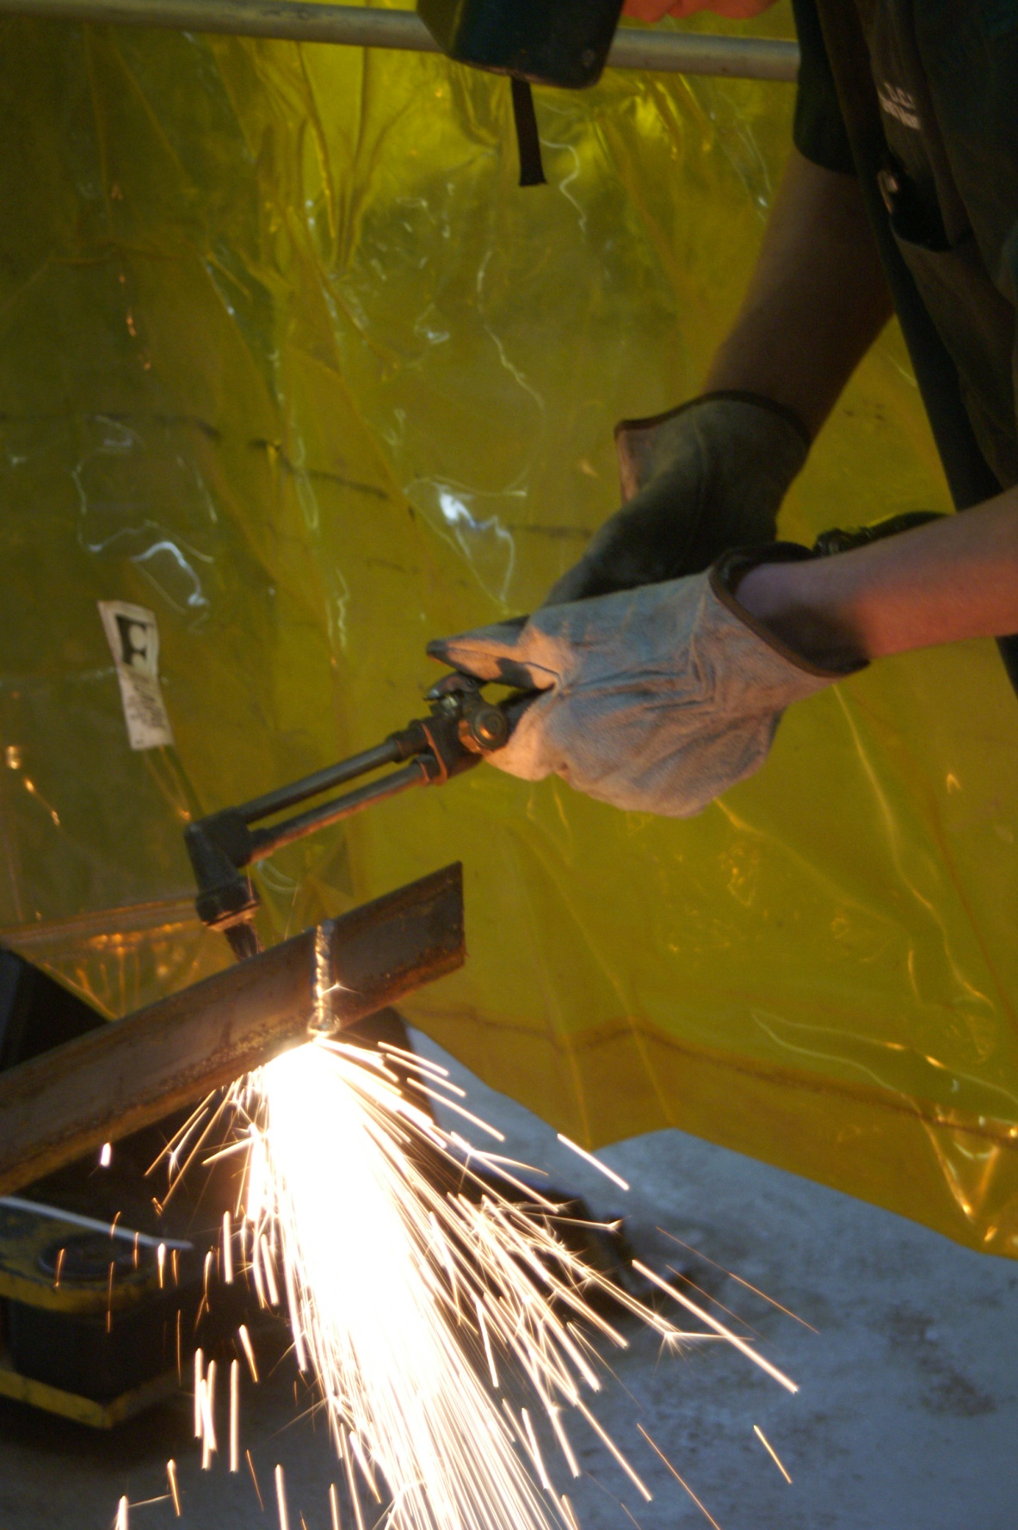

Slide 24
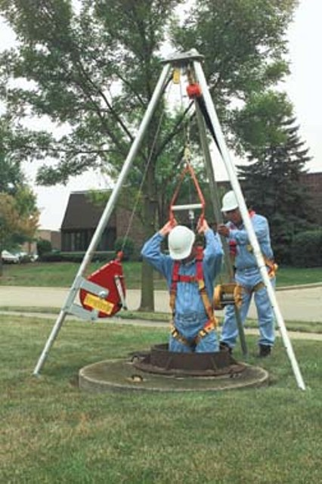

Slide 25
Internal Inspections
(Informal)
Walk through (Be an observer)
Listen to others
Meeting agendas
Training

Slide 26
Methods of Identifying and Analyzing Loss Exposures
External
Experiences of peers, and other outside businesses and industries (Best Practices)
Current events, trends, and issues
Geographic and regional issues
Consultants and other experts
Others

Slide 27
Loss Analysis
Every loss causing event has two dimensions:
  How expensive? (loss severity)
  How often? (loss frequency)

Slide 28
Loss Severity
  How severe have these losses been ?
  How severe are they likely to be over the next …years?

Slide 29
Loss Frequency
  How often?
    Has it occurred in the past?
  How likely?
    Will it occur in the future?

Slide 30
Safety Is More Than
“Common Sense”
Knowledge of operational risk, hazards and their potential severity
Understanding how behavior leads to accidents
Learning to recognize behavior that results in incidents
Incorporating behavioral analysis into incident investigation

Slide 31
Safety Program
Best Practices
Raise safety awareness through staff commitment
Utilization of outside influences
Variety of promotional and incentive techniques to accept safety as a “value”
Improved safety training
Employee involvement

Slide 32
Elements of Successful Programs
Management Commitment
Better employee selection
Educate employees in their safety role
Positive interaction with employees

Slide 33
Elements of Successful Programs
Better housekeeping
Use of personal protective equipment
Improve work environment
Lower turnover and absenteeism

Slide 34
Safety Program Obstacles
Overload
Budget Constraints
Risk Perception
Consequences
Attitudes

Slide 35
CONTINUOUS RISK IMPROVEMENT PROCESS
MEASURE RESULTS
IDENTIFY
Measure & monitor performance,
OPPORTUNITY
and continuously improve:
Mutually explore the situation and
Implement performance
form initial hypotheses of problem:
measurements
Identify nature/impact of the
Track performance
opportunity/problem
Evaluate results
Quantify costs/performance impact
Discuss improvement expectations
Enhance measures and
and initial performance measures
solution
Obtain expertise, resources, and
commitment
Commitment
EXECUTE –
CRI
ANALYZE
IMPLEMENT
PROCESS
Search for the problem’s most likely
SOLUTION
cause(s), refine and test the hypothesis:
Create and manage change:
Measurement
Collect quantitative/qualitative data
Ensure stakeholder participation
Develop performance measures
Develop action plans
Interpret data, analyze “gap”
Anticipate and plan for
DESIGN/
Use analytical tools to determine
potential problems
and verify most likely cause
Implement the change
SELECT
Assess support for solution
BEST SOLUTION
development
Identify the “best” solution, the risks
involved, and the commitment to change.
Refine/integrate measures of success
with solution criteria
Generate alternative solutions and determine
impact on stakeholders
Identify risks associated with each solution
Determine “best” solution vs. criteria
Assess commitment to solution

Slide 36
Overcoming the Obstacles
Recognize hazards
Develop programs to manage hazards
Implement programs in a timely and effective manner

Slide 37
Priority Planning
Make a compelling case relative to
  Risk
  Consequences or severity
  Probability
Cost of making change
Benefits of making change

Slide 38
Identifying Actions
Data Analysis to measure progress
  Incident/Accident Reporting and Investigation
  Inspections, Surveys
  SRM Claims Reports
Property Inspections
Roof Inspections
Safety Rules
Employee Orientation
Identifying Priorities

Slide 39
Loss Prevention is a reflection of your organization’s philosophy towards safety at all levels of management and staff.

Slide 40
Workplace Safety
Begins at home with you
Requires executive management commitment
Needs a plan of action
Meets specific organizational needs
Requires assigned responsibilities
Monitor and measure accountability

Slide 41
Loss prevention and loss control programs will reduce potential liabilities your agency faces
  if they are tailored to meet your needs
  properly communicated to all levels of your agency
  have assignable duties up and down the organizational ladder
  priority of executive management

Slide 43
Zero Losses=Ultimate Goal
Compliance=First Step
Education
Engineering
Accountability

Slide 44
Public Employee
Occupational Safety & Health

Slide 45
Japan Tsunami
http://www.bbc.co.uk/go/em/fr/-/news/world-asia-pacific-12725646

Slide 46
We always seem to fall back on what we are comfortable with!
Traditional safety (insanity)!

Slide 47
Your Safety Leadership
RM Director, Manager/Coordinator
Safety Committee
Leadership (managers, foreman, etc.)
ODOL
Compsource Oklahoma
Oklahoma Safety Council

Slide 48
Vehicle Liability

Slide 49
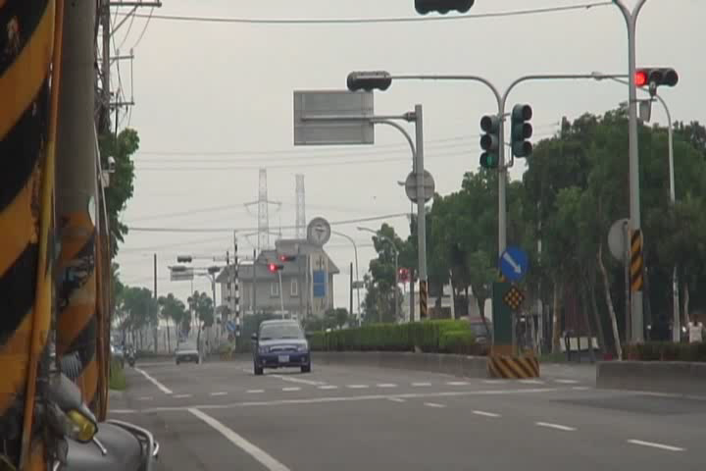

Slide 50
Investigation
  Obtain law enforcement report
  Investigate all aspects of the incident to determine the true cause
Communication
  Report to SRM immediately
  Assist the employee and others
Control
  Mitigate further loss through policies and procedures
Coordination
  Locally with SRM

